Slide 1
INTERNATIONAL REVIEW PANEL REPORT FOR THE 2014
INTERNATIONAL FISHERIES STOCK ASSESSMENT WORKSHOP
1-5 December 2014, UCT
NON TECHNICAL SUMMARY

Slide 2
The Panel
Alistair Dunn, NIWA, New Zealand
Jason Link, NOAA Fisheries, USA
André Punt, UW, USA
Gunnar Stefansson, UI, Iceland
Robin Waples, UW, USA
Expertise in quantitative fishery science, stock assessment, ecosystem modelling, statistical analysis of data, and genetics

Slide 3
Focus of the review
Hake
  Review plans for future assessments
    Transboundary issues (South Africa and Namibia)
    Stock structure
    Cannibalism
Sardine
  Review plans and progress regarding the 2-stock assessments
African Penguins
  Is the Island Closure Feasibility Study completed?
  What conclusions can be drawn now?
  What are the next steps?

Slide 4
Approach for the review
Overviews of scientific papers related to each topic
Technical comments on basic approaches, models, data analysis, data, sampling, etc.
This presentation focuses on highlights and key outcomes rather than the technical detail

Slide 5
Overall remarks
As in previous reviews, the Panel was highly impressed with the quality of information presented
The amount of information and the number of issues covered did not allow for the comprehensive technical review of every background paper
Maintaining data quality is vital for the future

Slide 6
Suggested modifications to the
Review Process
Terms of Reference for each species (aka “key questions”)
Develop “fishery descriptions” to assist new panel members get up to speed
Fewer documents – but more focused on the “key questions”

Slide 7
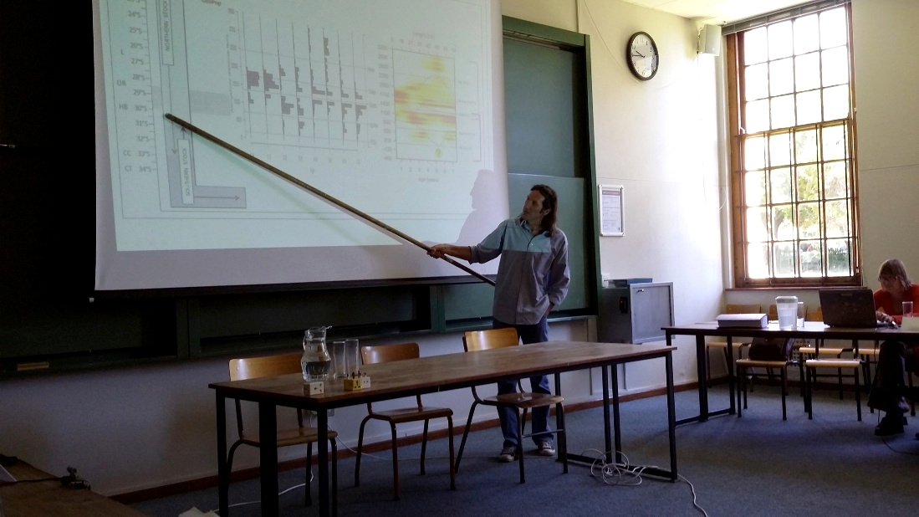
South African hake
Two species but how many stocks?
Genetic data were presented

Slide 8
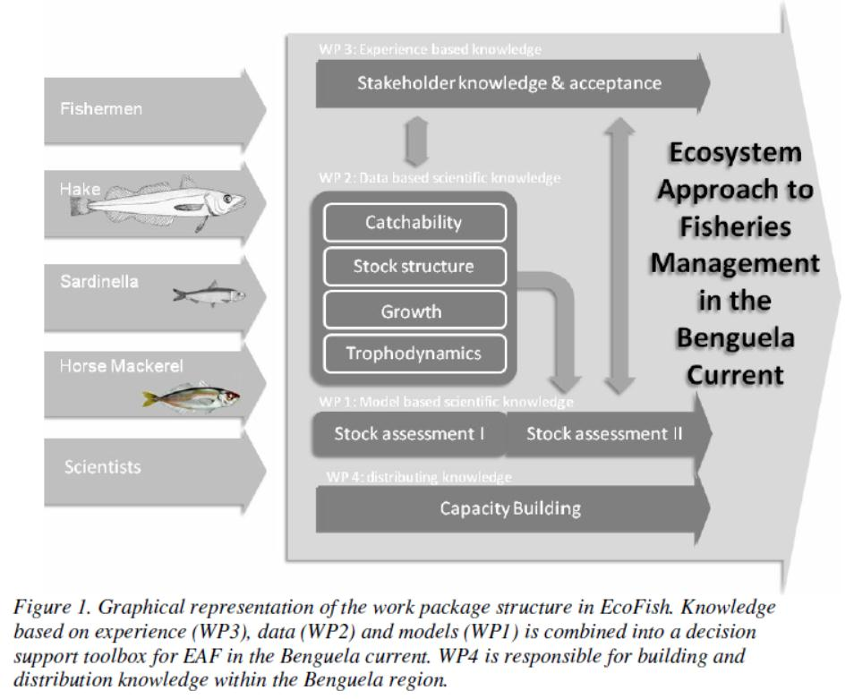

Slide 9
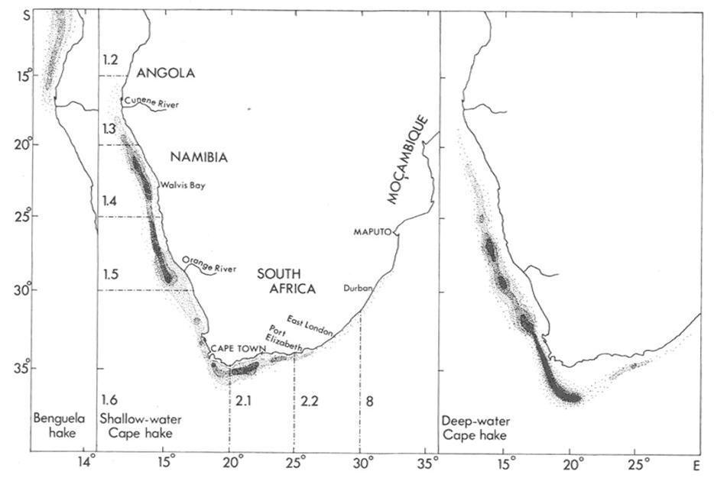
Hake
There is no obvious break in distribution at national boundaries

Slide 10
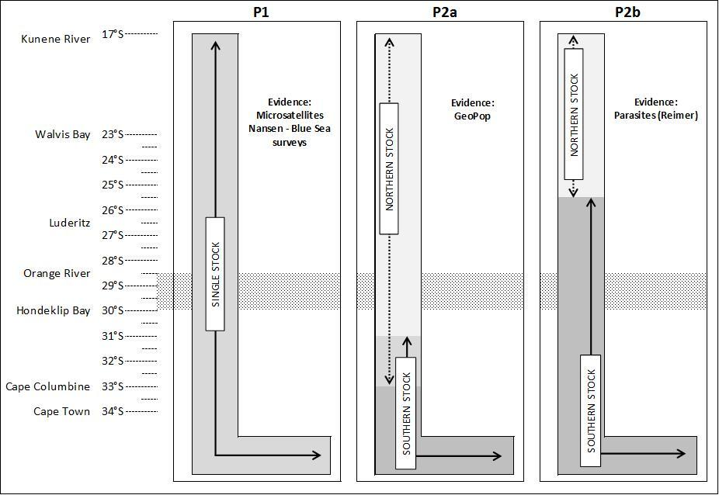
STOCK STRUCTURE HYPOTHESES Deepwater Hake
Additional work on GeoPop, demographic info could lead to multi-stock hypotheses

Slide 11
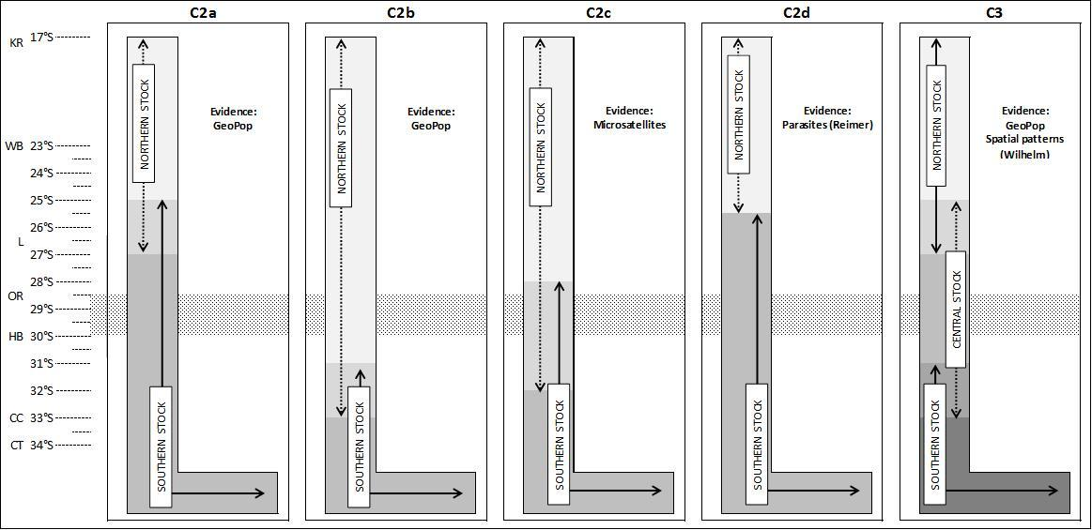
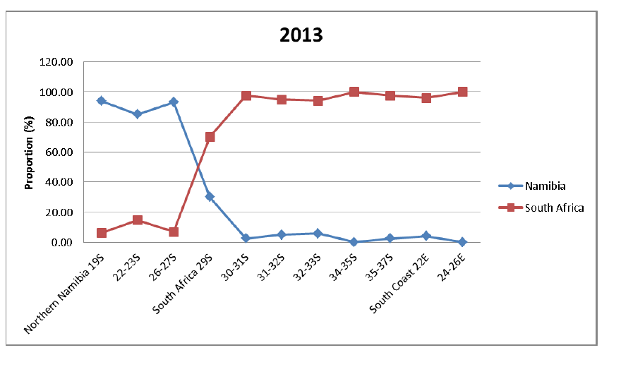
STOCK STRUCTURE HYPOTHESES Shallow water hake
Additional work on genetics could lead to a three stock hypotheses
Additional work on GeoPop, demographic info could lead to multi-stock hypotheses

Slide 12
Sardines
Movement exists between West and South/East waters
Multi-stock hypotheses
Parasites as natural tags: very promising

Slide 13
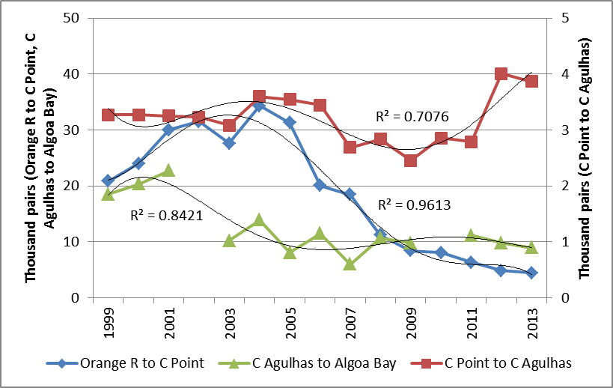
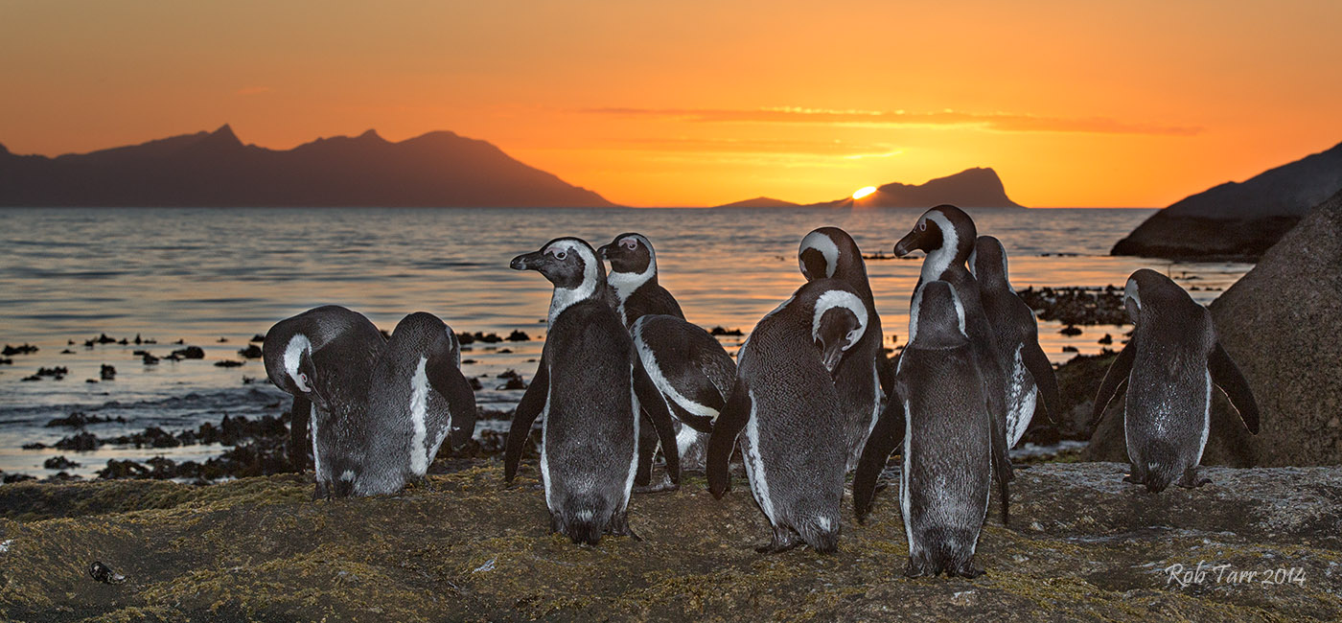
African
Penguins
CONCERN:
That fishing around penguin breeding
islands is a major contributor to
declining penguin populations

Slide 14
Scope of the Panel review
Decisions regarding closures of fishing for pelagic species around islands involves evaluating trade-offs among multiple objectives
The Panel recognizes that many aspects (socio-economic factors, tourism, addressing the need to recover the penguin island populations, etc.) will feed into the evaluation of trade-offs, but the scope of the Panel discussions was the Terms of Reference provided by DAFF to the Panel

Slide 15
Island Closures
The objectives from the 2010 Panel report were “to maximize the probability of determining whether pelagic fishing near colonies has an impact on penguins”

Slide 16
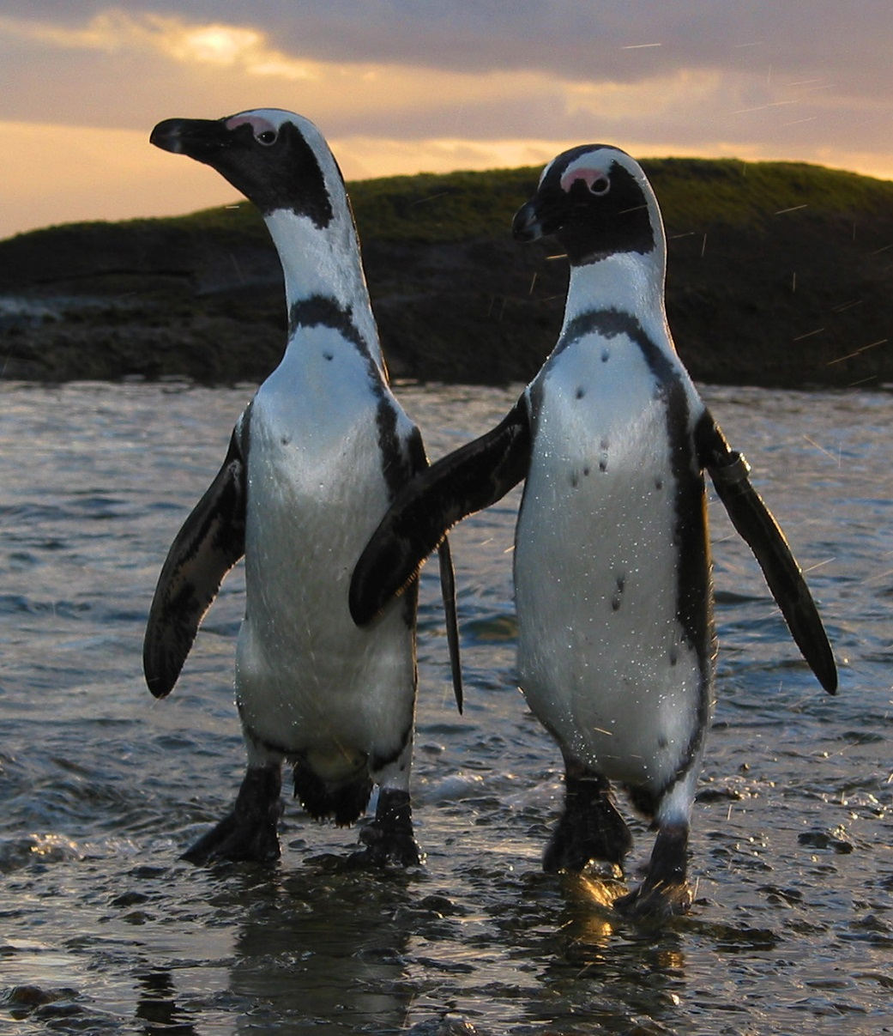
Penguin Feasibility Study Objectives
Provide a stronger basis for designing an experiment to evaluate the impact on penguins of fishing near islands
Draw conclusions on the impact on penguins of catches near islands
Draw conclusions on the impact on penguins of island closures

Slide 17
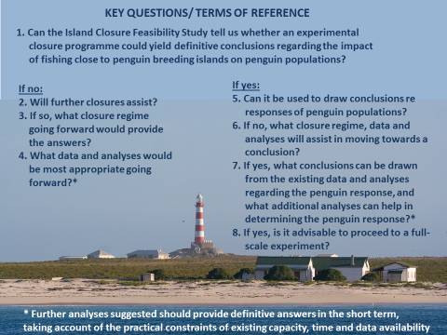

Slide 18
Key recommendations (ToR 1)
Can the Island Closure Feasibility Study tell us whether an experimental closure programme could yield definitive conclusions regarding the impact of fishing close to penguin breeding islands on penguin populations?
Yes, the Feasibility Study has completed its objectives

Slide 19
General: Results from feasibility study
Several statistically significant results
Conflicting results between analysts
Conflicting results between islands
Unknown factors may confound results
Summary from feasibility study:
Study is completed
Can be used for further analysis

Slide 20
Key recommendations (ToR 5, 6, 8)
5. Can [the feasibility study] be used to draw conclusions re responses of penguin populations?
The Panel concludes that final conclusions are premature
6. What closure regime, data and analyses will assist in moving towards a conclusion?
The Panel strongly recommends that the current closure regime be continued
8. is it advisable to proceed to a full-scale experiment?
The Panel concludes that sufficient data are available to conduct a scientifically appropriate power analysis to evaluate how long an experiment might have to be conducted for

Slide 21
Experimental design
 | Dassen | Robben | St Croix | Bird
2008 | X
2009 | X |  | X
2010 |  |  | X
2011 |  | X | X
2012 |  | X |  | X
2013 |  | X |  | X
2014 | X |  |  | X
2015 | X |  | X
2016 | X |  | X
2017 |  | X | X
2018 |  | X |  | X
2019 |  | X |  | X
2020 | X |  |  | X
2021 | X |  | X
2022 | X |  | X
2023 |  | X | X
2024 |  | X |  | X
2025 |  | X |  | X
2026 | X |  |  | X
2027 | X |  | X
2028 | X |  | X
2029 |  | X | X
2030 |  | X |  | X
2031 |  | X |  | X
2032 | X |  |  | X
Years(T) | 25 | 25 | 25 | 25
Closures | 12 | 12 | 12 | 12
(T from 2009) |  |  | 24 | 24

Slide 22
Concluding remarks
Hake
  Genetics work is leading towards a better understanding of stock-structure
Sardine
  Tests of two-stock hypothesis
  Parasites as natural tags
Penguins
  The island closures have demonstrated their importance
  The data collected can be used to design a full experiment
  Other approaches should be considered

Slide 23
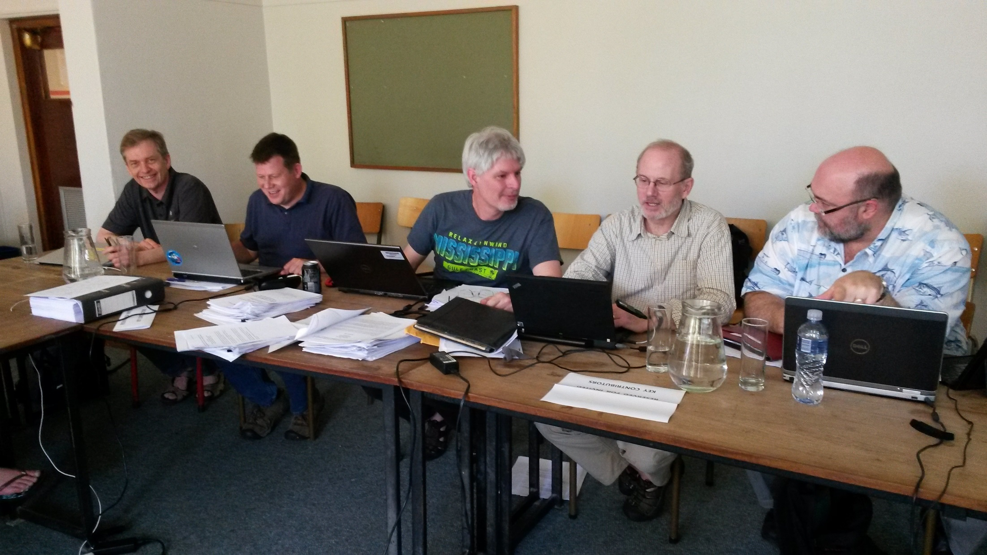
Questions???

