Slide 1


BCC Annual Science Forum 26. September 2013, Windhoek, Namibia
EcoFish Progress and Future
Fritz Köster, Hashali Hamukuaya, Ekkehard Klingelhoeffer,
Teunis Jansen, Jan E. Beyer et al.
Partners: DTU Aqua, UCT, NatMIRC, DAFF and INIP

Slide 2
Objectives of EcoFish
Improve the understanding of spatial population dynamics of fish stocks in the Benguela region
Enhance the knowledge on stock structure, growth and mortality rates as well as catchability, information to be used in fish stock assessments
Establish improved statistical stock-assessment methodologies and establish trans-boundary assessment models that could provide a basis for regional fisheries management advice
Develop methods for including stakeholder knowledge in stock assessment and fisheries management
Training and capacity building in methodologies throughout project.

Slide 3
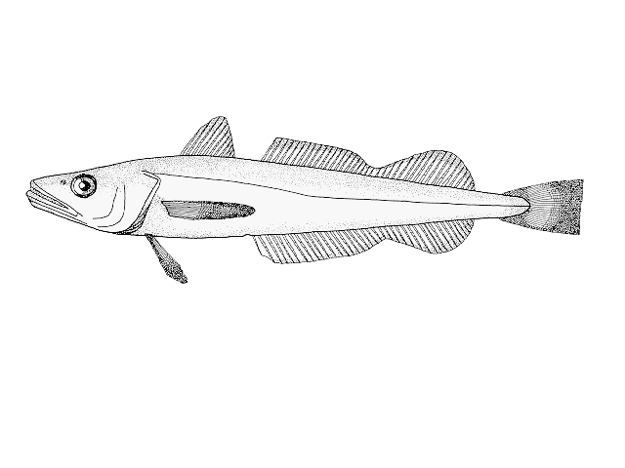
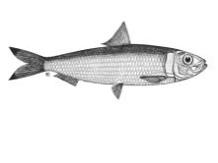
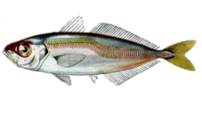
Work Package linkages
Experience based knowledge
“Fishermen”
WP3 Shareholder knowledge & acceptance
WP3 Decision support tools
WP2 Data based scientific knowledge
Catchability
Stock structure
Growth
WP2
Trophodynamics
WP1 Model based scientific knowledge
Stock assessment II
Stock assessment I
“fishermen”
phase I
phase II
“scientists”
WP4 Training
Capacity building

Slide 4
Work Package linkages
Experience based knowledge
“Fishermen”
WP3 Shareholder knowledge & acceptance
WP3 Decision support tools
WP2 Data based scientific knowledge
Catchability
Stock structure
Paulus Kainge et. al.
Kai Wieland & Deon Durholtz
Growth
Marek Linpinski & Conrad Matthee
WP2
Trophodynamics
Beau Tjizoo & Deon Durholtz
Johannes Itembu
WP1 Model based scientific knowledge
Stock assessment II
Stock assessment I
“fishermen”
phase I
phase II
“scientists”
WP4 Training
Capacity building

Slide 5
Work Package linkages
Experience based knowledge
“Fishermen”
WP3 Shareholder knowledge & acceptance
WP3 Decision support tools
WP2 Data based scientific knowledge
Catchability
Stock structure
Paulus Kainge et. al.
Kai Wieland & Deon Durholtz
Growth
Marek Linpinski & Conrad Matthee
WP2
Trophodynamics
Beau Tjizoo & Deon Durholtz
Johannes Itembu
WP1 Model based scientific knowledge
Stock assessment II
John Kathena
et al.
Teunis Jansen
Stock assessment I
“fishermen”
phase I
phase II
“scientists”
WP4 Training
Capacity building

Slide 6
Work Package linkages
Experience based knowledge
“Fishermen”
WP3 Shareholder knowledge & acceptance
Barbara Paterson
WP3 Decision support tools
WP2 Data based scientific knowledge
Catchability
Stock structure
Paulus Kainge et. al.
Kai Wieland & Deon Durholtz
Growth
Marek Linpinski & Conrad Matthee
WP2
Trophodynamics
Beau Tjizoo & Deon Durholtz
Johannes Itembu
WP1 Model based scientific knowledge
Stock assessment II
John Kathena
et al.
Teunis Jansen
Stock assessment I
“fishermen”
phase I
phase II
“scientists”
WP4 Training
Capacity building

Slide 7
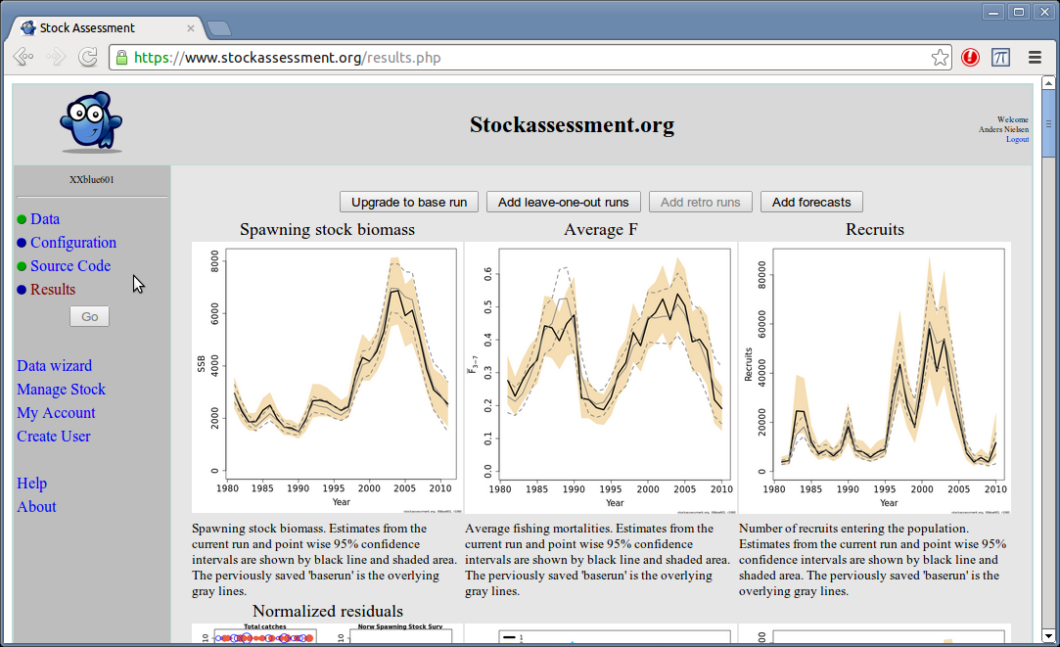
Workplan WP1
Task 1.1
  National hake stock assessment data and compilation procedures (Deliverable 1.1)
  → 1. hake stock assessment workshop in 2011 and follow-up work
  Set up of state space assessment model (SAM) for hake (Deliverable 1.2)
  Namibian hake
  Comparing results from SAM to Statistical catch at age model (SCAA) (Deliverable 1.3, part I)
  → Namibian hake and horse mackerel
Web interface for SAM
Recruitment of Namibian hake
John Kathena et al., this conference

Slide 8
Workplan WP1
Task 1.1 cont.
  Data compilation for transboundary analyses, review of data, data compilation procedures, e.g. split of species
  Establish trans-boundary assessment data in progress.
  Methodology for splitting hake species established, split for Namibian hake done, for SA hake: review of splitting approach by DSWG as part of OMP revision process.
  Compiling surveys as assessment input continuously.
Task 1.2
  Modify SCAA assessment model for SA hake to a spatial-box model with movement
  In progress, model coded and first indicative results available as part of the SA OMP revision process
  Task 1.3
  Compilation of stock assessment data for horse mackerel and sardinella, inclusive relevant quality measures (Deliverable 1.4)
  Namibian horse mackerel SAM assessment, but sardinella down-prioritised
  Contribution to Pelagic Stock Assessment WG, 5-7. November 2013
  SAM model for horse mackerel and sardinella (Deliverable 1.9)
  → Horse mackerel (presented at ASF 2012), but not Sardinella
Task 1.4
  Hake stock assessment with results from WP2.2 to be integrated

Slide 9
WP 2 Input to stock assessment models
Determine hake stock structure through genetic analysis
Correct time series of hake catch per unit effort data according to environmentally-driven differences in catchability
Improve estimates of hake, horse mackerel and sardinella growth rates through improved ageing
Determine the trophic position of hake, horse mackerel and other demersal and pelagic fish in the northern Benguela

Slide 10
WP 2 Input to stock assessment models
  WP2.1 delivered:
  → Population structure, need to know the spatial lifecycle on a demographic time scale; fundamental for assessment, i.e. which stocks to assess?
  Spawning time and place (Jansen et al., this conference)
  Migration based on GeoPop (Jansen et al., this conference)
  Test of stocks hypotheses and attempt to estimate straying (Jansen and Berg)
  Genetics in progress (Lipinski & Matthee, this conference )
  WP2.2 delivered:
  → Gear selectivity, key to combined survey datasets
    Cotter report
    Output from GeoPop (Jansen et al., this conference)
    → Catchability, will return to this
  WP2.3 delivered
  → Growth / aging, essential for age structures models, will return to this
    Wilhelm (submitted) compared to GeoPop (Jansen, this conference)

Slide 11
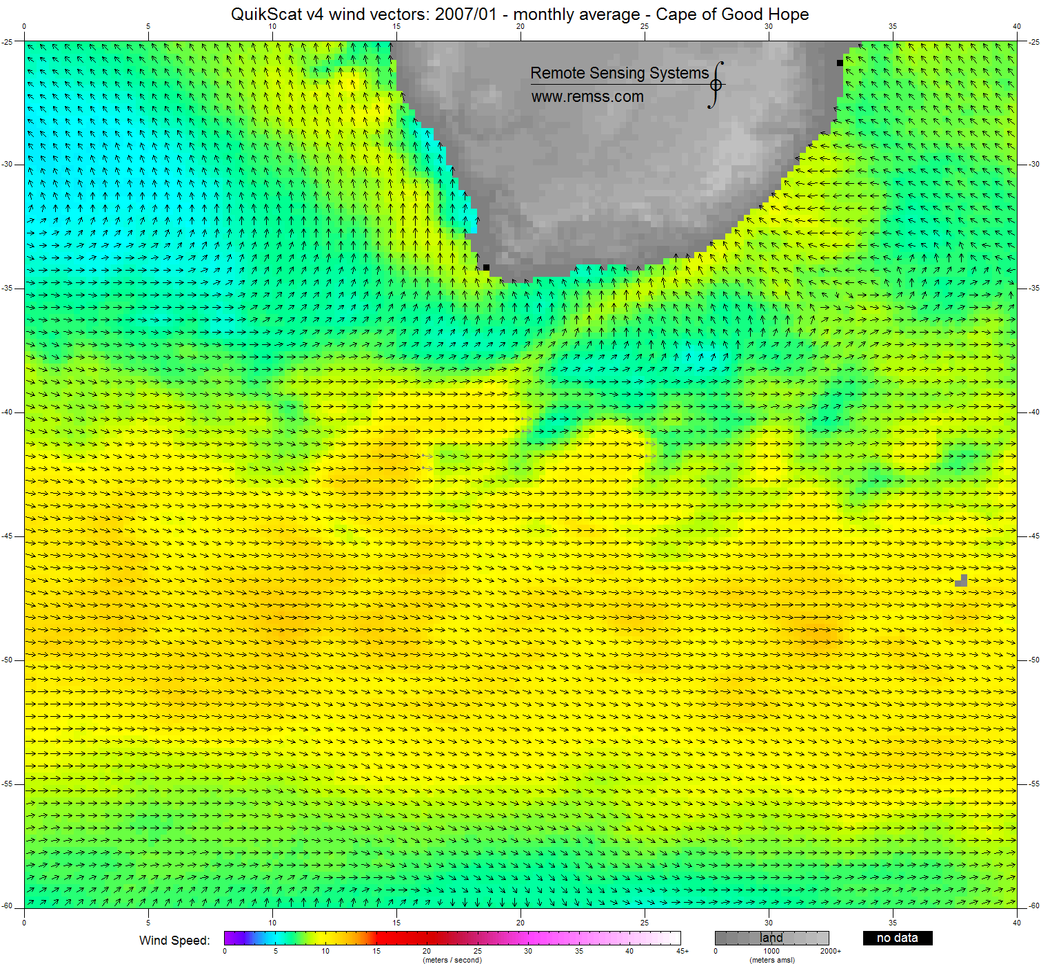
WP 2 Migration, population structure, growth and trawl selectivity examined with GeoPop (M. capensis, similar results also on M. paradoxus)
Demersal trawl surveys: Africana WC+SC, Nansen, Blue Sea, 1991-2012, 8,600 standardized demersal trawl hauls
GeoStatistical population model (GeoPop)
Estimates:
  Gear selectivity and efficiancy
  Growth
  Distribution by age
Suggests
  Migration through life
  2-3 semi-isolated groups, that may
  experience different growth and mortality rates
  Not matching traditional stocks (transboundary!)
  Meaningful hydrographic borders
  Next: Test as distinct or connected stocks
Wind speed

Slide 12
WP 2.1 Stock structure
M. paradoxus
M. capensis
Genetic analyses
(Lipinski & Matthee, this conf.)
Improved sampling :
Four regions included: 2012 + 2013
M. paradoxus = 897 fish
M. capensis = 974 fish
The highest level of differentiation was detected among the Namibian and West –Coast SA samples for M. paradoxus.
Weak signal, pairwise values were not significant between any of the four sampling sites!
However, mtDNA and microsatellites samples from 3 years under analysis; conclusions need to await these results, available in 2014.

Slide 13
WP 2.2 Catchability
SA west coast
Exploratory analysis documents that:
Time of day effect is not relevant (random station allocation, fishing during daytime only)
Wind effect in a part of the area important (list of stations which should be discarded has been provided for 2002 and 2010 – 2012, other years to be checked in 2014)
CPUE at stations fished twice at different wind conditions in the southern part of the survey area in 2003
Catch rates considerable higher at moderate than at strong winds
Effect of strong SE wind / jet current in a part of the survey area
Kai Wieland & Deon Durholtz, this conference

Slide 14
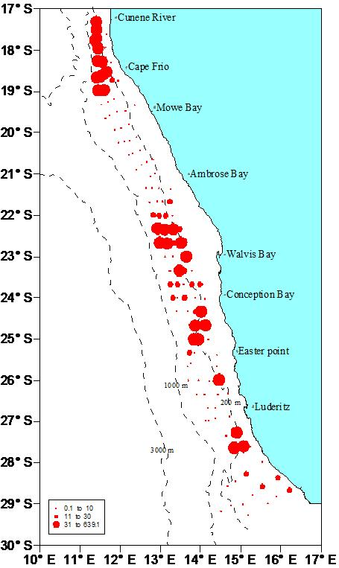
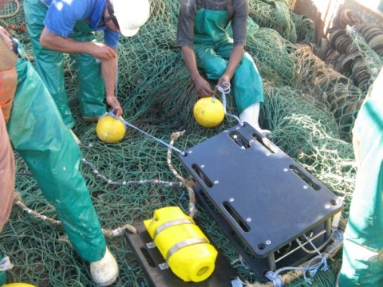
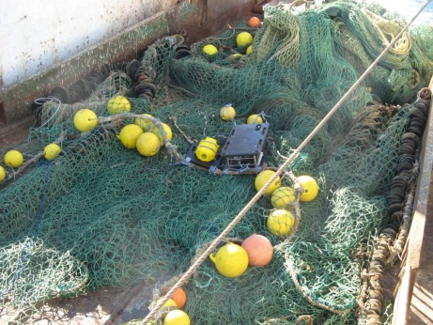
WP 2.2 Catchability
SA west coast
No indication that ‘green water’ effects seriously the quality of the survey indices but the process needs to be studied in 2013/2014 (commercial & scientific vessels)
High portion of M. paradoxus at depths larger than covered by the survey in 2002 – 2010 depending on bottom temperature, method for ‘adding’ biomass by length group requires validation (planned for 2013/2014)
SA south coast
No analysis done but 1) and 3) likely also true, 2) (and 4) ?) not relevant
⇒ unlikely that correction of survey indices is necessary (except for change of trawl)
Namibia
Exploratory analysis documents that time of day effect is probably relevant (station allocation along transect, fishing also at night, unbalanced design with considerable differences between years ⇒ bias of survey indices)
Effect of hydrographic factors (O₂, ‘green water’) indicated, but not yet analyzed
1) and 2) to be studied in 2014 – 2015 (Kainge et al., this conference)
Cape hake

Slide 15
WP 2.4 Age reading and growth
Objective
Validate age determination methods for hake, horse mackerel and sardinella to ensure accurate estimates of age (and hence growth) for input to regional stock assessment models being developed
Approach (Tjizoo & Durholtz, this conference)
Initial work plan developed for the ECOFISH proposal incorporated a suite of approaches, includeding radiochemical dating, mark-recapture experiments and marginal increment analyses.
Most approaches have been discarded due to a combination of funding and capacity constraints.
Analysis of otolith growth patterns monitored over time, as developed by Margit Wilhelm during her Ph.D., has been identified as potentially most useful approach.

Slide 16
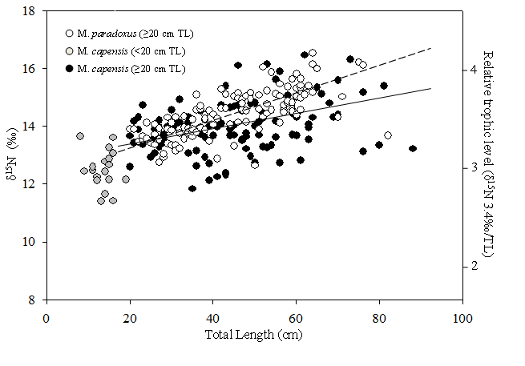
WP 2.4 Trophodynamics
Objective
To determine the trophic position of hake using stable isotope technics.
Results (Itembu, this conference)
Both hake species showed significant size-specific shifts in δ¹⁵N
MP displayed a stronger relationship between size and δ¹⁵N
MP feed at higher trophic position than MC
Isotope mixing model indicates relatively low predation on hake by hake
Status and plans
Field sample collection is finished
Finalization of laboratory sample Analyses (October 2013 – March 2014)
Data analyses (April 2014-August 2014)
Comparison of ecosystem models results and stable isotope results (September 2014-February 2015).

Slide 17
Workplan WP1 (phase 2)
Task 1.4 cont.
  Extend spatial SCAA box model for hake to include Namibia, taking into account stock-structure within species with input from WP2.1 (Deliverable 1.3, part II)
  Planed for 2015
Task 1.5
  Modify SCAA to take account of hake cannibalism and inter-species predation with information from WP2.4
  → In progress for reporting at DSWG December 2013
  Task 1.6
  Extend SAM to cover two species, SA west and south coast and possibly also the Namibian regions with input from WP2.1 (Deliverables 1.6)
  Extend SAM to take account also improved growth and catchability estimates (input from WP2.2 & 2.3)

Slide 18
Workplan WP1 (phase 2)
Task 1.7
  Spatial dynamics of hake considering survey gear catchability (GeoPop) (Deliverable 1.8)
  → Migration, population structure, growth and trawl gear selectivity of hake examined with a geostatistical population model (Jansen et al., this conference)
M. capensis

Slide 19
WP 3 Incorporation of stakeholder knowledge
Objectives
Develop social and economic indicators for fisheries
Develop expert systems to integrate multitude of indicators into a single assessment
Develop methods for including stakeholder knowledge in assessment and management
Approach
EAF conceptualisation: objectives hierarchies for the Namibian hake fishery
Integration of fishers knowledge into stock assessment
Spatial distribution of fishing effort
Hake migration
Stock structure
Effort and efficiency
Barbara Paterson, this conference with focus on the latter

Slide 20
WP3 Conclusions
Understanding of fish & fishing behaviour important for accuracy of assessment
Log-book data require interpretations
Knowledge on stock structure, distribution and migration
Knowledge on efficiency (e.g. technological creeping)
When stakeholder and scientific information match, uncertainty in assessment and management can be reduced
When information diverge, further investigations are needed to strengthen the knowledge base

Slide 21
WP 4: Training and capacity building
Plans for 2013-2014.
WP1 course held in 6-10. May 2013 in Swakopmund with scientists from Angola and Namibia, will be repeated 7-11. October, Cape Town
WP1 SAM introduction to stakeholders, 4. October 2013, Walvis Bay, more to follow…
WP1 follow-up course Fish stock assessment planned for October 2013 (with introduction to data handling/sharing and focus on SAM) delayed to 2014, coupled to R-course
WP2 course on Exploratory analysis of survey data linked to environmental information, 10-14. June 2013, Lobito
Series of WP1-2 Technical workshops have been hold, e.g. in genetic analyses at Stellenbosch University
WP3 Contributions to various EAF workshops organised by BCC
2 Ph.d. enrolments (WP1 and WP2) at DTU, 3 further in preparation stage
Post-doc in stock assessment employed at BCC, Post-doc in ageing in preparation

Slide 22
EcoFish mid way status (progress against objectives)
Improve the understanding of spatial population dynamics of fish stocks in the Benguela region
→ Substantial progress made in compilation of catch data, analyses of survey results, both through analysis of catch rates and geostatistical modelling (GeoPop), but much more potential, e.g. inclusion of hydroacoustic surveys
Enhance the knowledge on stock structure, growth and mortality rates as well as catchability, information to be used in fish stock assessments
Genetic analyses in progress, but require higher effort than expected;
catchability analyses progresses – field part a bit delayed due to technical problems, but sea trials commenced in SA and in planning for Namibia;
growth analyses/ageing a substantial challenge;
trophodynamic analysis on its way, implementation in stock assessment focusses on cannibalism, how important is that?

Slide 23
EcoFish mid way status (progress against objectives)
Establish improved statistical stock-assessment methodologies and establish trans-boundary assessment models that could provide a basis for regional fisheries management advice
Different SAM models set-up (flexible, relatively easy to use, web-based model);
comparisons to SCAA as standard assessment model conducted;
SCAA being made spatially explicit for SA and will include cannibalism;
but both models not transboundary yet;
coupling of SAM and GeoPop an option for the late part of the project.
Develop methods for including stakeholder knowledge in stock assessment and fisheries management
Results from industry survey for Namibian hake confirms largely WP2 findings on distribution, diurnal and horizontal migration, catchability, partly also stock structure, merger of information with WP2 also in publications.
Training and capacity building in methodologies throughout project.
Series of workshops and courses conducted, but participation often local; repetition in different locations necessary; higher effort than expected – advantage that level can be adjusted to local needs.

Slide 24
Conclusions
Challenging project, of high importance to build up international and transboundary stock assessment and advisory capabilities in BCC.
Progress is good, quoting Monitoring Report from 2. August 2013: “so far highly successful project”
… but it needs to be recognised that we deal with some problems hardly solved in other regions of the world, even with well established international stock assessment/advisory organisations; these include: spatially explicit stock assessment models, catchability changes in relation to environmental changes, ageing/growth of hake. Way forward will be incremental and through international WG’s.
BCC data handling
Not part of the project, but projects assists BCC; suggestion to intensify cooperation with International Council for Exploration of the Sea (ICES) to assist in building up or take over central database functions.
Planning second phase for EcoFish
It is expected that all major scientific and technical project goals are reached; however even if the project will deliver data, information, models and work processes to enable international stock assessments by BCC, successful and sustainable implementation requires a follow-up project.

Slide 25
Thank you for listening !

