Slide 1
Some advantages of MPAs for fisheries
Colin Attwood
Marine Research Institute
Department of Biological Science
University of Cape Town

Slide 2
The Schaefer production model
Holy Grail
Model parameters: r = 0.4 y⁻¹, K= 100 000 t

Slide 3
How do fishery dynamics alter with MPAs?
cost
MPA model parameters: r = 0.4 y⁻¹, MPAs cover 20% of area, Effort displacement included,
Movement mimics resident fish with broadcast spawning

Slide 4
Think of a fishery in your area, and tick the correct boxes.
Yes
No
Is there an effective catch monitoring system?
2) Is there a robust assessment procedure?
3) Is there a reliable observer system?
4) Is compliance with regulations good?
5) Is the administration corruption-free?
Yes
No
Yes
No
Yes
No
Yes
No

Slide 5
If you ticked no for one or more questions, your fishery could end up here (if it is not here already).

Slide 6
Sometimes (very, very seldom) scientists get it wrong.

Slide 7
Mysterious New Whale Species Discovered in Alaska

Slide 8
Insurance quote
Premium
Cover

Slide 9
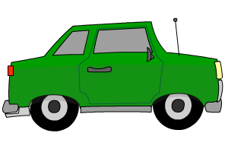
Annual costs of insurance
1.5% of the value of your house
4.5% of the value of your car
How much should we pay here?

Slide 10
Regulation by TAC and effort control have some limitations.

Slide 11
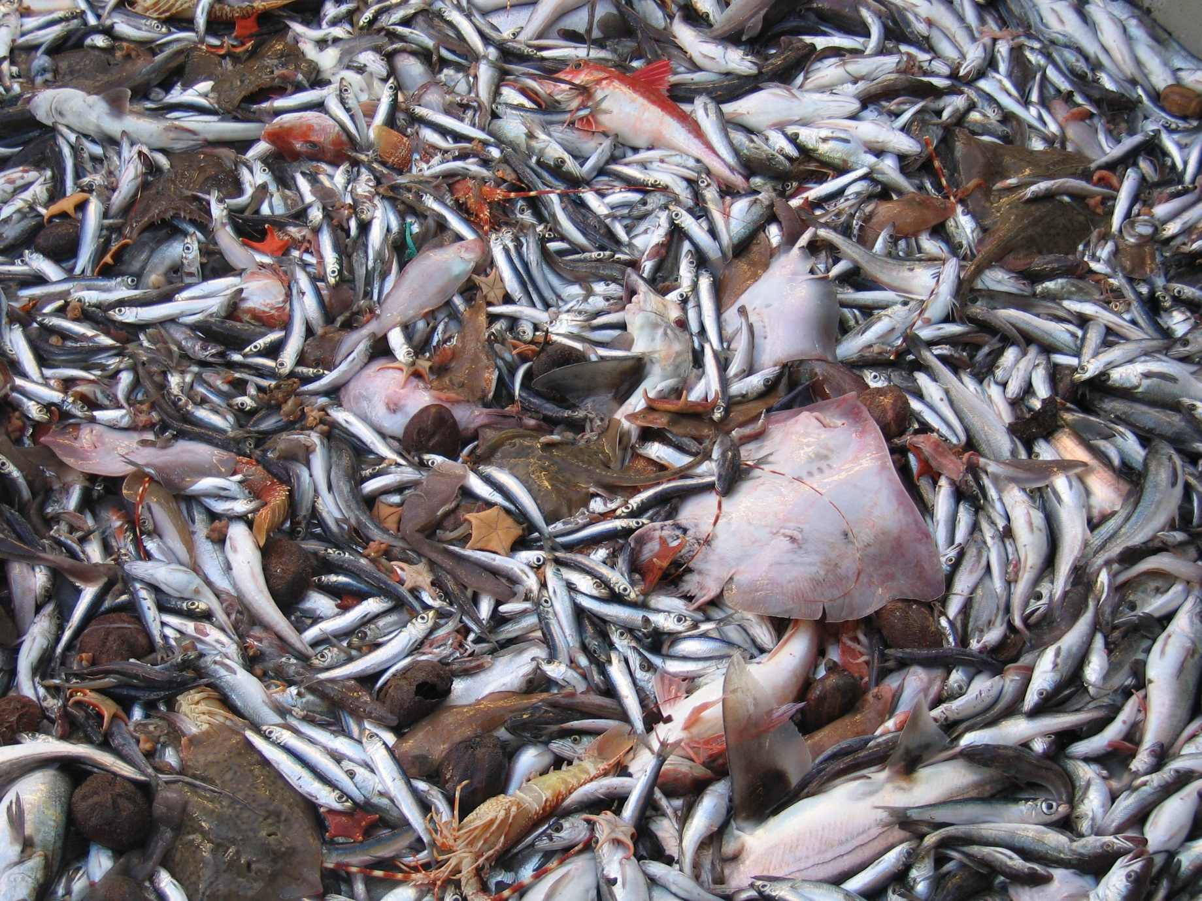
Most types of fishing gear catch several species of fish at once, other than the one targeted

Slide 12
These other species are usually less productive. What happens to catches of these species when we reach for the Holy Grail?
?
?
R.I.P.

Slide 13
Fisheries assessment is easy at high latitudes, but difficult in the tropics. Why?
The number of species increases dramatically from pole to equator, but the abundances diminish. We need to do more assessments in the tropics, yet the financial incentive is less for each species. Of ±600 exploited fish species in SA, 16 are assessed!
With so many similar tropical species, there is great taxonomic confusion, and catch records are not reliably assigned to species.
Seasonal signals are weak or non-existent, so we struggle to read the bands in the otoliths, and to follow cohorts. We do not know the fish’s vital rates, such as growth and mortality, and the age-at-maturity. These are important parameters that influence productivity.

Slide 14
Problem Fisheries assessments are difficult in the tropics. AND Tropical countries have the worst governance and the weakest scientific capacity.
MPAs are especially useful in the tropics!

Slide 15
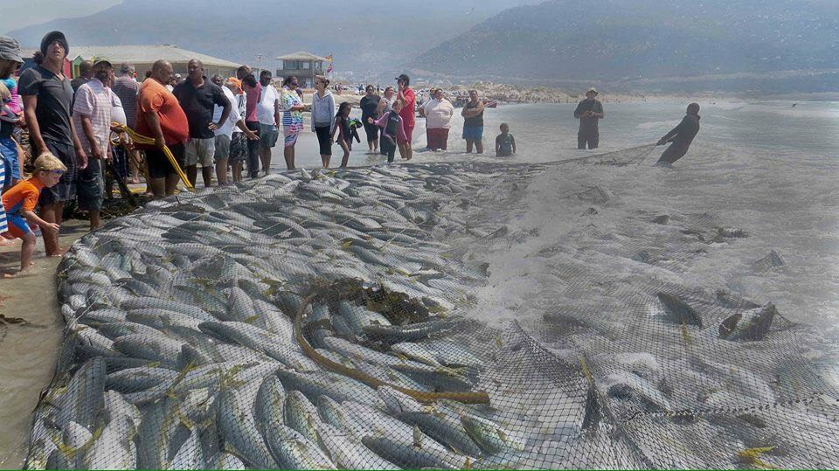
Modern fishing intensity presents a massive selection pressure against
particular traits. Many of these are heritable.

Slide 16
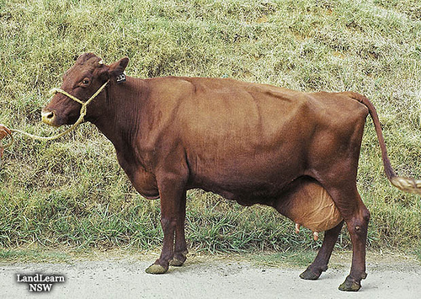
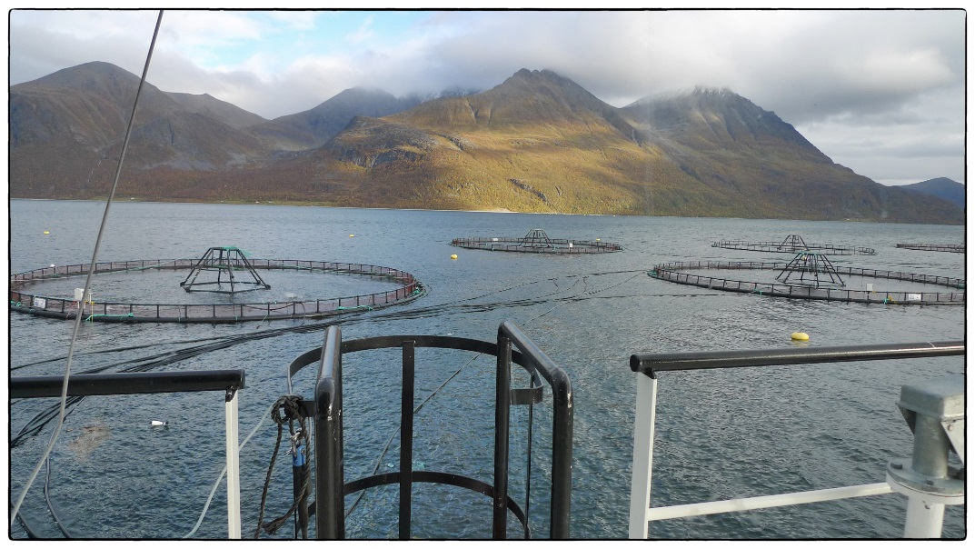
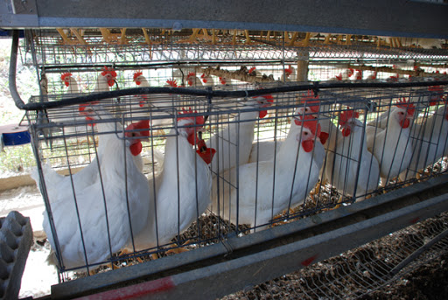
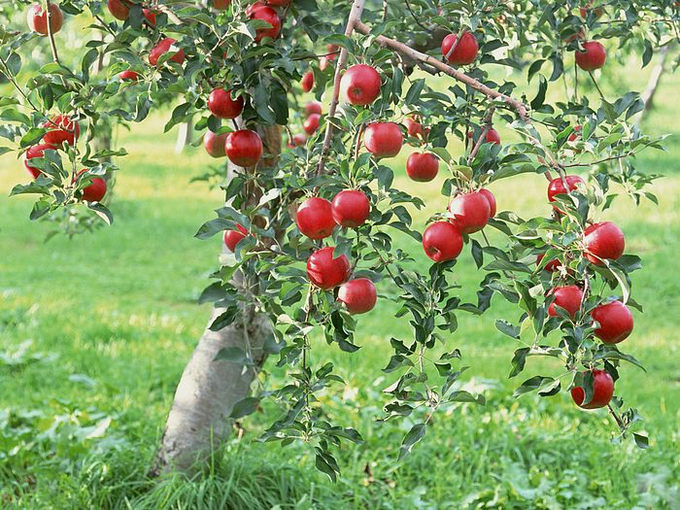
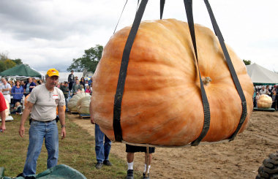
Farmers select the best strains for breeding
Farmers improve their stock

Slide 17
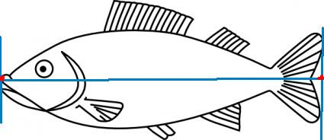
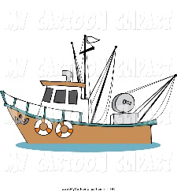
Fishing does the opposite
We kill the strong and leave the weak to breed.
Intense fishing weakens the productivity of the stock.
Fishing also quickly reduces genetic variability. Genetic variability
is a fundamental requirement for Darwinian selection and adaptation in times
of (climate) change. Ultimately, fish production depends on genetic variability.
MPAs are the best means to maintain natural selection pressures and to preserve
genetic variability.

Slide 18
MPAs can provide substantial benefits to most of the world’s fisheries

