Slide 1

Intro to MPA debate
Ray Hilborn
School of Aquatic and Fishery Sciences
University of Washington

Slide 2
Threats to the ocean biodiversity
Global Warming
Ocean Acidification
Oil spills
Land based run off of sediments
Plastics and other pollutants
Legal regulated fishing
Illegal unregulated fishing

Slide 3
History of MPA movement
1990s were a time of overfishing and stock collapse in N. Atlantic
Marine protectionists took the terrestrial paradigm of parks
The early MPA movement assumed that there were no fish outside reserves, thus the need for networks so there was dispersal between islands of fish in reserves amid a desert of empty ocean
The early MPA movement assumed fisheries management did not work

Slide 4
What MPAs do
Move existing effort outside MPA – no effort inside -- more effort outside
Marine systems differ from terrestrial systems
  When fisheries are regulated there are lots of fish outside of reserves
  Farms, cities don’t support much biodiversity

Slide 5
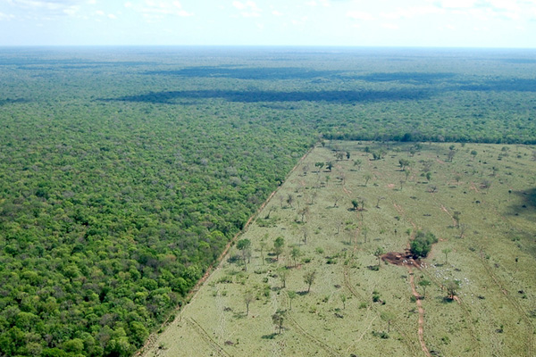

Slide 6
Theory and empirical data suggest
You will always have higher abundance of targeted species inside reserves that are effectively enforced
Abundance outside reserves will be less
If fisheries are well regulated total catch will be less than without reserves
If fisheries are not well regulated the reserves will augment catch and abundance for those species that are
  Seriously overfished
  Whose movement is matched by size of the MPAs

Slide 7
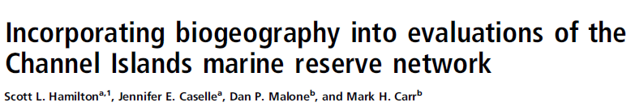
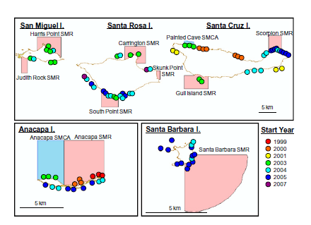

Slide 8
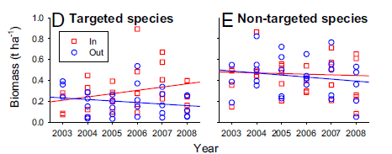

Slide 9
The MPA movement fails to acknowledge that fisheries management better protects biodiversity
By making sure that abundance is maintained at a high level throughout the entire area (not just the MPA)
By reducing by-catch throughout the area
By identifying and protecting sensitive habitats throughout the area

Slide 10
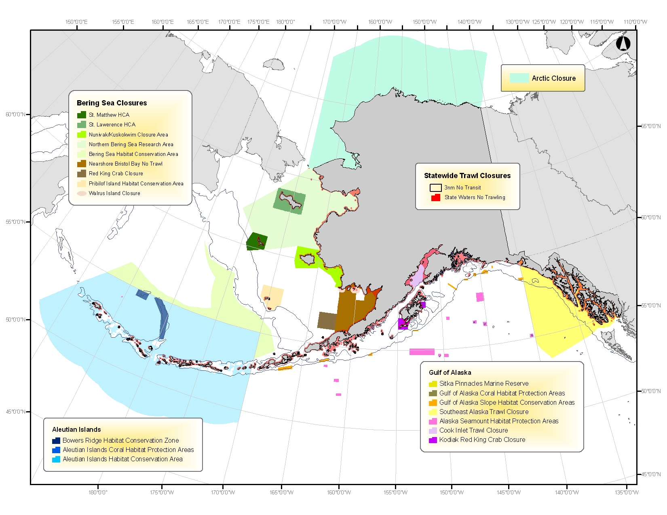
Identify and protect sensitive habitats

Slide 11
Kareiva, Chief Scientist for TNC
”Conservation in the anthropocene”
Parks as a strategy are not working to protect biodiversity
Most biodiversity is found in human used areas
We need to shift conservation from a parks strategy to improving management in human used areas

Slide 12



Slide 13
Threats to the ocean biodiversity
Global Warming
Ocean Acidification
Oil spills
Land based run off of sediments
Plastics and other pollutants
Legal regulated fishing
Illegal unregulated fishing

Slide 14
Packard Foundation did a program review and concluded that the $200 million they had spent on MPA science and advocacy would have protected biodiversity better if it had focused on improving fisheries management.

Slide 15
What should be done
Identify the problem(s) and alternative tools.
These tools include the fisheries management actions – catch and effort limitation, gear modification, closed areas to specific gears and MPAs.
Evaluate which tools provide the best mix of yield and biodiversity protection

