Slide 1
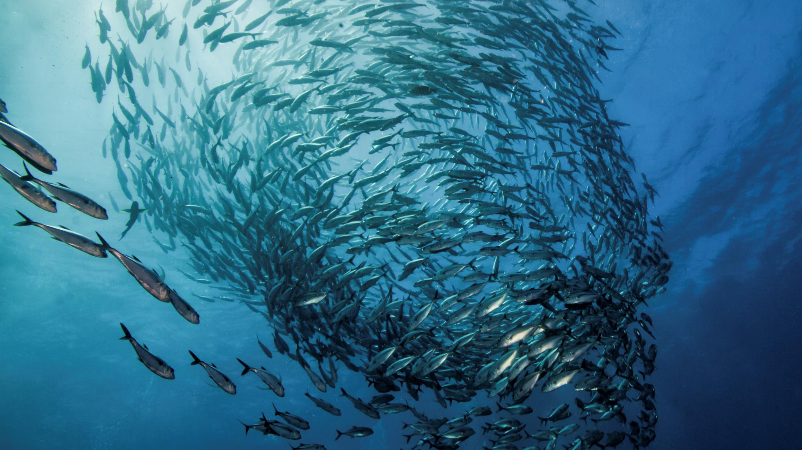
Global collaboration | Positive impacts
Delivering lasting improvements for healthy oceans
Marine Stewardship Council

Slide 3
How MSC Standard evaluates fishing sustainability
www.msc.org/global-impacts

Slide 4
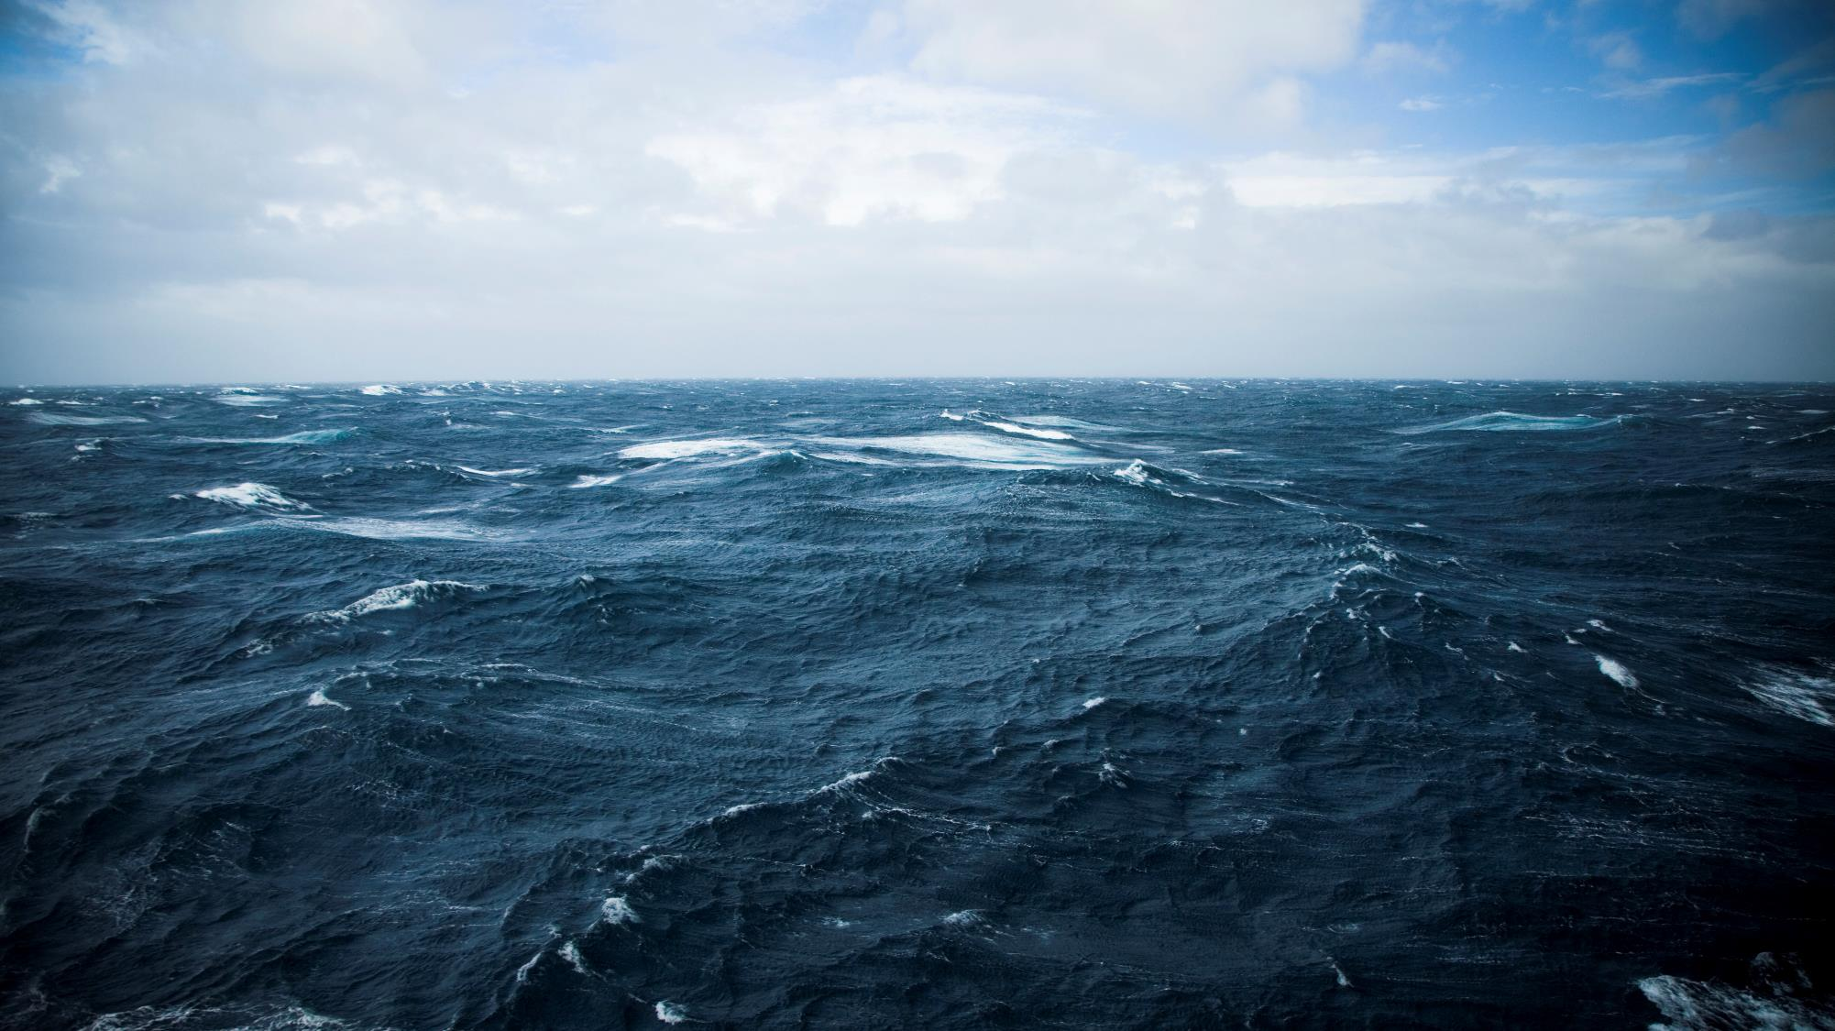
GIR - Key highlights
Global collaboration has doubled MSC certified catch and tripled chain of custody commitments since 2010.
94% of MSC certified fisheries made at least one improvement to strengthen the sustainability of their operations.
99.6% of MSC labelled products that were DNA tested were correctly labelled.
36% of fishery assessments received stakeholder inputs, 12.5% lead to changes in scores, and 5-6% commented fishery assessment with added conditions.
Stocks targeted by MSC fisheries are well managed. Targeted European stocks are better managed than before MSC certification.
www.msc.org/global-impacts

Slide 5
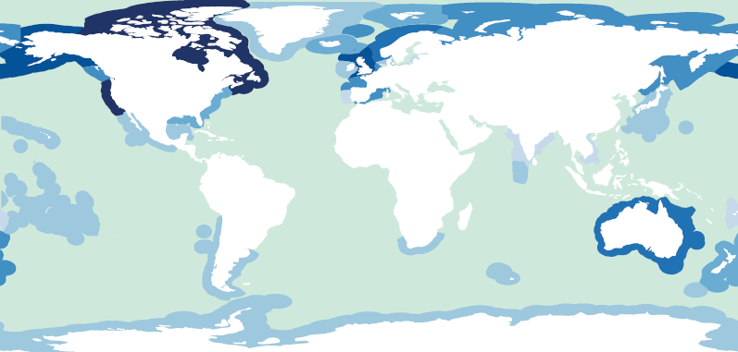







Growing support
Number of certified fisheries in December 2015
www.msc.org/global-impacts

Slide 6
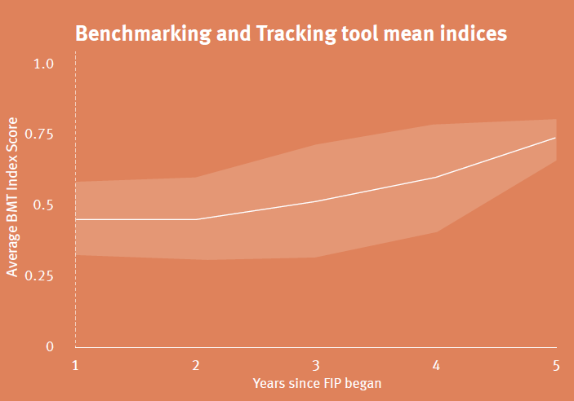




Accessibility tools and capacity building
1
Undertake MSC Pre-assessment
2
Develop improvement action plan
3
Implement actions & track progress
23 fisheries in 13 developing countries engaging in Fishery Improvement Projects (FIPs) have publicly report their improvements using MSC Benchmarking and Tracking tool (BMT)
4
Enter MSC full assessment
www.msc.org/global-impacts

Slide 7
Some thoughts
What is the MSC?
Market mechanism
Science-based sustainability standard
Stakeholder driven
Voluntary
Has MSC missed the mark?
Could we do better by making the standard more achievable?
OR, are we just not there YET?
Is not being certified really a barrier to trade?
OR is not being ‘certifiable’ the bigger issue?
www.msc.org/global-impacts

Slide 8
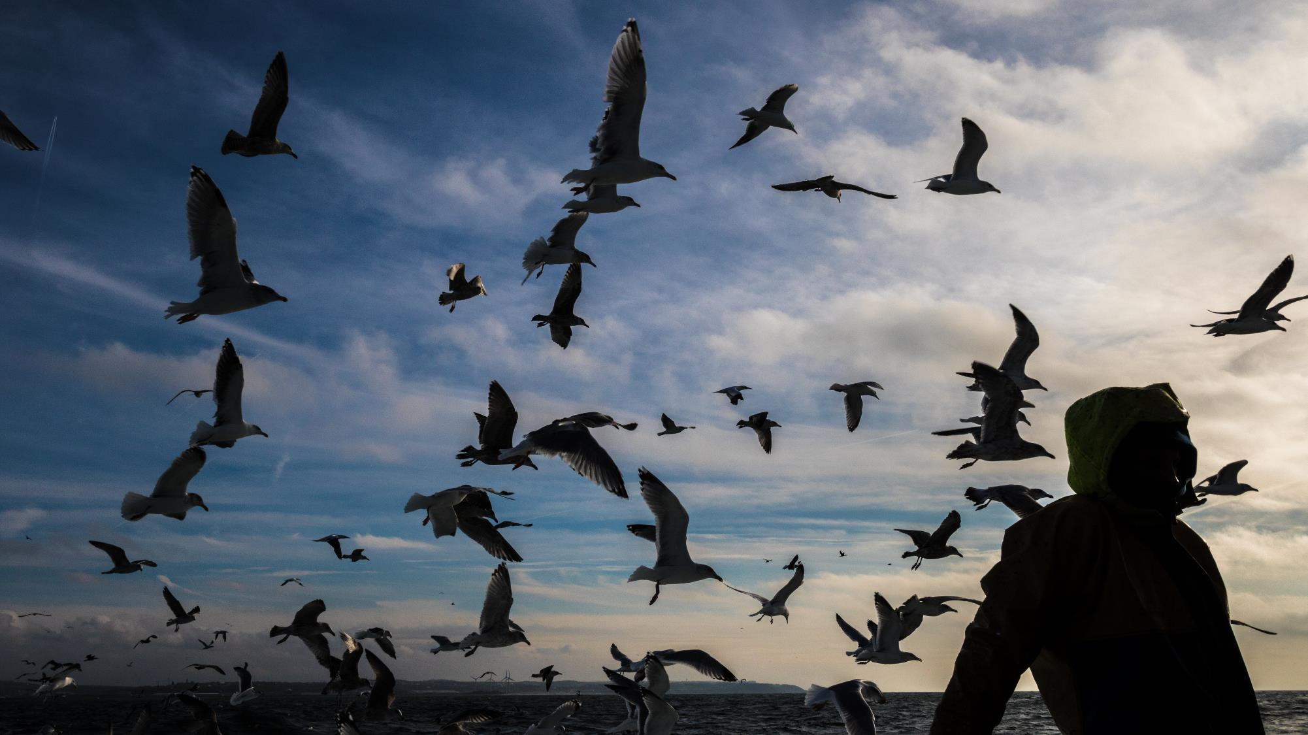
Thank you
Visit msc.org/global-impacts
Further resources:
www.msc.org/2016-impacts-appendix
michael.marriott@msc.org
/global-impacts

