Slide 1
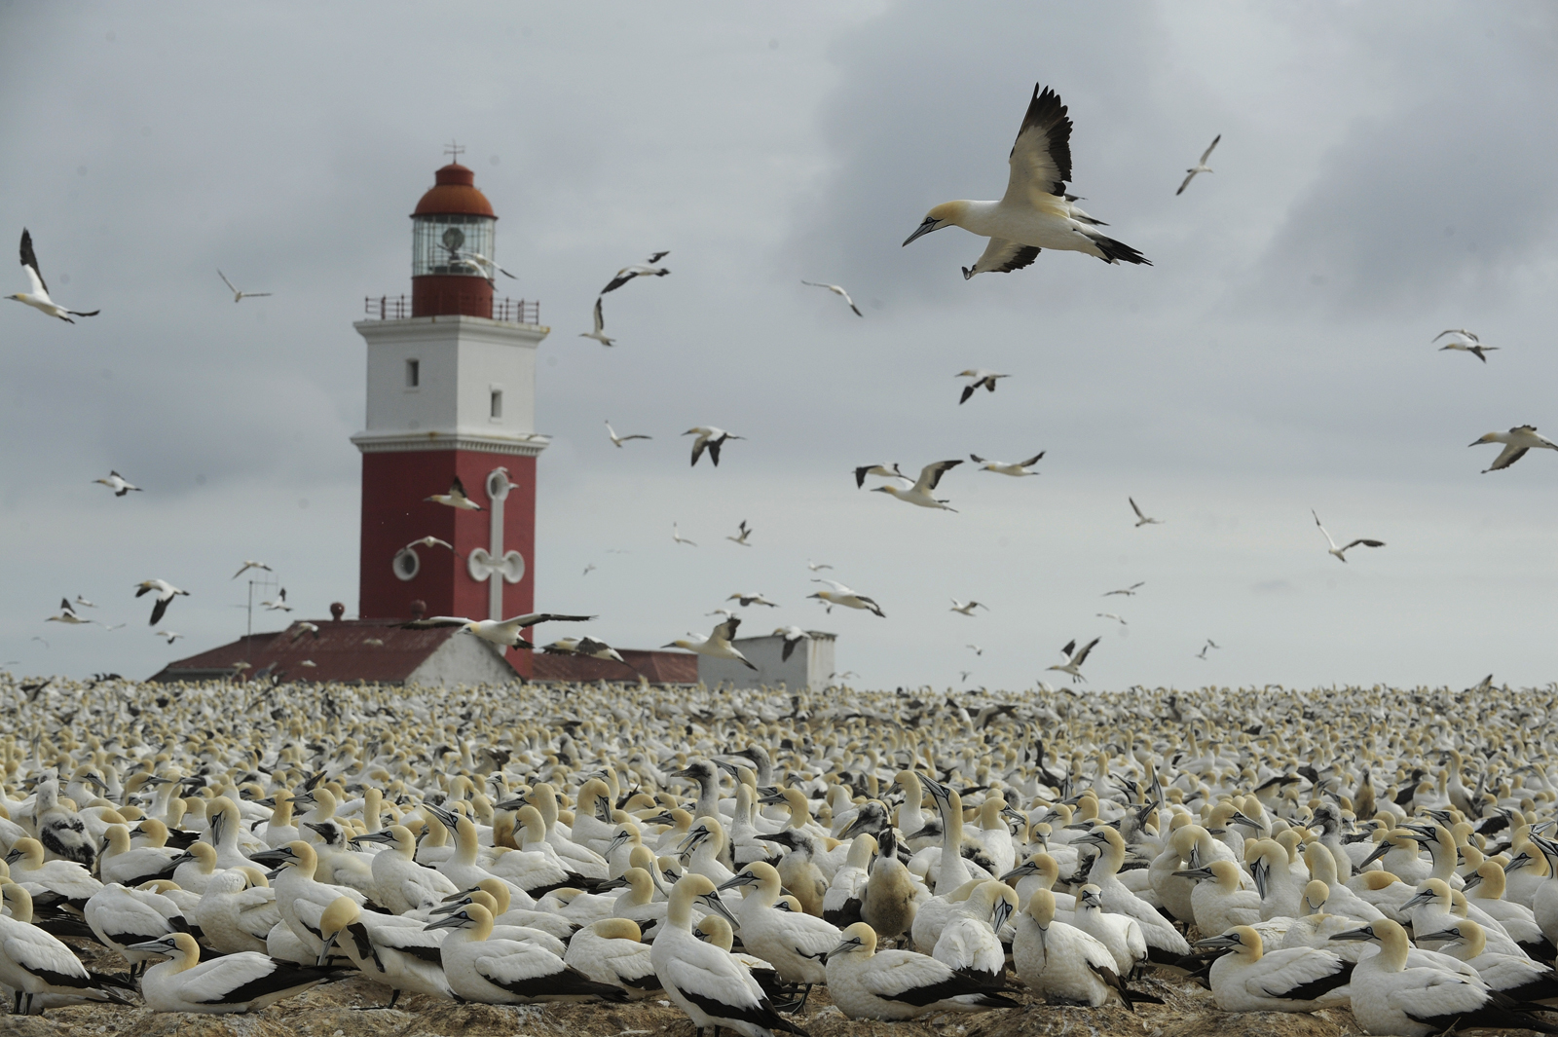
The MSC and Small-Scale fisheries
John Duncan
WWF-SA Marine Programme
Senior Manager
© Cat Holloway / WWF-Canon

Slide 2
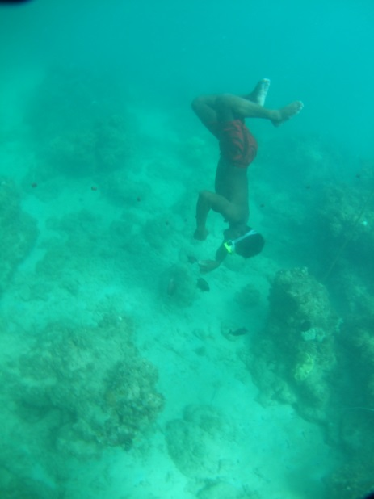
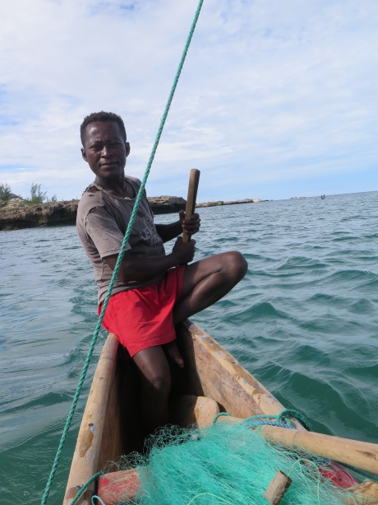
MSC certification and Small-scale Fisheries
Limited examples of successful SSF certifications to date particularly in the developing world
Vietnamese Ben Tre clam fishery √
Mexican spiny lobster fishery X
SSF generally face a number of challenges to certification
Costs
Capacity
Data deficiency
Organisation
Access rights
Markets

Slide 3
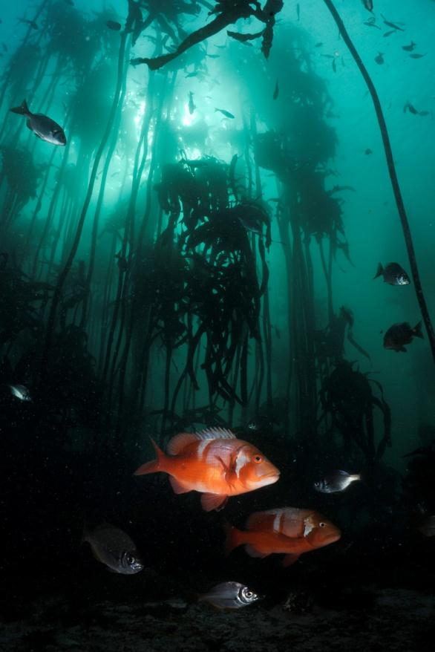
MSC certification and Small-scale Fisheries
The often low bargaining power SSF tends to make it difficult for them to receive benefits such as price premiums
SSF operations are not generally suited to export because of logistical and food safety challenges
Fisheries certification standard was not developed with SSF in mind (but this is changing…)

Slide 4
Conclusions
Is the MSC a barrier that restricts developing countries from market access?
Short answer: NO, the standard does not distinguish between developed and developing world fisheries
The standard does however restrict market access to fisheries that cannot prove sustainability credentials
Many developing world fisheries are poorly managed and are increasingly unsustainably exploited. Many of these fisheries are commercially valuable and focus on export markets. Market pressure on these fisheries can help to improve fisheries management and generate greater returns for fishers…
But some developing world fisheries are sustainable, particularly SSF, but struggle to prove it…

Slide 5
Conclusions
Is the MSC the most successful initiative to improve fisheries’ sustainability over the last decade?
Certification has driven a number of improvements in many fisheries across the world, including SA hake trawl fishery
Success isn’t only measured by the number of certified fisheries. The MSC standard provides an excellent tool for the development of Fisheries Improvement Projects (FIPs)
Short Answer: YES/NO. It is only one tool not the only tool to drive fisheries improvement
Market-based tools can only help drive improvement in fisheries where markets are sensitive to sustainability issues
Barriers to improving SSF are more often linked to social challenges (crime, unemployment, lack of education, power imbalances). We are still grappling with how best to address these challenges but this doesn’t mean that we can ignore the marine ecosystems which underpin these fisheries.

Slide 6
Closing thoughts
Abalone and West Coast rock lobster are two of South Africa’s most valuable commercial seafood products both of which are almost exclusively exported
Unrestricted market access to both legal and illegal catches has resulted in the collapse of these species and many SSF livelihoods. Market restrictions on the basis of legality/sustainability could have helped to prevent this.
The questions should rather be:
Does the MSC drive fisheries improvement?
Is the MSC ecolabelling model applicable to all types of fisheries?
What are the solutions to improving the long-term survival of SSF?

