Slide 1
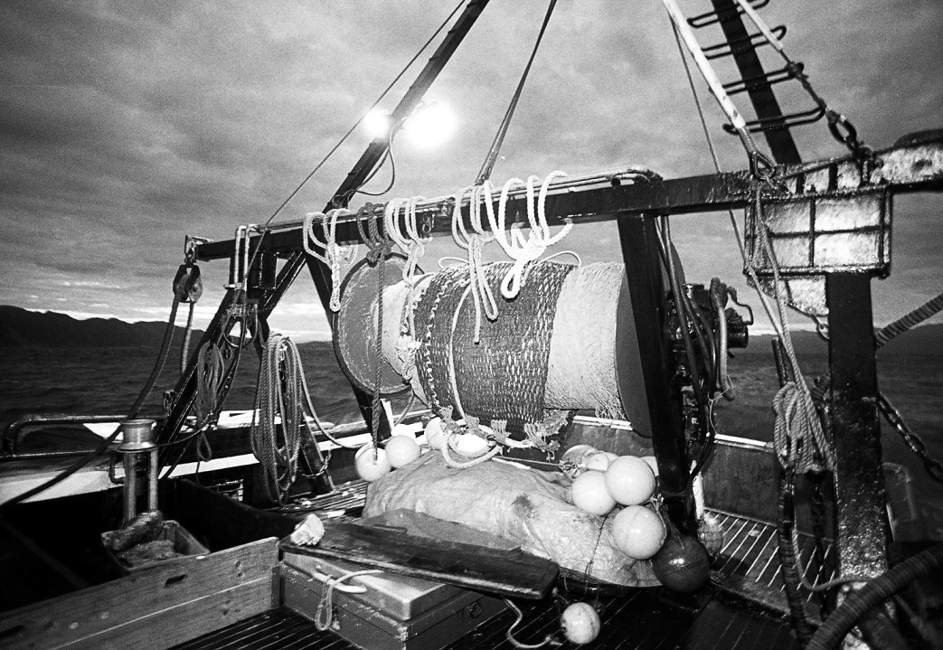
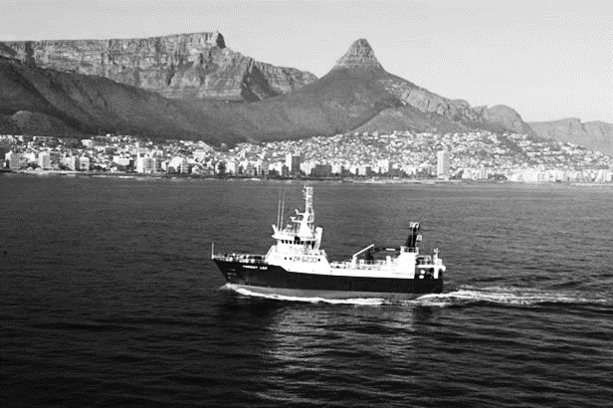
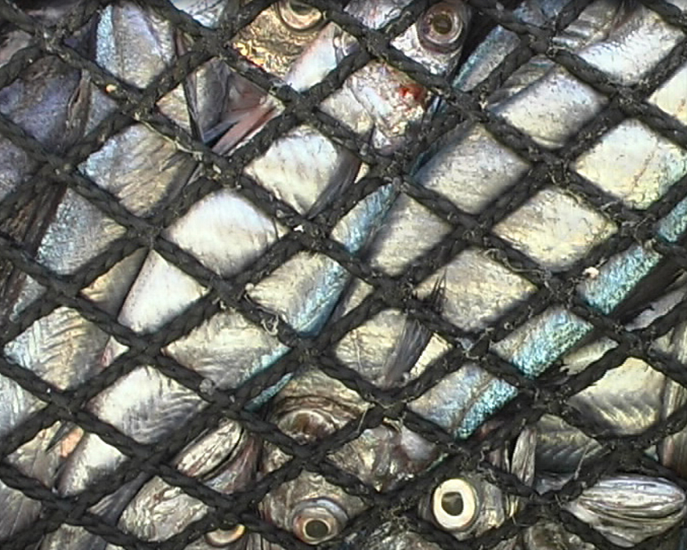
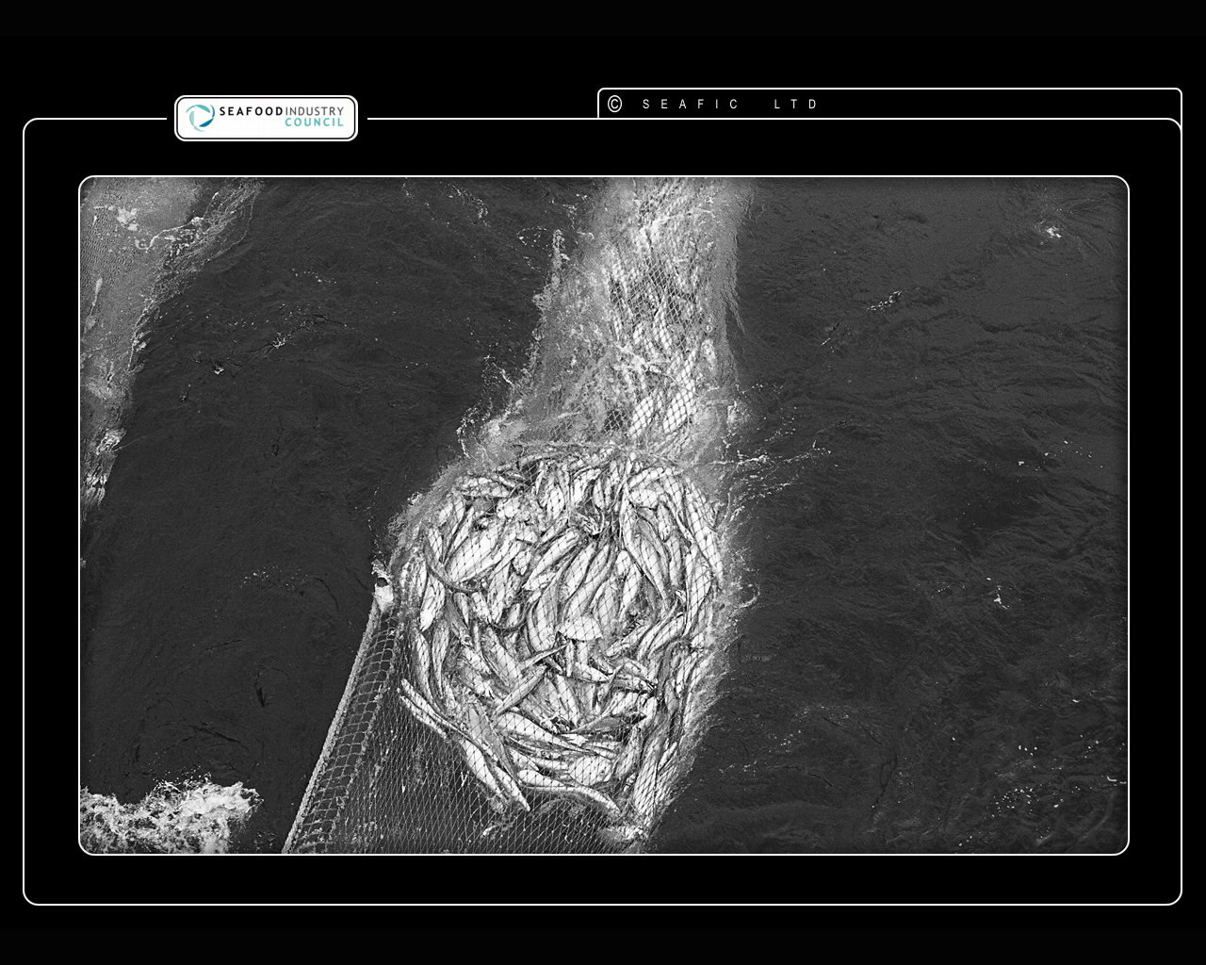
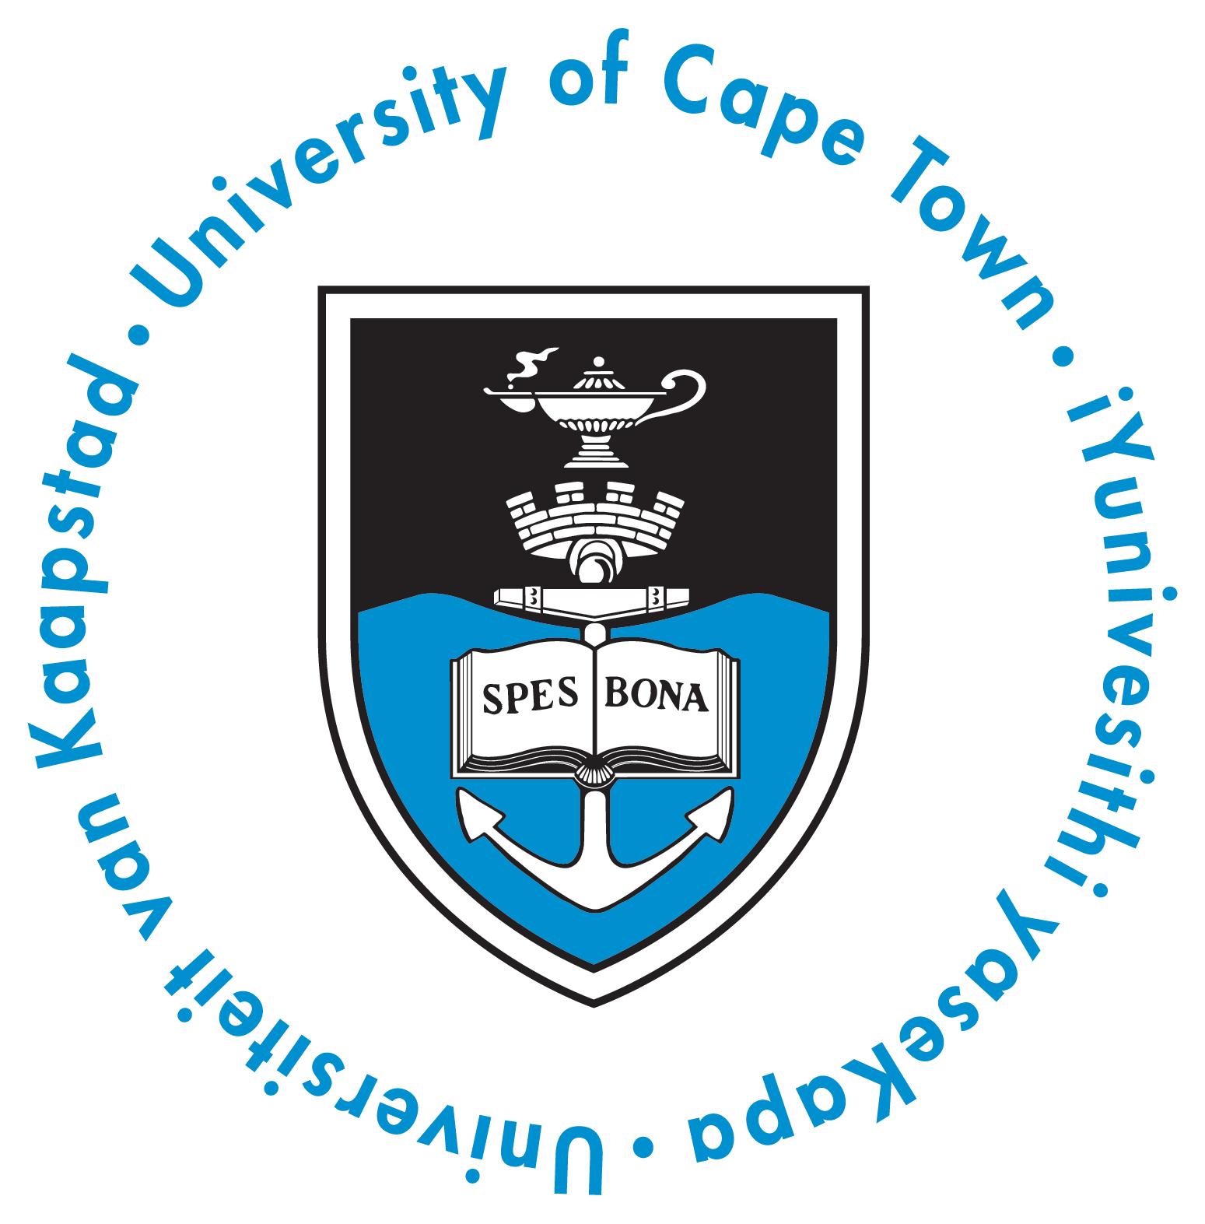




Socio-Economic Implications
of
MSC certification
for the
South African
Hake Trawl Fishery
Philippe Lallemand
Panel Discussion on Fishery Certification
November 30th 2016,
University of Cape Town, South Africa

Slide 2
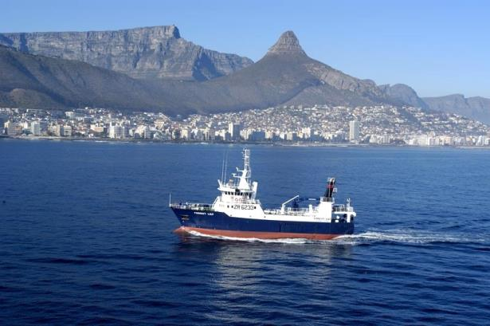
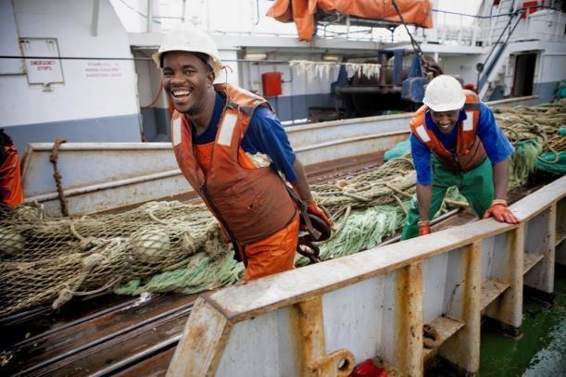

SA Hake Trawl - Background
Most valuable commercial fishery in South Africa (accounts for more than 50% of the value of South Africa's commercial fisheries)
Directly employing 6 653 men and women (37% of all fisheries employment)
It creates 65 jobs for every thousand tons landed
Indirectly supporting a network of logistics companies, secondary processors and exporters
Annual sales exceed R5.4 billion with total foreign exchange earnings of R3.5 billion (more than 63% of the catch is exported)
Panel Discussion on Fishery Certification
November 30th 2016, University of Cape Town, South Africa
Notes:
The SA Hake trawl fishery is the most valuable commercial fishery in South Africa
It directly employs 8,300 men and women (37% of all fisheries employment).
More than 60% of the catch is exported, bringing in US$ 180 million in annual revenue
Indirectly supporting a network of logistics companies, secondary processors and exporters

Slide 3
South African Hake Catch
Source: Rademeyer and Butterworth (2014) and DAFF (2002–2013).
Panel Discussion on Fishery Certification
November 30th 2016, University of Cape Town, South Africa

Slide 4
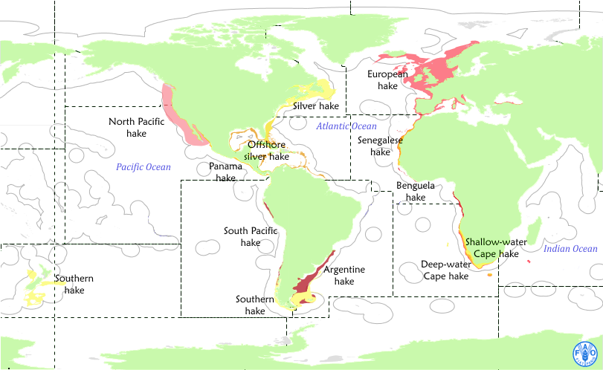
Hake species geographic distribution
Panel Discussion on Fishery Certification
November 30th 2016, University of Cape Town, South Africa
Notes:
The SA Hake trawl fishery is the most valuable commercial fishery in South Africa
It directly employs 8,300 men and women (37% of all fisheries employment).
More than 60% of the catch is exported, bringing in US$ 180 million in annual revenue
Indirectly supporting a network of logistics companies, secondary processors and exporters

Slide 5
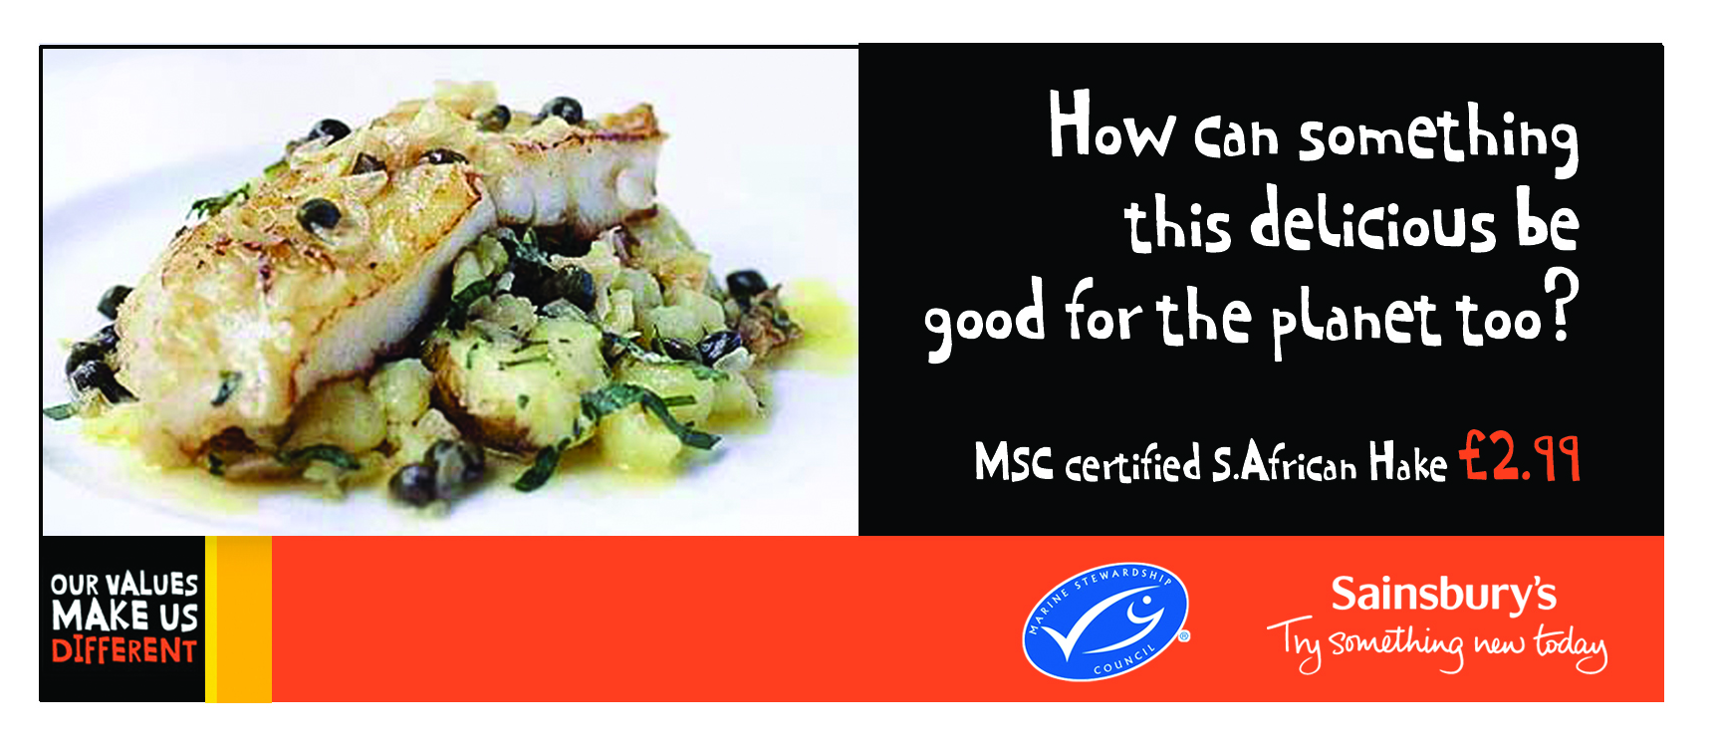
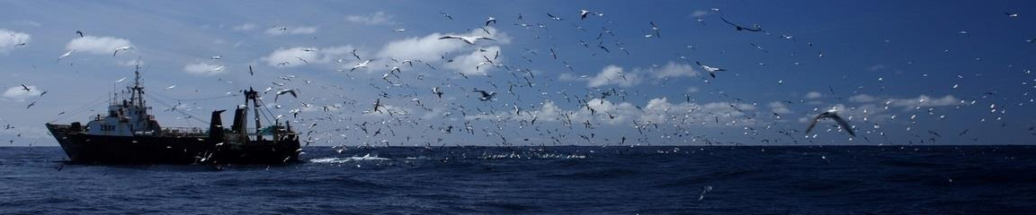
Connecting to global markets
SA Hake certified 2004, recertified in 2010 and again in 2015
Strengthened position in other ‘MSC-friendly’ markets (UK, US, Germany, Netherlands etc.)
Environmental gains include quota reductions, ring-fencing of fishing grounds, by-catch management, reduced seabird interactions
Process benefits – much improved cooperation among all stakeholders (Field et al, 2013)
Panel Discussion on Fishery Certification
November 30th 2016, University of Cape Town, South Africa
Notes:
The SA Hake fishery was first certified in 2004 and was re-certified in 2010 and successfully again in 2015 for its 3rd 5-year cycle. Since the fishery was certified, and especially in the last 10 years, they have strengthened their market position in ‘MSC friendly” markets, particularly in northern Europe (UK, Germany, Netherlands etc.) but also in other markets such as the US and Australia where there are increasing recognition of the MSC as a sustainability standard.
The environmental benefits of certification have been demonstrated and independently verified in the SA Hake fishery. These include quota reductions and rebuilding of stocks, ring-fencing of trawl grounds, improved by-catch management and major reductions in seabird interactions and mortalities.
Researchers at the University of Cape Town also emphasised the process benefits that certification has brought to the fishery, citing much improved cooperation among all stakeholders (government, industry, scientists, NGOs etc).

Slide 6
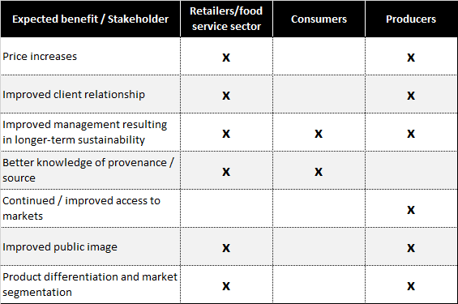
Recalling perceived benefits of certification
Perceived socio-economic, environmental and biological benefits of certification and eco-labelling for the producers, consumers and retailers
X
X
X
X
X
X
X
Based on: Standing 2009, UNEP 2009, Mathew 2011
Panel Discussion on Fishery Certification
November 30th 2016, University of Cape Town, South Africa
Notes:
If we look at some of the perceived socio-economic, environmental and biological benefits that certification brings, we can distinguish between 3 distinct groups, namely the (1) retailers & foodservice sector, (2) consumers and (3) producers. Issues that might be important to producers, in other words the fishing companies or potential clients of certification are (a) price premiums, (b) improved client relationships between the buyer and seller, (c) improvements in management leading to improved resource sustainability, (d) better knowledge of provenance or source, (e) continued or improved access to markets, (f) improved public image and (g) product differentiation and market segmentation.
Also interesting here is that the only expected benefit that is shared by all 3 groups is the notion that certification will lead to improvements in the management of fisheries which will ultimately lead to long-term sustainability of the resource. This is an important issue as ultimately this is the main objective of most market-based incentive schemes or programmes.

Slide 7
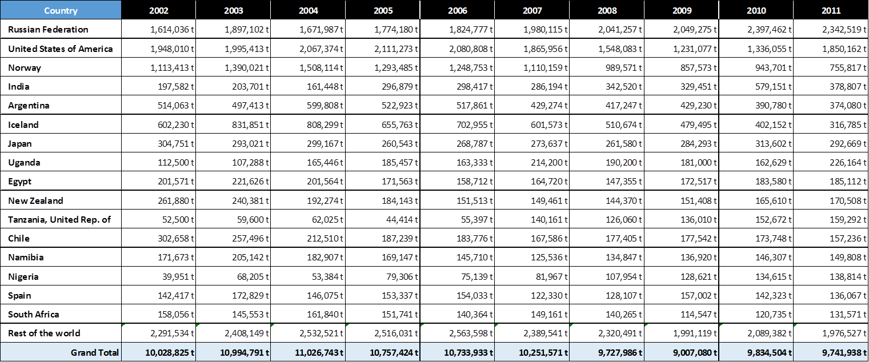
Global Whitefish production (wild capture)
Whitefish production from wild capture fisheries in tonnes of green weight, taken from FAO FishStatJ, for the top 16 producing countries globally
SA, with 1.4% of global catches are ‘price takers’ and not ‘price fixers’
Panel Discussion on Fishery Certification
November 30th 2016, University of Cape Town, South Africa
Notes:
In a global context South Africa is a relatively minor player as far as whitefish production is concerned, ranking at no. 16.
With 1.4% of global whitefish catches from wild capture fisheries, South Africa are definitely ‘price-takers’ and not price fixers’.

Slide 8
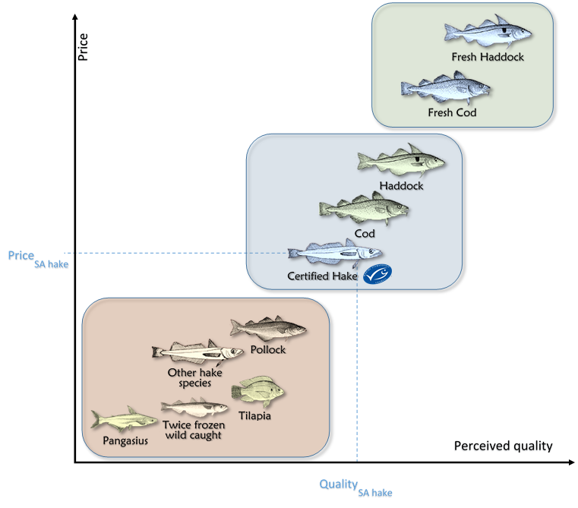
Whitefish perceived quality
Based on Geldenhuys (2013)
Panel Discussion on Fishery Certification
November 30th 2016, University of Cape Town, South Africa

Slide 9
Whitefish existing eco-label
Panel Discussion on Fishery Certification
November 30th 2016, University of Cape Town, South Africa

Slide 10
Recent market trends in hake markets
Certification of SA Hake created diversification opportunities to non-traditional markets such as the UK, Germany, Switzerland, Australia
Buyer commitments often the driver
Other southern hake fisheries (e.g. Namibia, Argentina, Uruguay, Chile) struggling to remain competitive due to their dependence on the strength of traditional markets in southern Europe (Spain, Portugal and Italy)
These markets hard hit by recent economic crisis
Cheaper farmed whitefish imports gained market share (e.g. Pangasius) in southern Europe
Emerging markets such as China, India and Brazil likely to have prohibitive barriers of entry and/ or cheaper substitute, making it too difficult to break into. Cheaper farmed product already established in some of these markets
Panel Discussion on Fishery Certification
November 30th 2016, University of Cape Town, South Africa

Slide 11
Study looked at Market Context
The MSC’s Southern Africa office commissioned a study look at the economic benefits that certification has brought to the SA Hake fishery
Review of global white fish market
Focus on recent trends and influence of downward economic trends in main markets in southern Europe
Importance of market diversification; the role of MSC certification in providing access to ‘new’ markets
Volumes and prices of hake traded in different markets, type of products, sustainability requirements/procurement policies of buyers, application of MSC logo on products etc.
Position of SA Hake on global markets when compared to non-certified hake fisheries from Namibia, Argentina, Uruguay and Chile (potential competitive advantage)
Current levels of employment in SA Hake companies and the potential impacts on employment if the fishery was no longer certified.
Panel Discussion on Fishery Certification
November 30th 2016, University of Cape Town, South Africa

Slide 12
Basis for the Analysis
Data sources: UN COMTRADE and FAO FishStatsJ data augmented by the MSC’s own database of consumer facing and non-consumer facing products exported from South Africa. Also interviews with industry, NGO, news articles etc.
Assumptions made on the baseline, being the present fishery situation and value, conversion factors for value-added products and currency exchange rates
Model constructed with four different successive scenarios of how the South African hake fishery might look in the absence of MSC certification
Compared with uncertified hake fishery in Namibia – similar to SA regarding exports and prices..
Panel Discussion on Fishery Certification
November 30th 2016, University of Cape Town, South Africa

Slide 13
Markets comparison SA vs Namibia (product types and destination)
Panel Discussion on Fishery Certification
November 30th 2016, University of Cape Town, South Africa

Slide 14
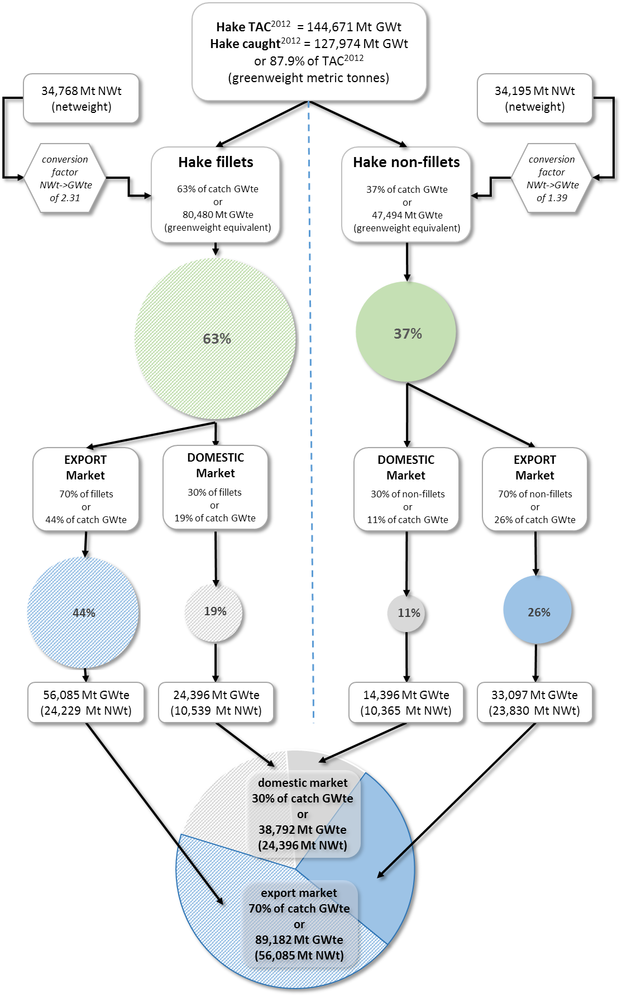
Model baseline
Panel Discussion on Fishery Certification
November 30th 2016, University of Cape Town, South Africa

Slide 15
Potential Scenarios
Potential Scenarios
  Market and product status quo with loss of MSC price premium
  Shift from Northern to Southern Europe export market
  Downgrading export product type to mostly non-fillet.
  Shifting most exports to the domestic market
Study found that under each scenario considered independently, the SA Hake trawl industry’s contribution to South Africa’s GDP value would decrease substantially
Decrease of 28 - 54%, depending on the scenario.
Panel Discussion on Fishery Certification
November 30th 2016, University of Cape Town, South Africa

Slide 16
The Successive Scenarios
We look at the impacts of successive scenarios which were combined over a period of 5 years by simulating the following impacts:
Period | Result
1st Year | loss of price premium
2nd Year | loss of access to premium markets
3rd Year | substitution of value-added to basic product types in the product mix
4th Year | a dramatic shift of export volume into the domestic market
5th Year | Continued shift to domestic markets
Period | Result
1st Year | loss of price premium
2nd Year | loss of access to premium markets
3rd Year | substitution of value-added to basic product types in the product mix
4th Year | a dramatic shift of export volume into the domestic market
Period | Result
1st Year | loss of price premium
2nd Year | loss of access to premium markets
Period | Result
1st Year | loss of price premium
Period | Result
1st Year | loss of price premium
2nd Year | loss of access to premium markets
3rd Year | substitution of value-added to basic product types in the product mix
Panel Discussion on Fishery Certification
November 30th 2016, University of Cape Town, South Africa
Notes:
The four scenarios used to estimate the value of MSC certification are:
Scenario 1: “Market and product status quo with loss of MSC price premium”.
Scenario 2 – “Shift from Northern to Southern European export market”
Scenario 3 – “Downgrading export product type towards non – fillet products”
Scenario 4 – “Shifting most exports to domestic market”
These scenarios can be viewed as independent possible outcomes or as a sequence in the evolution of the fishery following a loss of MSC certification. For the latter the five year sequence which is assumed is:
2014: Scenario 1, “Market and product status quo with loss of MSC price premium”
2015: Scenario 2, “Shift from Northern to Southern Europe export market”
2016: Scenario 3, “Downgrading export product type towards non – fillet products”
2017 and 2018: Scenario 4, “Shifting most exports to domestic market”

Slide 17
Scenarios assumptions
Panel Discussion on Fishery Certification
November 30th 2016, University of Cape Town, South Africa

Slide 18
Hake domestic demand schedules (response to scenarios)
Panel Discussion on Fishery Certification
November 30th 2016, University of Cape Town, South Africa

Slide 19
Scenarios Summary
Panel Discussion on Fishery Certification
November 30th 2016, University of Cape Town, South Africa

Slide 20
Export Data Limitations
International Merchandise Trade Statistics National Compilation and Reporting Practices (2006 Survey Results for South Africa): 107 of the 173 questions relate to recommendations made in International Merchandise Trade Statistics: Concepts and Definitions or the Compilers Manual
http://unstats.un.org/unsd/tradereport/countryform_MM.asp?cid=710
  64 answers comply with UN recommendations (59.8%)
  39 answers do not comply with UN recommendations (36.4%)
  4 questions have no answer. (3.7%)
UN Comtrade export data
  Data Availability (http://comtrade.un.org/db/mr/daYearsNewResults.aspx?px=ori&y=2012&r=710)
  Product classification levels (HS92 to HS2012, SITC rev. 1 to rev. 4)
  Change in level of classification between years
  SA Hake exported recorded as whitefish
  Reconciliation of SA hake exported reported by SA customs with SA hake imported by other countries’ customs
  Dealing with re-import
Panel Discussion on Fishery Certification
November 30th 2016, University of Cape Town, South Africa

Slide 21
Domestic Market Data Limitation
Extrapolation of the volume sold in domestic market from total reported catch and export.
Extrapolation of the price structure of the domestic market (Namibian export to SA)
Estimate the elasticity of SA hake demand in the domestic market (literature)
Assumptions regarding impact on other fish products
Panel Discussion on Fishery Certification
November 30th 2016, University of Cape Town, South Africa

Slide 22
Limitation of Data used in Scenarios Computation
Separating Hake products caught with longline and those caught with Trawl
Conversion factors to express the volume exported as greenweight regardless of product type
The Determination of the feasible scenarios
Choice of discount rate and time horizon
Grouping relevant export countries into sub-markets
Applying pro-rata price structure to the different scenarios
how to determine exchange rate in future periods (different assumptions)
Panel Discussion on Fishery Certification
November 30th 2016, University of Cape Town, South Africa

Slide 23
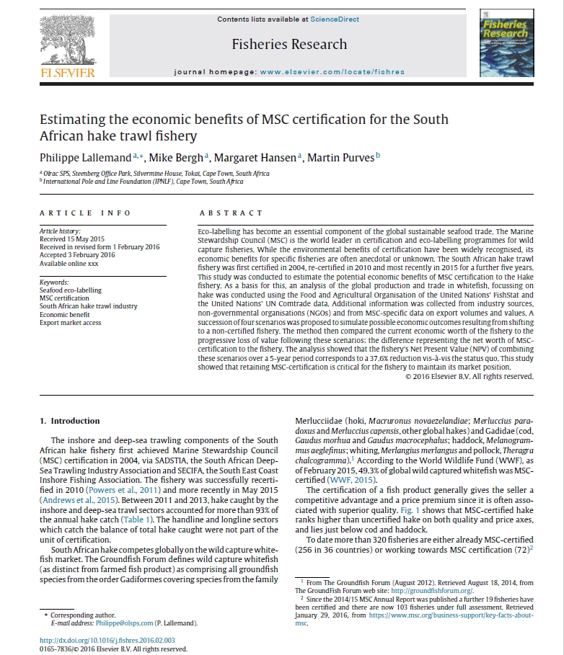
First study of its Kind
Panel Discussion on Fishery Certification
November 30th 2016, University of Cape Town, South Africa

Slide 24
Thank You!
Panel Discussion on Fishery Certification
November 30th 2016, University of Cape Town, South Africa

