Slide 1
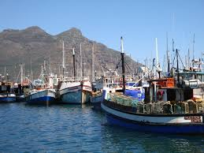
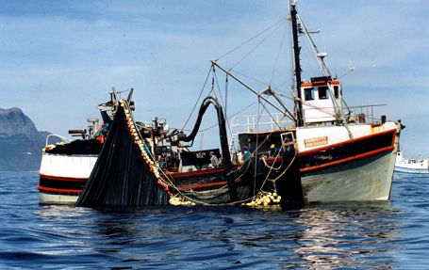
Socio-economic implications of spatial management and the development of OMP-17 in the Small Pelagic fishery
South African Pelagic Fishing Industry Association

Slide 2
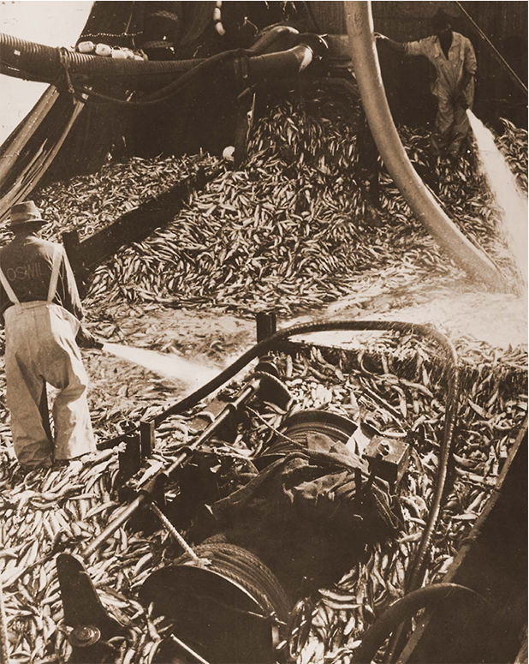
Basics
Largest sector in terms of catches ( sometimes > 500 000 tons for all species)
Second largest sector in terms of value in the (2014 wholesale value of landings: R2.642 billion, or 26,4% of all sectors).
Value of processed products adds R1.55 billion (2013)
5 200 people are employed in the industry.

Slide 3
Allocated Directed Sardine TACs 2013-2016
2013 – TAC 90 000 t from Interim OMP-13, based on a Sardine 1+ biomass of 345 054 tons.
2014 – TAC 90 000 t from Interim OMP-13 v3, based on a Sardine biomass of 851 553 t. This interim version allowed for a conservative initial directed sardine TAC in the event that the biomass was in the range 300 000 to 600 000 t. Rule for top-up not yet decided at that time.
2015 – Initial TAC 75 443 tons from OMP-14, based on Sardine biomass of 444 500 t; proposed proportion to be caught W of 20⁰E to lie between 50,2 and 70,2%.
2016 – Initial TAC 64 563 tons from OMP-14, based on a sardine biomass of 363 230 tons: proposed proportion to be caught W to lie between 25,6 and 45,6%.

Slide 4
Implications for the sector
Ultimately this W/E catch ratio could not be achieved in 2016, mainly because the fish was not available for long enough on the South Coast, was not catchable at times and some companies could also not secure landing facilities in Mossel Bay on time.
Before this spatial management approach for sardine was applied, the OMP had assured a TAC of at least 90 000 t, provided the spawner biomass estimate was above 300 000t. Although the spawner biomass had not declined below 300 000 t in 2015, the precautionary approach associated with spatial management had reduced the 2016 directed TAC to only 65 000 t.

Slide 5
Potential impacts of a reduction in the minimum sardine TAC from 90 000 t to 75 000 t. (from Anchor Environmental Consultants study)
Industry Component | Rands (Millions)
Rights holders Loss of quota usage fee on 15 000t Vessel owners Loss of catching fee less crew commission on 15 000t Loss of four type 1 (small sardine specialist) vessels in long term Vessel crew Loss of commission on 15 000t Processors revenue (excluded from TOTAL) Loss of 660 000 cartons locally caught and canned sardine (12 000t raw fish) Loss of 3000t whole frozen sardine Processors Operating profits (included in TOTAL) Loss of 660 000 cartons locally caught and canned sardine (12 000t raw fish) Loss of 3000t whole frozen sardine Seasonal workers Reduced shifts resulting in reduced earnings for 3 500 seasonal workers | R29.42 R17.25 36 seagoing jobs R11.5 R147.18 R30.00 R45.84 R15.00 R16.5
TOTAL LOSS (operating profits and earnings, excluding processors revenue) | R135.51

Slide 6
Current TAC of 64 928 tons – Implications
Represents a 27% reduction from 2014
Has a correspondingly greater effect than the previous reduction of 17% - may be pushing some operations closer to the edge of unprofitability.
A reduction in the number of sardine only vessels to 18 in 2015 and 15 in 2016
Further losses of quota usage fees to right holders
Further loss of catching fees less crew commission to vessel owners
Loss of commission on 25 000 t to vessel crew.
Additional cost to offload & truck fish from Mossel Bay to the W Coast factories: R1 250/t
6 freezing factories ceased operations.
Loss on revenue from +/- 1 m ctns canned sardine, 7 000 t frozen sardine to processors.
Loss of operating profits from +/- 1 m ctns canned sardines, 7 000 t of whole frozen sardine.
Loss on revenue from 9000t of offcuts lost to fishmeal and oil production, worth approximately R40 million.
Further reduced shifts resulting in reduced earnings for 3 500 seasonal workers of at least R25 million.
Potential total losses close to R400 million

Slide 7
SAPFIA’s Position
SAPFIA is fully aware that the sustainability of the sardine stock should not be compromised, and as such we have been prepared to accept lower TACs as a consequence of the new OMP being developed in spite of the length of time it has taken so far.
Information is provided in order to:
give the panel a flavour of the prevailing economic situation in the small pelagic industry and
to illustrate that when major decisions are made that affect the TAC or areas of operation that there are significant economic consequences.
There should, therefore, be some caution applied when changes to the OMP are considered – there should at least be an acceptable level of certainty about the hypotheses that are taken into account when such changes are being proposed.

Slide 8
Thank you!
Image from Wikipedia

