Slide 1
IWC 2016, Hake, WD P1 and P2
Inferring migration and population structure from
Geostatistical population modelling of M. capensis and M. paradoxus
Teunis Jansen et al.
EcoFish Project BCC / DTU AQUA / MFMR / DAFF

Slide 2
Data and model
Over-dispersed, Zero inflated, Count data
Catch rates are
Correlated in space and time+size through Population dynamics (g and M)
Size structured local noise (Schooling)
Therefore…Geostatistical population model:
Log-Gaussian Cox process model (LGC)
with spatiotemporal correlations using Template Model Builder (TMB) and Amazon Elastic Compute Cloud, EC2.

Slide 3
Results (paradoxus)

Slide 4
Results (paradoxus)
Deepest distribution at around 50-55 cm length at depths deeper that 600 m.
These depths were not completely covered by the surveys. This corresponds to an increased mortality at the same sizes, which could be explained by fish moving out of the survey coverage.

Slide 5
Results (paradoxus)
One primary recruitment/nursery area on the west coast of South Africa and a second low-production area around Port Elizabeth on the South Coast.
Juveniles initially migrated away from the main recruitment area, followed by natal homing by larger individuals.
}

Slide 6
Discussion / Conclusions (paradoxus)
The level of interconnection (mixing/straying) between these components (stocks) is presently unknown, but appears to exceed the threshold where genetic differentiation occurs in the mitochondrial DNA (Henriques et al., 2016).
The rarity of small juveniles in the eastern survey catches is puzzling and calls for field work using other techniques than the standard survey.
Strong support for the hypothesis of one shared transboundary stock.
Mismatch between biology and assessments may lead to suboptimal and/or unsustainable management advice.

Slide 7
Results (capensis)
3 primary population components in the region, namely the Walvis (central and northern Namibia), the Orange (Southern Namibia – Northern SA) and the Agulhas (Southern part of SA) components.
}

Slide 8
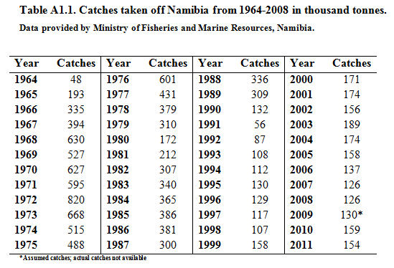
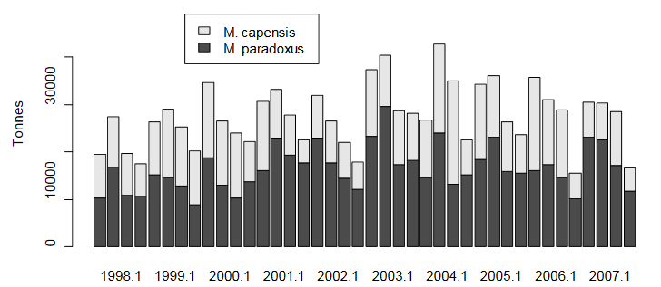
Recommendations for hake assessments in BCLME
The population structures (components / stocks)
The transboundary migrations.
Is it worthwhile?
! Some paradoxus migrates to Namibia Consider the current assessment under these two scenarios:
They all die there
Survivors return to SA as adults to eat juveniles, be fished upon and to spawn

