Slide 1
INTERNATIONAL REVIEW PANEL REPORT FOR THE 2016
INTERNATIONAL FISHERIES STOCK ASSESSMENT WORKSHOP
28 November - 2 December 2016, UCT
NON TECHNICAL SUMMARY

Slide 2


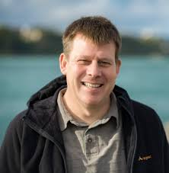


The Panel
Alistair Dunn, MPI, New Zealand
Malcolm Haddon, CSIRO, Australia
Ana Parma Cenpat, Argentina
André Punt, UW, USA
Expertise in quantitative fishery science, stock assessment, ecosystem modelling, and statistical analysis of data

Slide 3
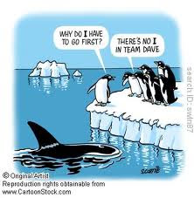
The 2016 IWS Panel
WHY DO I HAVE TO PRESENT THIS?
THEIRS NO ’I’ IN PANEL ANDRE
Topics
  African Penguins
  South African hakes
  Sardines

Slide 4
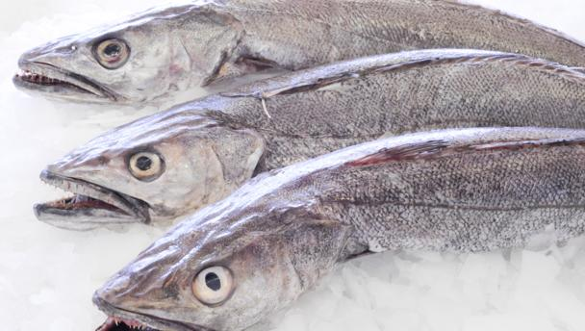
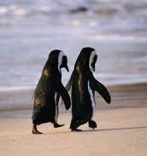
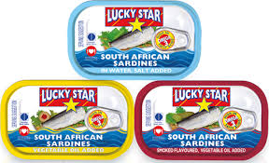
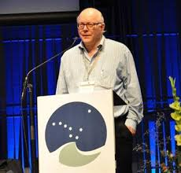
With Special Guest Stars

Slide 5
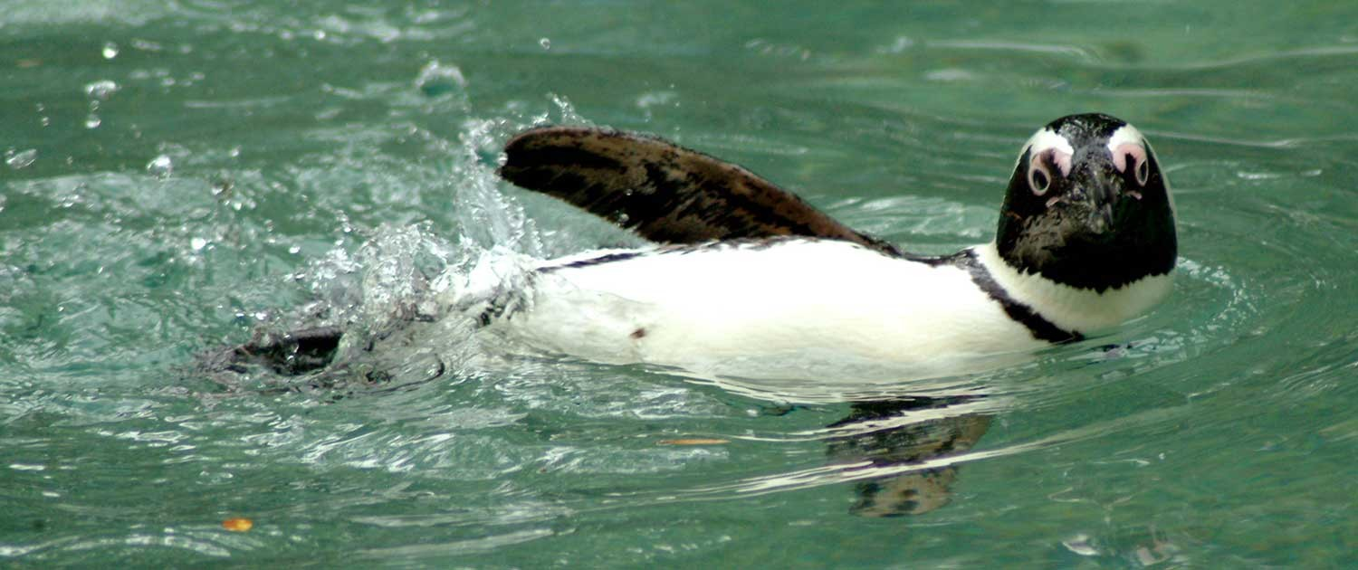
Focus of the review
1. Penguins
Island closures
  Advise on aspects of the power analyses undertaken following last year’s IWS
  Advise on implications of these analyses with respect to potential recommendations on the continuation of the island closures
  Comment on the aggregated versus non-aggregated assessment analyses
  Recommend future research priorities
Pressure model
  Advise on the utility of the penguin pressure model to inform management decisions
  Recommend future research priorities

Slide 6
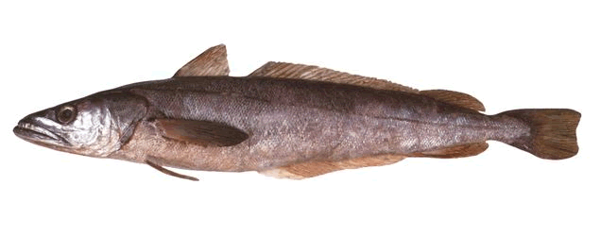
Focus of the review
2. Hake
Hake assessment
  Advise on the reliability of the assessment projections
  Advise on the OMP revision timing
Hake predation
  Review the two predation models and recommend on future research priorities

Slide 7
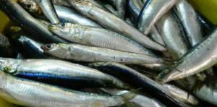
Focus of the review
3. Sardine
Stock Structure
  Advise on aspects of alternative hypotheses of stock structure
  Advise on implications of these hypotheses
  Recommend future research priorities
Review the projection framework for OMP testing
  Advise on movement hypotheses
  Advise on methods for projecting future recruitment
  Comment on aspects of the OMP specifications
  Advise on the appropriate risk specification
  Recommend future research priorities

Slide 8
Overall Comments
As in previous reviews, the Panel was impressed with the quality of information presented
The Panel thanked the participants for their hard work preparing and presenting the workshop papers, for the extra analyses undertaken during the workshop, and for the informative input provided during discussions
The Panel encouraged continuing collaboration between university, industry, eNGO, and government researchers as a means to ensure best available data and analyses are used in decision making
The Panel noted that they would have benefited from “fishery descriptions” to provide an overview of the data in the papers to assist panel members in their review
The change to specific review questions is a constructive improvement to the review process as it helped to focus discussion.

Slide 9
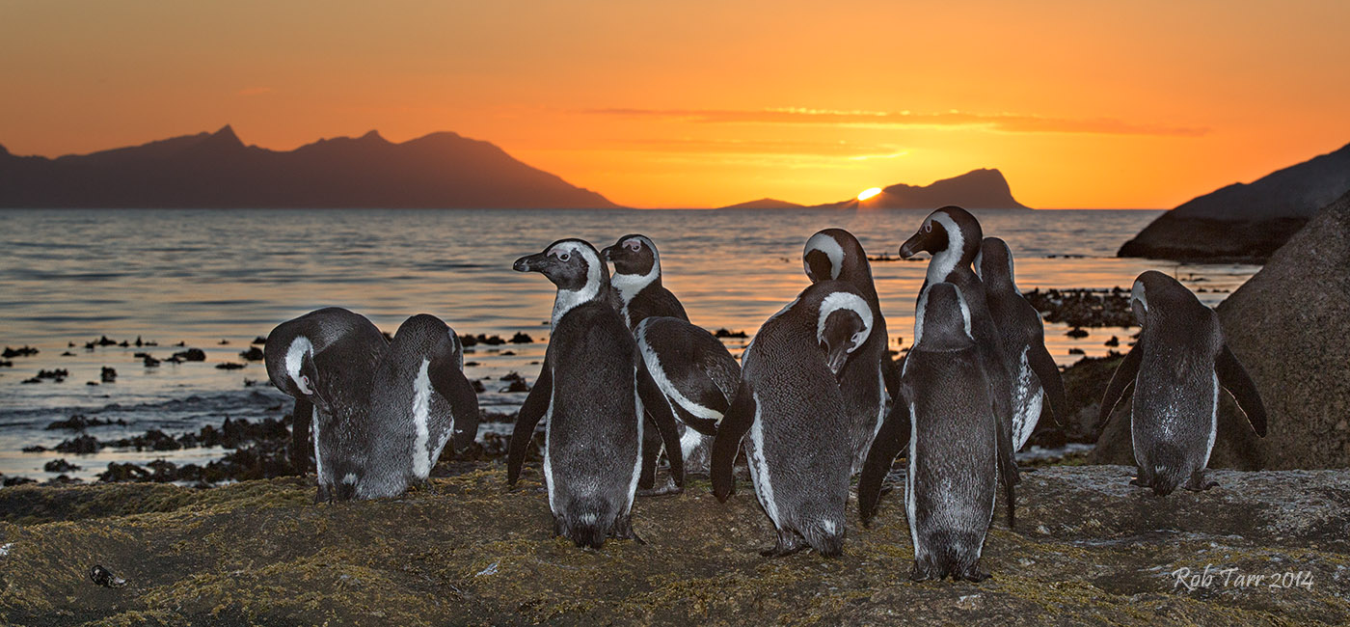
African Penguins
Robben Island

Slide 10
Background
 | Dassen | Robben | St Croix | Bird
2008 | X
2009 | X |  | X
2010 |  |  | X
2011 |  | X | X
2012 |  | X |  | X
2013 |  | X |  | X
2014 | X |  |  | X
2015 | X |  | X
2016 | X |  | X
2017 |  | X | X
2018 |  | X |  | X
2019 |  | X |  | X
2020 | X |  |  | X
2021 | X |  | X
2022 | X |  | X
2023 |  | X | X
2024 |  | X |  | X
2025 |  | X |  | X
2026 | X |  |  | X
2027 | X |  | X
2028 | X |  | X
2029 |  | X | X
2030 |  | X |  | X
2031 |  | X |  | X
2032 | X |  |  | X
Years(T) | 25 | 25 | 25 | 25
Closures | 12 | 12 | 12 | 12
(T from 2009) |  |  | 24 | 24
The objectives from the 2010 Panel report were “to maximize the probability of determining whether pelagic fishing near colonies has an impact on penguins”

Slide 11
Issues for penguins
Does fishing near islands have a biologically important impact on penguin reproductive success
Issues for the panel
Detection of an island closure effect
  Advise on aspects of the power analyses undertaken following last year’s IWS
  Advise on implications of these analyses with respect to potential recommendations on the continuation of the island closures
  Comment on the aggregated versus non-aggregated assessment analyses
  Recommend future research priorities
Pressure model
  Advise on the utility of the penguin pressure model to inform management decisions
  Recommend future research priorities

Slide 12
Detection of closure effect
The work conducted during 2016 focused on implementing the recommendations related to evaluating the statistical power to detect biologically meaningful impacts that may be caused by the fishery
It had not proved possible to fully implement the recommendations related to evaluating power made by the 2015 IWS
However, sufficient progress has been made that it is possible to identify for which combinations of response variable and island it is possible to conclude there is a fishery effect and for which there is no fishery effect
The power analysis should also assist management to identify the response variable and island combinations for which no conclusions could be drawn even given continued collection of the data concerned over 20 more years
The Panel developed an algorithm for interpreting the results from the experiment as they stand today and from the power analysis

Slide 13
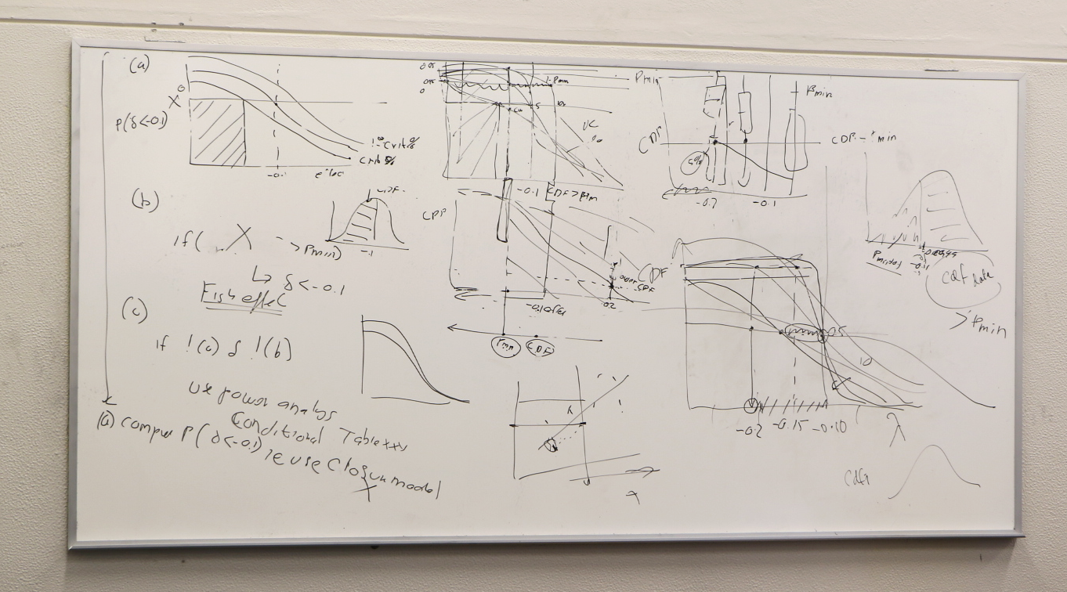
Perhaps we should COVER this qualitatively!

Slide 14
Detection of closure effect
The Panel proposed the following algorithm for interpreting the results from the experiment as they stand today and from the power analysis:
  Consider only the closure model (and analyses based on aggregated data) – future work could consider other models and disaggregated data
  Do the data collected to date allow us to already conclude there is fishery effect that is biologically important?
  If not, are there levels of fishery impact that we can reject as plausible given the currently available data and the power to detect fishery effects?
  Given the outcomes of step 2, examine the results of the power analysis to assess the benefits of future years of experimental manipulation of fishing to be able to detect those effects?

Slide 15
The Penguin Pressure model
Neither the penguin pressure model nor the power analysis and associated island closure experiment can be used to conclude if the decline in the numbers of African penguins is primarily due to fishing near offshore islands
The Panel recalled that several previous IWS Panels had highlighted the need to implement a comprehensive research program that quantifies the core reasons for the reduction in penguin population numbers

Slide 16
The Penguin Pressure model
The penguin pressure model provides a way to explore the implications of a large range of potential factors that may impact penguins
This model can explore the potential implications of more factors than the model of Robinson et al. (2015)
However, the conclusions that can be drawn can only be considered in a strategic rather than a tactical sense
When used in this context, the penguin pressure model constitutes an important tool in assisting with research planning, development of monitoring strategies, and investigating potential management interventions

Slide 17
Hake assessment
The Panel reviewed the development of models that account for spatial structure and inter-specific predation and cannibalism
The GeoPop model identified that M. capensis and M. paradoxus off the coasts of South Africa and Namibia as spatially linked to some extent
The Panel strongly recommends that efforts be made to allow assessment analysts to have access to data from all the countries concerned to maximize the opportunities for progress on assessment models

Slide 18
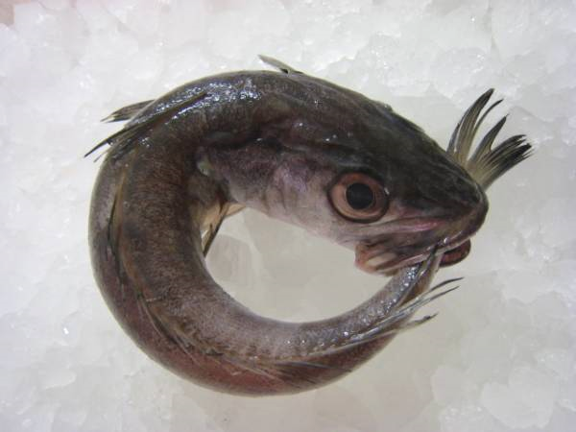
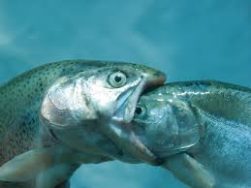
Hake predation
The current assessment model does not include the impact of changes over of time of hake biomass on predation rates:
M. capensis eats M. capensis
M. capensis eats M. paradoxus
M. paradoxus eats M. paradoxus

Slide 19
Hake predation
The development of the predation model for the Cape hakes is an important, but challenging scientific endeavour
The 2016 IWS reviewed two potential predation models
The two models provide substantially different estimates for the current status of the M. paradoxus resource
The reasons for this need to be understood before a predation model can be used for management purposes
The Panel made a number of recommendations that may assist in the development of a hake predation model

Slide 20
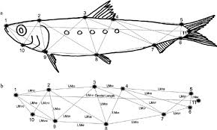
Sardine - stock structure

Slide 21
Sardine - projection framework for OMP testing
The Operational Management Procedure (OMP) for the South African sardine is scheduled for revision during 2017
The Panel reviewed aspects of how candidate OMPs will be evaluated, with a focus on the operating models that represent the hypotheses regarding the population dynamics and stock structure of sardine off South Africa. Issues considered included:
  how much does spawning on the south coast impact recruitment to the west coast
  how to account for future movement from the west to south coasts
  spatial management
  risk criteria for interpreting projection results

Slide 22
Sardine - stock structure and movement
There is no evidence from the (preliminary) genetic study of independent stocks off the west and south coasts (and even the east coast)
In the short-term, the outputs from the hydrodynamic model should be used obtain estimates of transportation rates from the south coast to the west coast, after these have been weighted by monthly GSI values
The current hydrodynamic model was based on several assumptions that need further exploration
The Panel supports the proposed additional work on the oceanographic model, and highlights the importance of adding more biological realism to the individual based model, for example in the form of accounting for diurnal vertical movement of larvae

Slide 23

Questions?

Slide 24
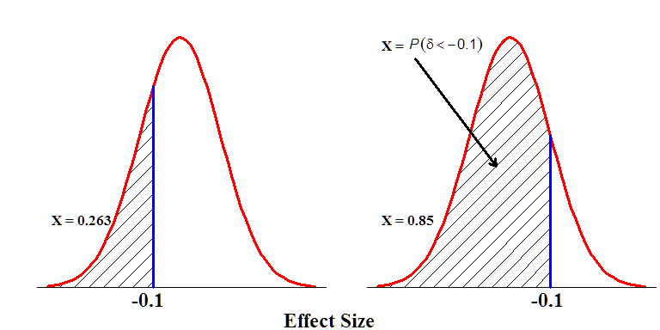

Slide 25
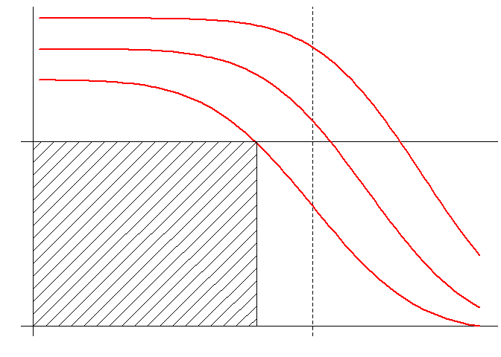
(b)
P(δ < -0.1)
X
1 - Crit%
Crit%
-0.1

