Slide 1



JABBA-Select: Performance evaluation of JABBA-Select against and an age-structured simulator and estimation model
Henning Winker*
MARAM International Stock Assessment Workshop
2017
*Henning.winker@gmail.com

Slide 2
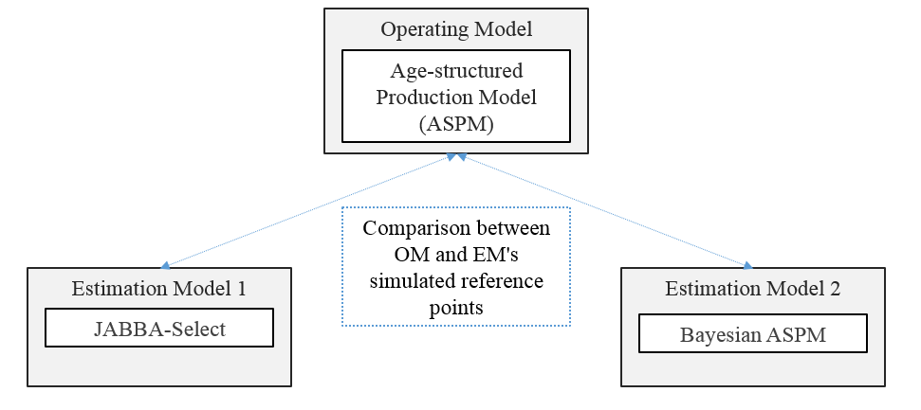
Simulation experiment

Slide 3
Simulation experiment
The simulation follows four general steps:
Development of the OM, and use of the OM to generate datasets. Resulting parameter estimates from the OM are taken as the ‘true' values for the simulation.
The estimation models (EMs) are fit to each generated dataset.
Estimates of relevant quantities from each EM are compared with their “true” values.
Performance evaluation of EMs against the simulated (known) stock status values

Slide 4
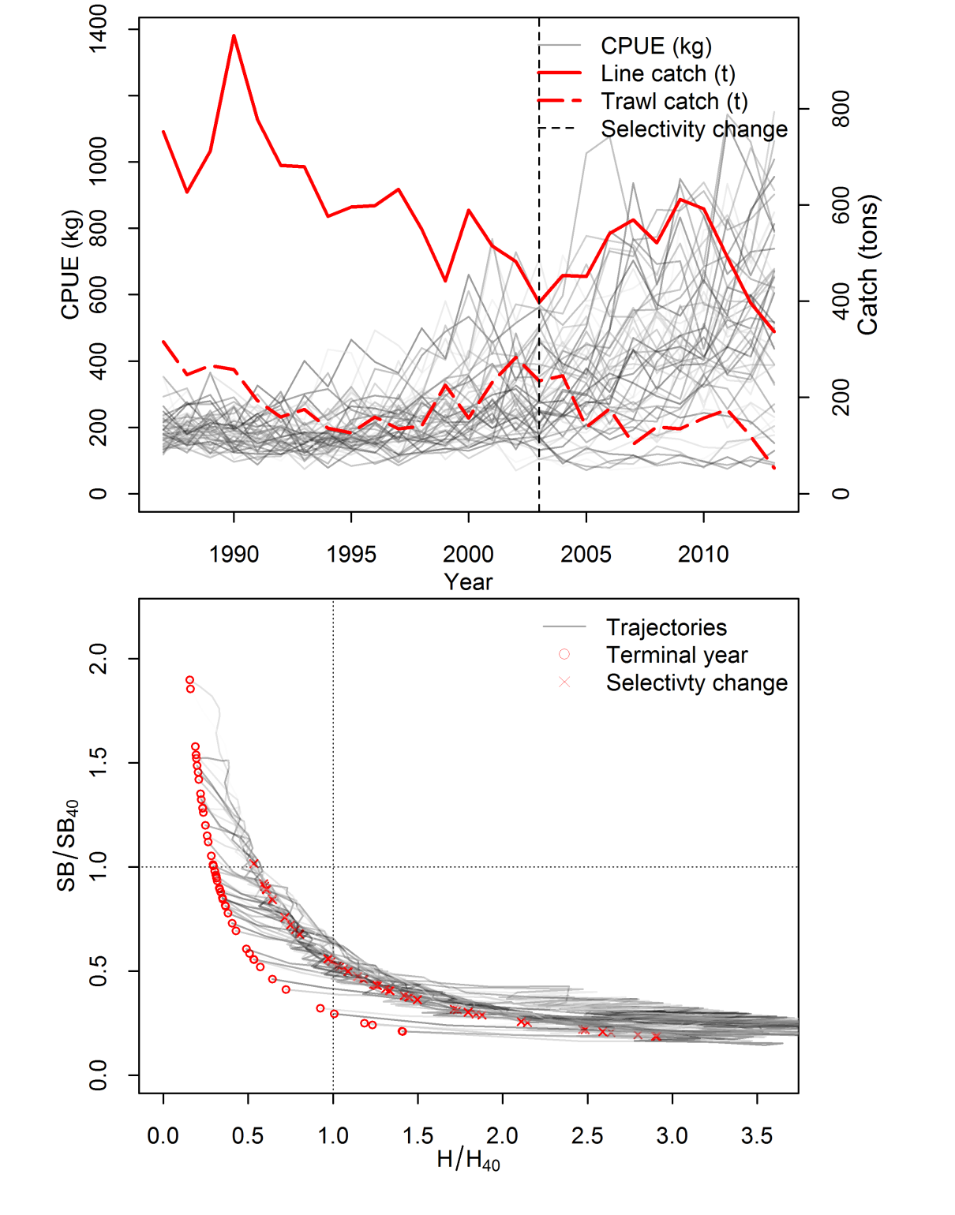

Operating Model for silver kob

Slide 5
Scenarios
Base-Case: All input parameters correctly specified
  JABBA-Select: priors for HMSY and m from random deviates of M and h
  BASPM: M prior and h fixed.
‘how M’: natural mortality M misspecified
‘high M’: natural mortality M misspecified
‘low h’: ‘steepness’ h misspecified
‘high h’: ‘steepness’ h misspecified

Slide 6
Prior specifications

Slide 8
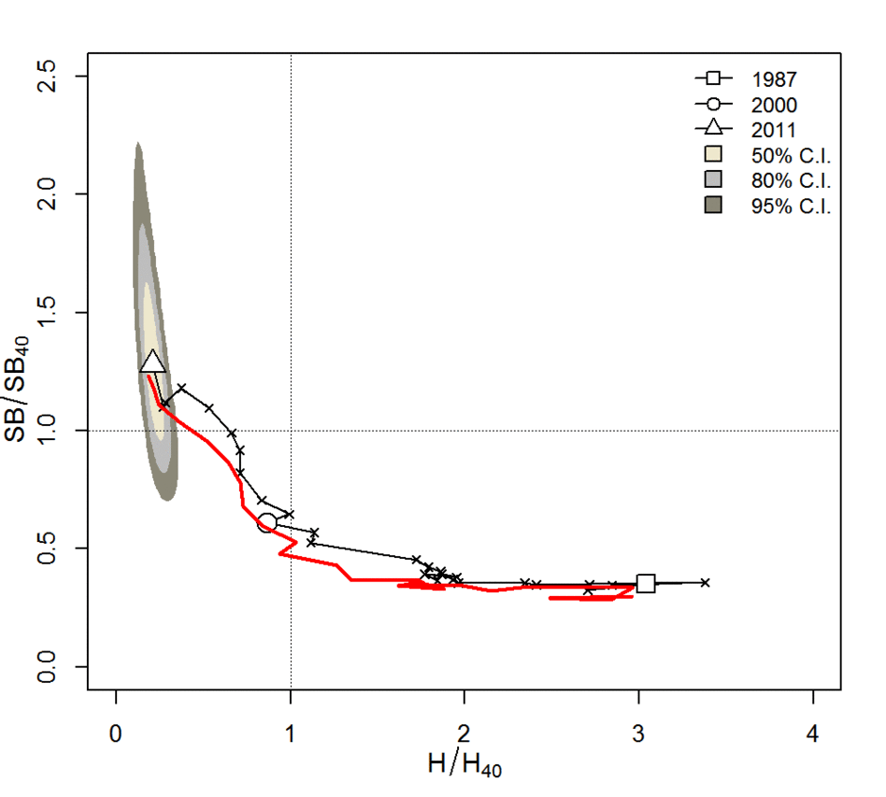
JABBA-Select demo runs 1-10

Slide 9
Performance Evaluation

Slide 10
Control OM to EM base-case run

Slide 11
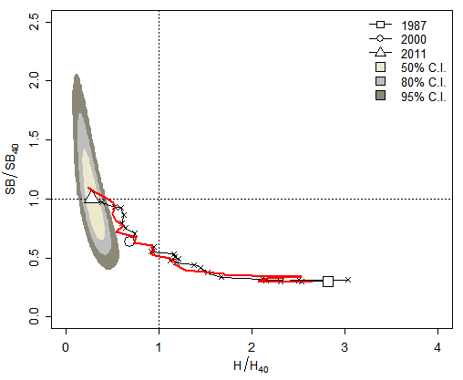
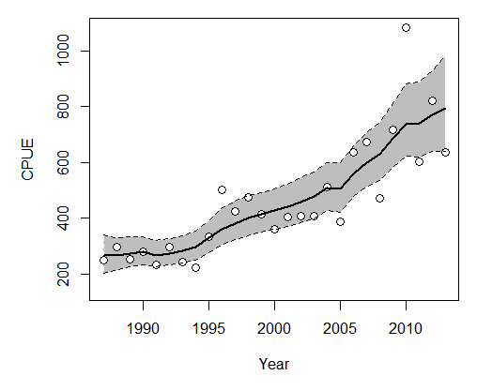
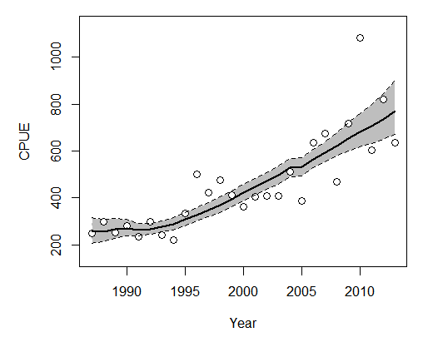
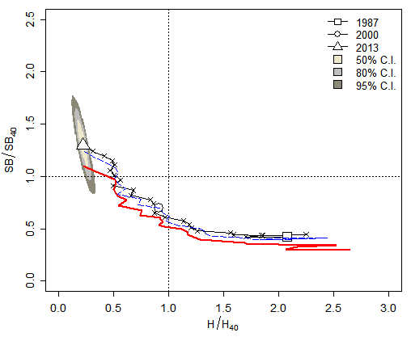
Example run inspection
BASPM

Slide 14
Concluding remarks
JABBA-Select performed better than the BASPM in terms of the adequate representation of uncertainty and robustness to input prior misspecifications. `
JABBA-Select was able to approximate selectivity-depend reference points H_{40,s} and Y_{40,s} and to separate the absolute quantity of SB₄₀ from the biomass aggregated abundance information. This could assist to make ASM and SPM stock status results more comparable.
The better performance of the JABBA-Select base-case may partially attributed to the advantage of accounting for process error in the JABBA-Select, versus the assumption of deterministic recruitment in the BASPM.
The results of this simulation experiment reiterate the difficulties of estimating the key parameters M and h and related FRPs in data-limited age-structured assessments
JABBA-Select can provide a more parsimonious solution than conventional ASPMs in similar situations by providing a means to better account process and parameter uncertainty.

Slide 15

The End Part II…Thank you

