Slide 1
MARAM/IWS/2017/Sardine/P9
Use of the relationship between long term catch and biomass to establish a management target

Slide 2
This submission relates to the following question in MARAM_IWS_2017_Sardine_P1:
“Can one dispense with risk and simply consider catch over the medium-to-long term as sufficient to incorporate any negative consequences of undue depletion of the population? (This because future catches should be reduced if the stock is depleted such that future recruitment drops.)”
Conventionally for South African sardine, biological risk has been defined as the probability of biomass falling below a threshold value over a 20-year time horizon. Given the high degree of recruitment variability, standard SY vs B relationships have not been used to establish a reference point for management. However, the main risk due to low biomass is low recruitment and hence low catch. The extent of this is already explicitly quantified in the relevant OM. Transients due to initial conditions are rapidly eliminated in forward simulations. Thus average catch versus average biomass over the 20 year time horizon can serve as a proxy for SY vs B, and plots of this “SY” vs “B” for B in (0,K) could help to establish a meaningful target reference point for resource management. The time horizon of 20 years can be extended if it is felt that the initial conditions are influential, or results can be limited to, say, 75% of the time horizon.

Slide 3
1. Conventionally the relationship between SY and B drives choice of management target
2. But for sardine we don’t consider SY vs B for the selection of management targets.
3. Why not? Instead, we consider risk, measured as p(biomass) < threshold. Variability, uncertainty.
4. However, as we increase F, biomass < threshold more frequently. This leads to lower catches, as is quantified by the OM.

Slide 4
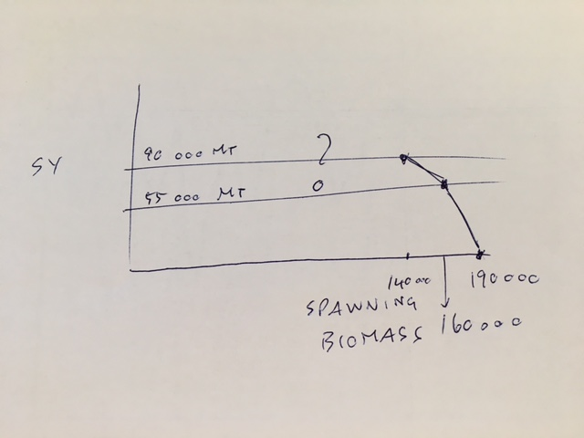
5. Sardine system has little memory, hence in projections for given a particular CMP, spawning biomass and catch rapidly reaches a “stochastic equilibrium”. Easy to define long term average catch (“SY”) and spawning biomass (“equilibrium biomass”).
6. Plot “sustainable yield” versus “biomass” for a range on a particular OMP tuning parameter values.

Slide 5
7. Spin-off, allows for fair comparison of CMPs when both “SY” and “B” change – i.e. plot SY/B relationship on the same set of axes for a comparison.
8. Are we not still far to the right of MSYL, what does the graph look like? What would be the appropriate management target, balance between biological risk and economic benefit.

