Slide 1




Investigation into the process error in biomass dynamics of fishes
Henning Winker*
MARAM International Stock Assessment Workshop 2018
*Henning.winker@gmail.com

Slide 2
Motivation
2017 IWS Panel recommendations:
Sensitivity should be explored to the catch term not being affected [by the timing of process error].
Ideally, the posterior for the process error variance [on the biomass] should be comparable to the variation in spawning biomass obtained by projecting the age-structured model forward for many years without catches, but with process error.

Slide 3
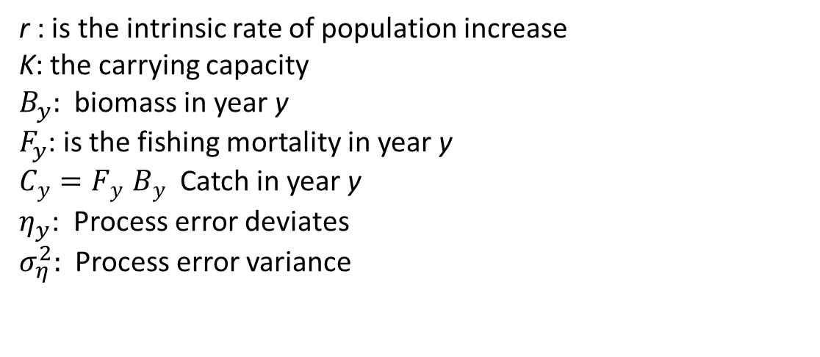

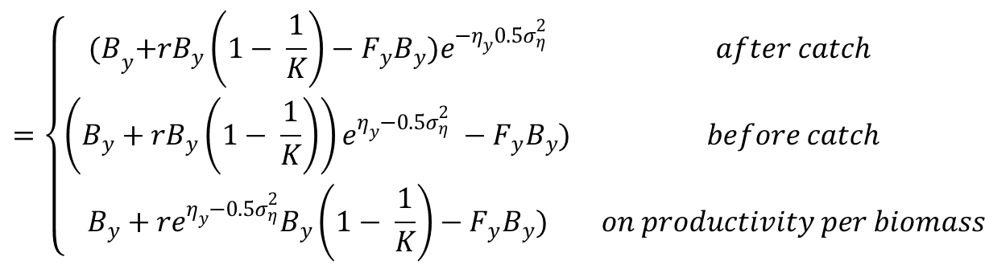
1. Evaluating sensitivity to the location of the process error
Schaefer Surplus Production model:
$$=\left\{\begin{matrix}{(B}_{y}+rB_{y}\left(1− \frac{1}{K}\right)−F_{y}B_{y})e^{{−η}_{y}{0.5σ}_{η}^{2}} & after catch \\ \left(B_{y}+rB_{y}\left(1− \frac{1}{K}\right)\right)e^{η_{y}−{0.5σ}_{η}^{2}} −F_{y}B_{y}) & before catch \\ B_{y}+re^{η_{y}{−0.5σ}_{η}^{2}}B_{y}\left(1− \frac{1}{K}\right)−F_{y}B_{y}) & on productivity per biomass\end{matrix}\right.$$
$$B_{y+1}$$
r : is the intrinsic rate of population increase
K: the carrying capacity
$B_{y}:$ biomass in year y
$F_{y}$: is the fishing mortality in year y
$C_{y}{=F}_{y}B_{y}$ Catch in year y
$η_{y}$: Process error deviates
$σ_{η}^{2}:$ Process error variance

Slide 4
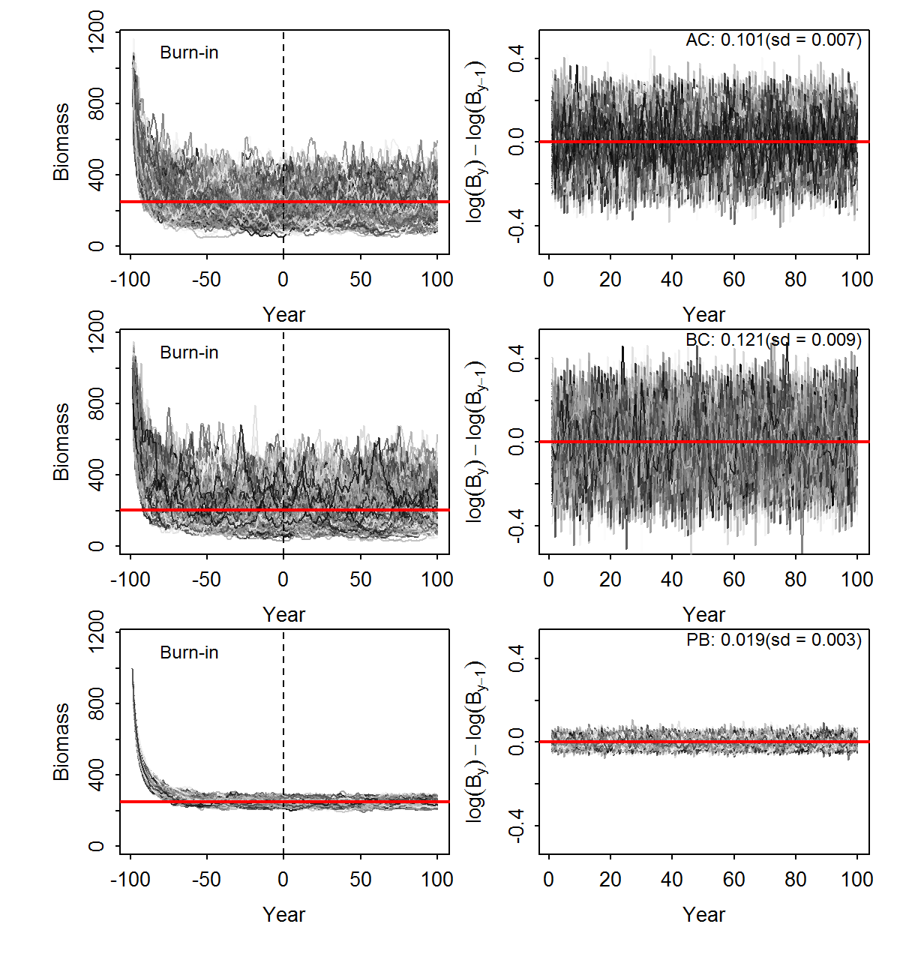
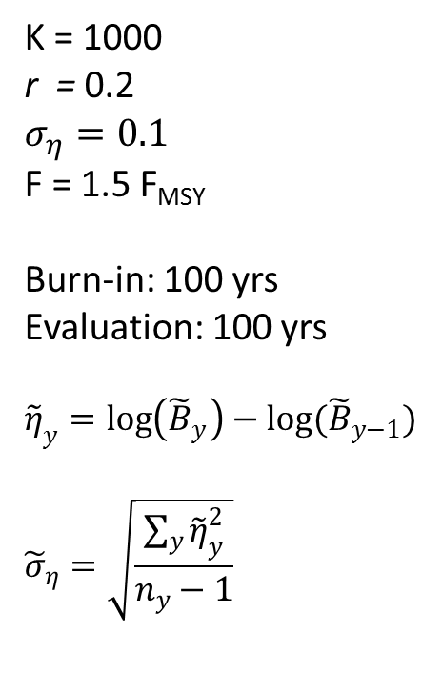
Simulation trial
K = 1000
r = 0.2
$$σ_{η}^{}=0.1$$
F = 1.5 F_{MSY}
Burn-in: 100 yrs
Evaluation: 100 yrs
$${\tilde{η}}_{y}=\log\left({\tilde{B}}_{y}\right)−log({\tilde{B}}_{y−1})$$
$${\tilde{σ}}_{η}=\sqrt{\frac{\sum_{y}{{\tilde{η}}_{y}^{2}}}{n_{y}−1}}$$

Slide 5
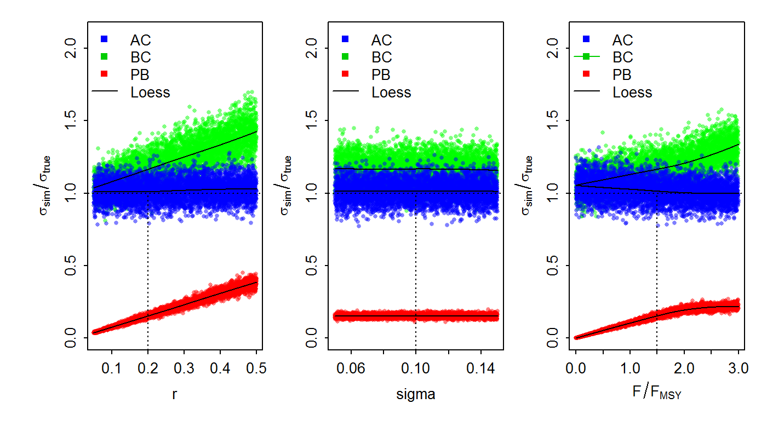
Variations

Slide 6
Summary: Experiment I
After Catch (AC):
  Enables approximating the process error from the simulated biomass trajectories under a constant F prescription, but positive bias (≤10%) towards F = 0
  conveniently allows isolating the natural variation in the biomass under constant fishing mortality + burnin
Before Catch (BC):
  Positive bias in the variation of the simulated biomass.
  Likely “mechanistic” measurement of log(B_{y})- log(B_{y-1})
  Includes the positive expectation about the surplus production and the associated variance.
On productivity per biomass (PB):
  Close to less than an order of magnitude of biomass variation when compared to the AC and BC models and ‘true’ input value.
  Unlikely to be suitable for deducting the process variance component that is attributable to recruitment variation.
  More suitable to estimate systematic changes in average stock’s productivity, such as changes in somatic growth, maturation or predation pressure.
  Alternative to treating variations about r as ‘white noise’ , could be a random walk or AR1 formulations to potentially improve the ability of isolate the though after trends from the recruitment signal.

Slide 7





2. Predicting process error from age-structured simulations
Multivariate hierarchical model of FishBase
RAMs S-R Database
Integrate Analysis
FishLife2.0
$${\overline{y}}_{{spec}_{ }}=\left\{L_{∞},κ,M,a_{mat},a_{max},h,ρ,σ_{R}\right\}$$
$${Cov}_{{spec}_{ }}=\left\{L_{∞},κ,M,a_{mat},a_{max},h,ρ,σ_{R}\right\}$$
$${\tilde{y}}_{{spec}_{ }}\sim MVN({\hat{y}}_{{spec}_{ },}{Cov}_{{spec}_{ }})$$
Random generator
Age-structured Simulator
Biomass
Trajectories
Process error
$$σ_{η}^{}$$
AR1
$$ρ$$

Slide 8

Predictive Life History Model:
R Package FishLife2.0
James Thorson (in press)

Slide 9
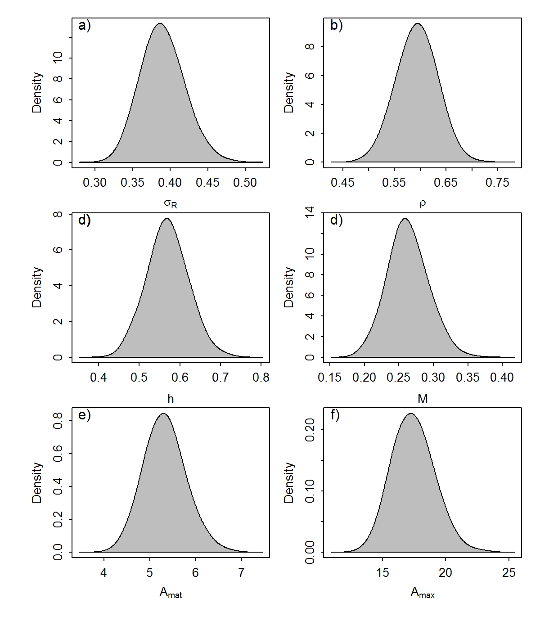
FishLife2.0: Merluccius paradoxus

Slide 10
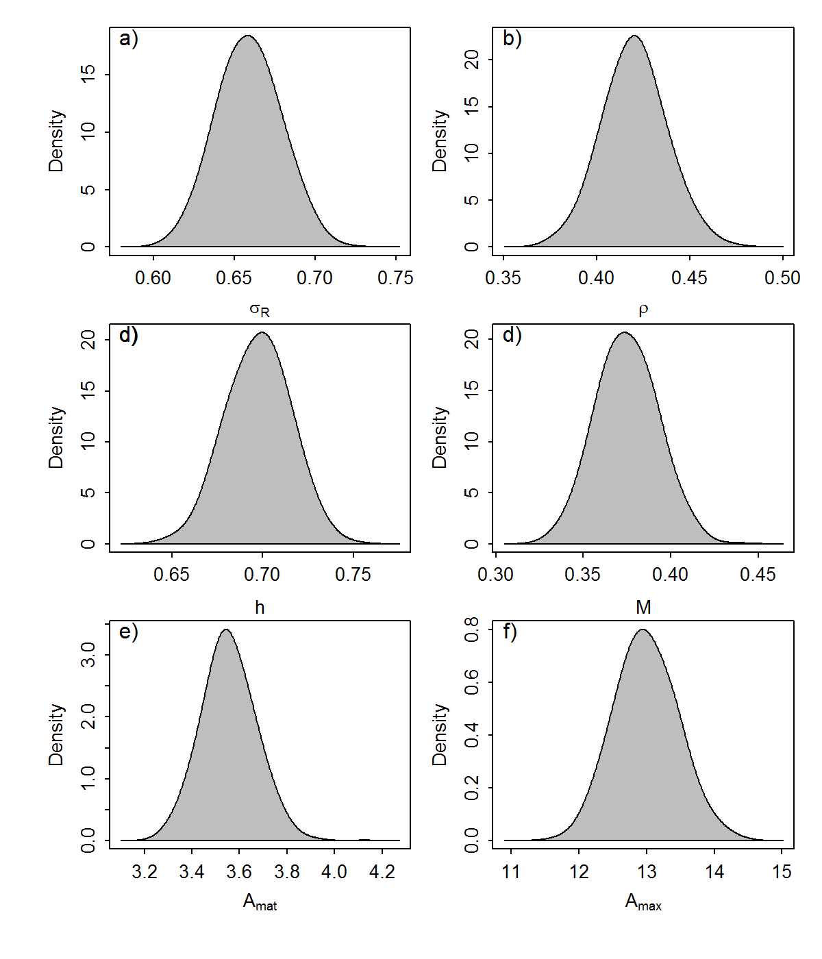
FishLife2.0: Sardinops sagax

Slide 11
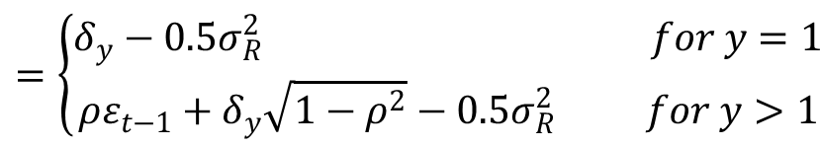

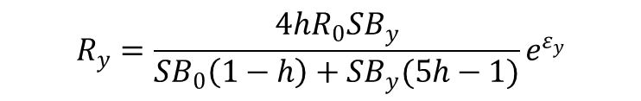
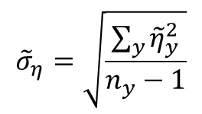


Simulating Recruitment Variation
B&H S-R function
$$R_{y}=\frac{4hR_{0}SB_{y}}{{SB}_{0}\left(1−h\right)+SB_{y}(5h−1)}e^{ε_{y}}$$
Recruitment deviates
$$=\left\{\begin{aligned}δ_{y}−0.5σ_{R}^{2} for y=1 \\ ρε_{t−1}+δ_{y}\sqrt{1−ρ^{2}}−0.5σ_{R}^{2} for y>1\end{aligned}\right.$$
$$ε_{y}$$
Simulated biomass process error deviates
Process error
$${\tilde{σ}}_{η}=\sqrt{\frac{\sum_{y}{{\tilde{η}}_{y}^{2}}}{n_{y}−1}}$$
$${\tilde{η}}_{y}=\log\left(SB_{y}\right)−\log\left(SB_{y−1}\right)$$
AR1 $: ρ=Cor(\log\left(SBy\right))$

Slide 12
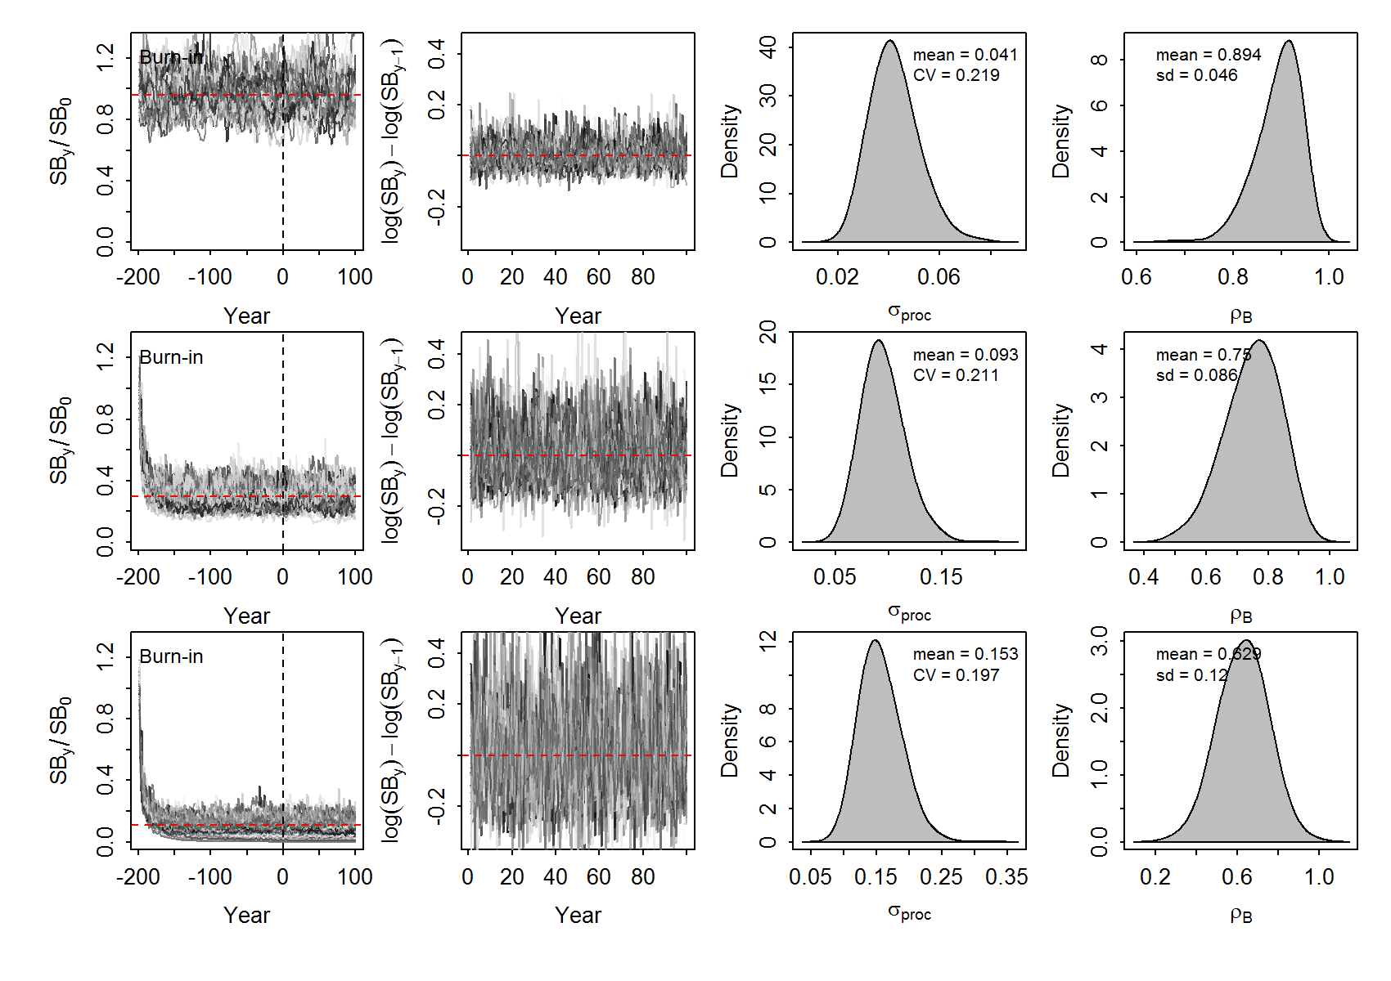
Deep-water hake: Merluccius paradoxus

Slide 13
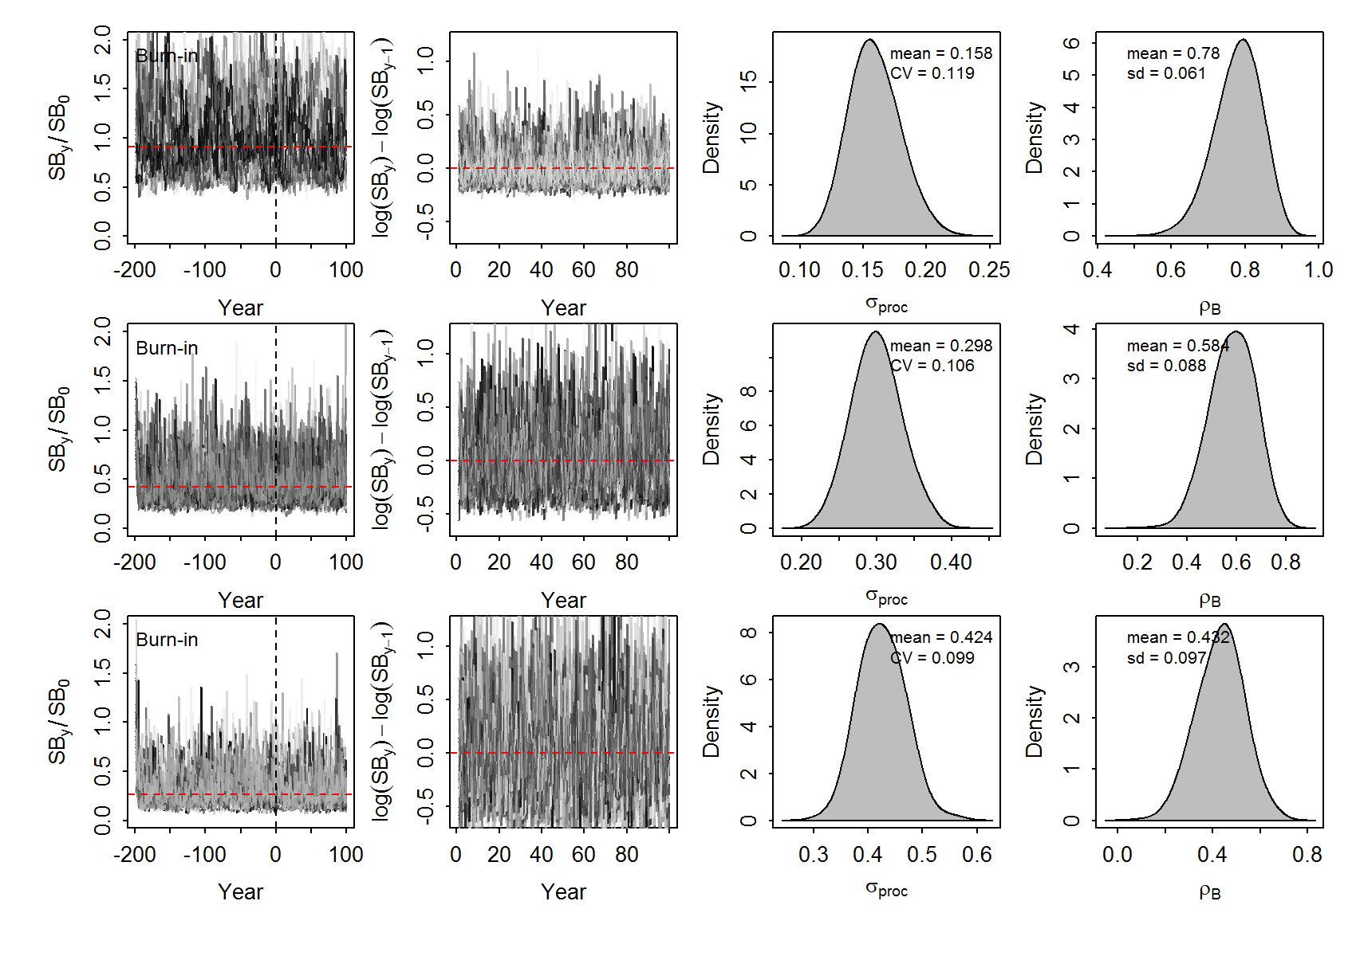
Pilchard: Sardinops sagax

Slide 14
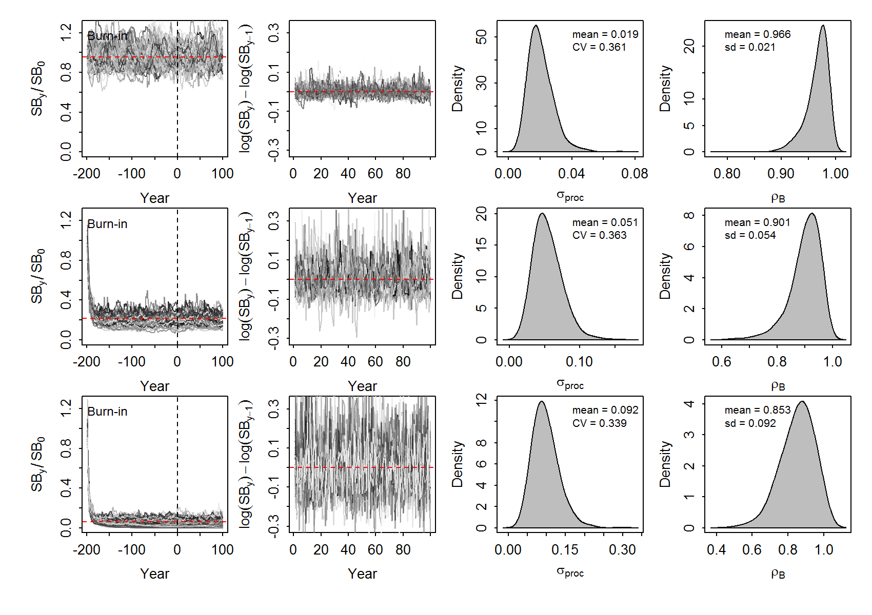
Silver kob: Argyrosomus inodorus

Slide 15


Summary
Process Error $σ_{η}$ of Spawning Biomass
Auto-correlation $ρ$ of Spawning Biomass

Slide 16
3. Process error and posterior diagnostics (IWS/2018/Linefish_P2 & P3):
The stochastic age-structured simulator, which was suggested as a diagnostic tool for process error variance estimate (E.1), infers the process error from an unfished state.
However, the simulation results in P3 indicate that the fisheries-induced truncation of the population is likely to inflate variation in the log-biomass variation at low abundance.
Provide directions for future research towards generalizing this approach to inform process error prior parameterization and process error diagnostic tests.

Slide 17

Thank You

