Slide 1






JABBA-Select: Simulation-Testing
Henning Winker*, Felipe Carvalho, James Thorson, Denham Parker, Sven Kerwath, Tony Booth, Laurie Kell
MARAM International Stock Assessment Workshop 2018
*Henning.winker@gmail.com

Slide 2
Simulation Evaluation Framework
Operating Model (OM):
Stochastic Age-Structured Simulator
Estimation Models (EMs):
‘Naïve’ Schaefer model (in JABBA)
JABBA-Select
Deterministic ASPM (in TMB)
Stochastic ASPM (in TMB)

Slide 3
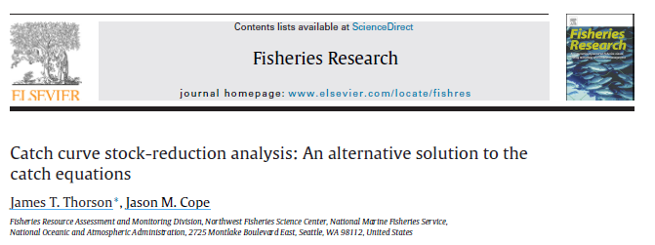
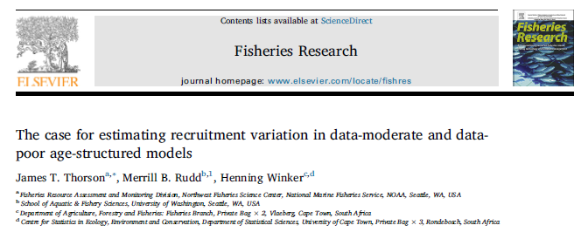
Age-Structured Simulation Evaluation Framework
Building on CCSRA package with R/TMB interface

Slide 4
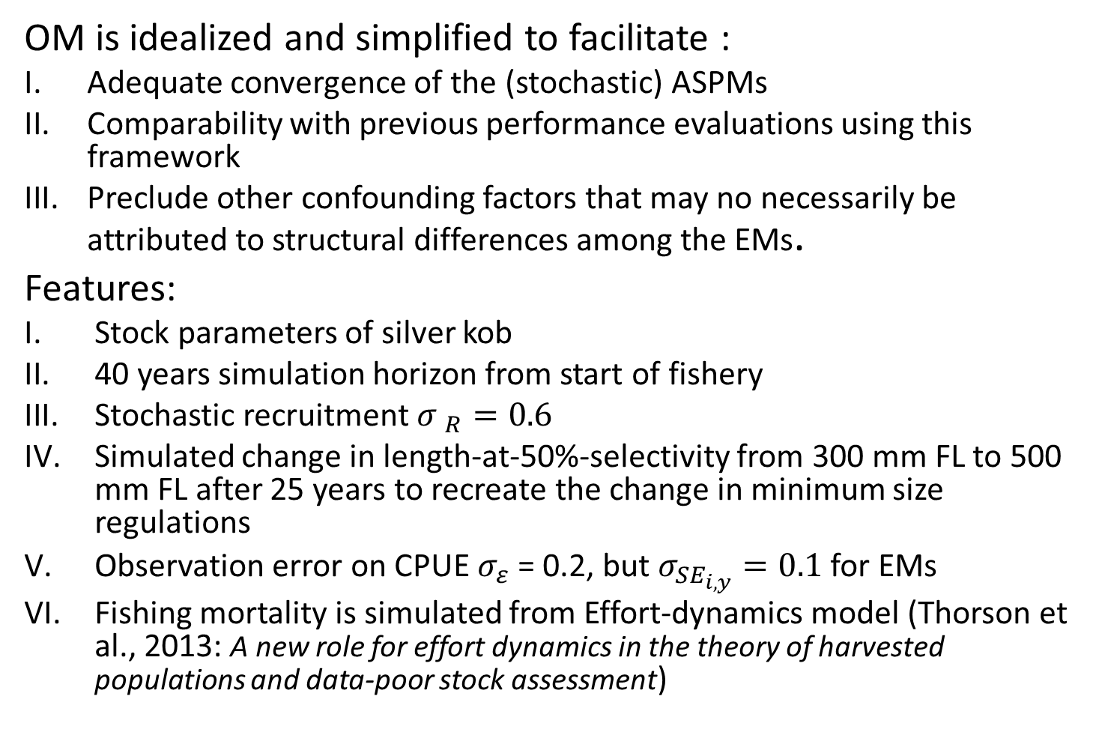
Operating Model
OM is idealized and simplified to facilitate :
Adequate convergence of the (stochastic) ASPMs
Comparability with previous performance evaluations using this framework
Preclude other confounding factors that may no necessarily be attributed to structural differences among the EMs.
Features:
Stock parameters of silver kob
40 years simulation horizon from start of fishery
Stochastic recruitment ${σ }_{R}=0.6$
Simulated change in length-at-50%-selectivity from 300 mm FL to 500 mm FL after 25 years to recreate the change in minimum size regulations
Observation error on CPUE $σ_{ε}$ = 0.2, but $σ_{{SE}_{i,y}}=0.1$ for EMs
Fishing mortality is simulated from Effort-dynamics model (Thorson et al., 2013: A new role for effort dynamics in the theory of harvested populations and data-poor stock assessment)

Slide 5
Simulated age-structured dynamics (20 reps)
Selectivity
change

Slide 6
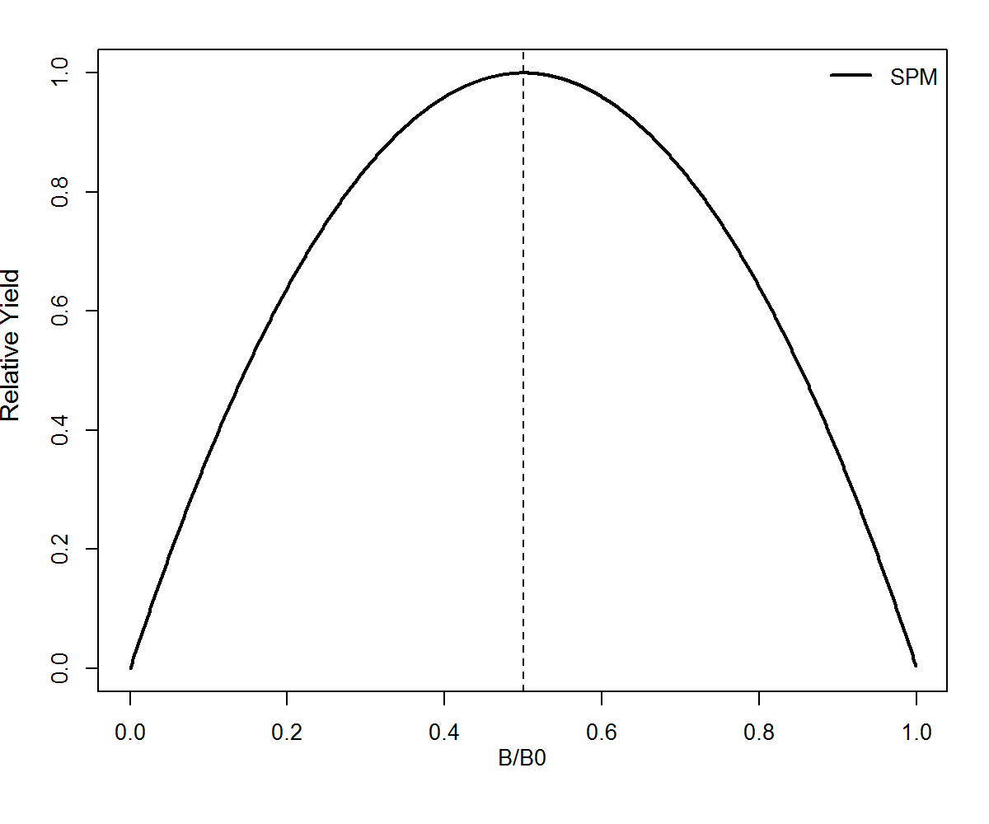
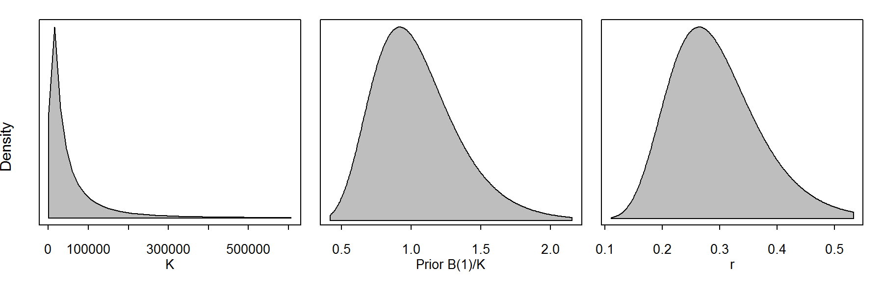
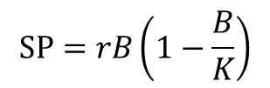
1. EM: Schaefer Model
Implemented in JABBA
r prior generated from Leslie matrix using Monte-Carlo simulations (McAllister et al. 2001)
This approach ignores selectivity on r
$$SP=rB\left(1−\frac{B}{K}\right)$$

Slide 7
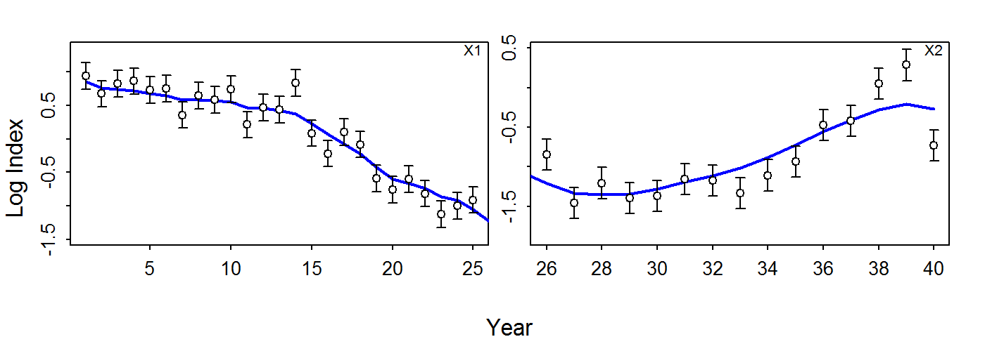
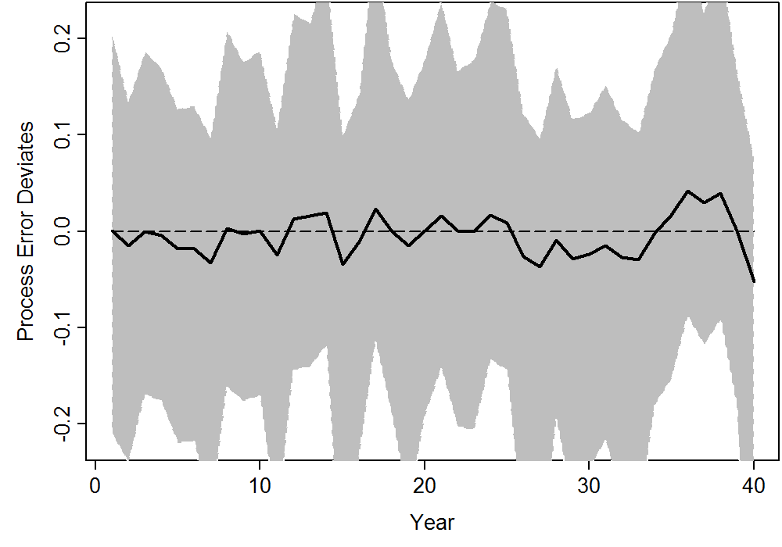
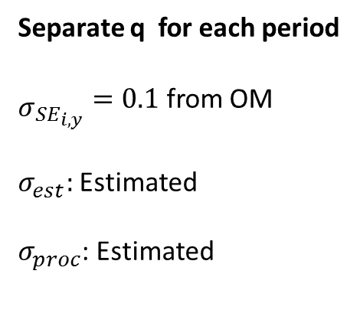
1. EM: Schaefer Model
Separate q for each period
${\begin{aligned} \\ σ\end{aligned}}_{{SE}_{i,y}}=0.1$ from OM
$σ_{est}:$ Estimated
$σ_{proc}$: Estimated

Slide 8
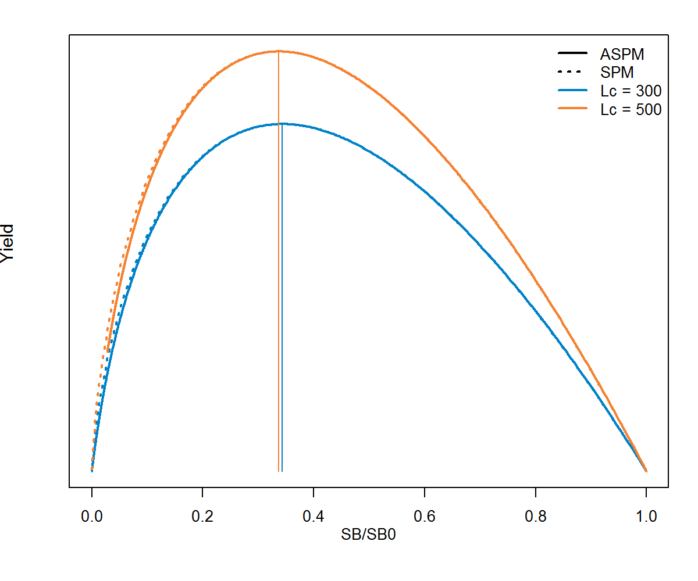
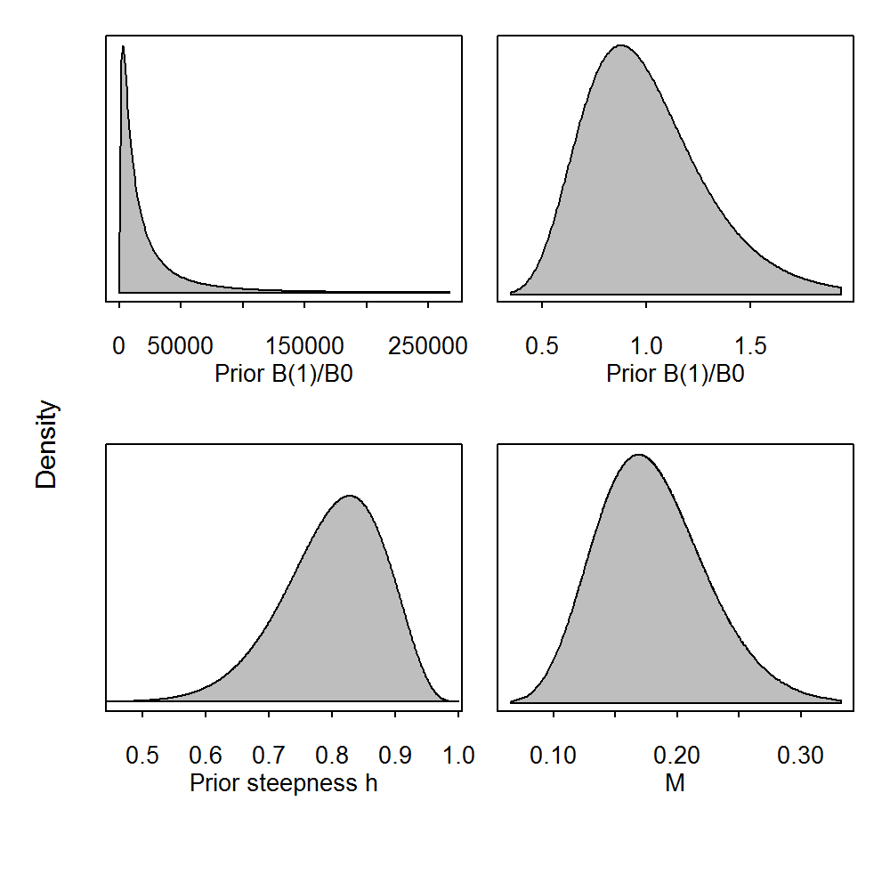
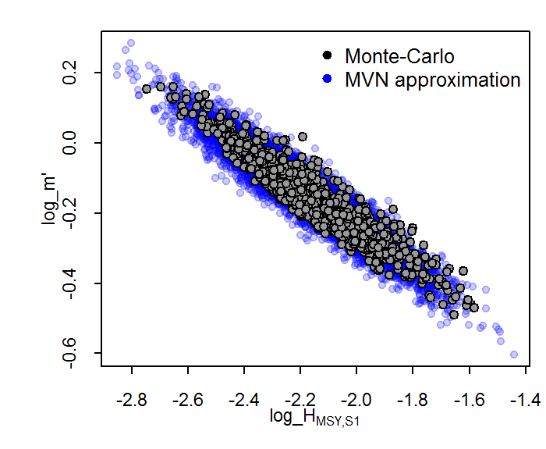
2. EM: JABBA-Select

Slide 9
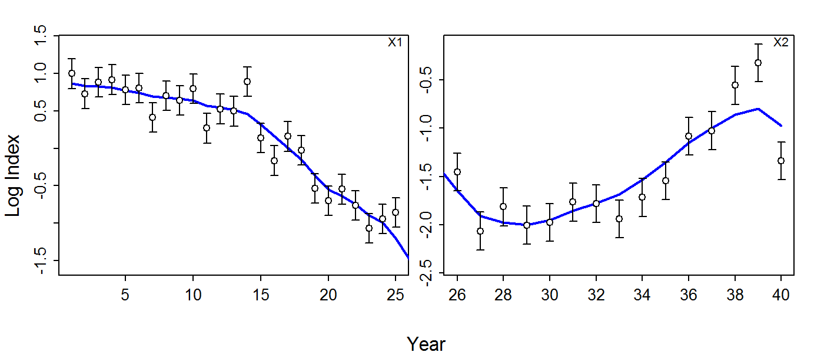
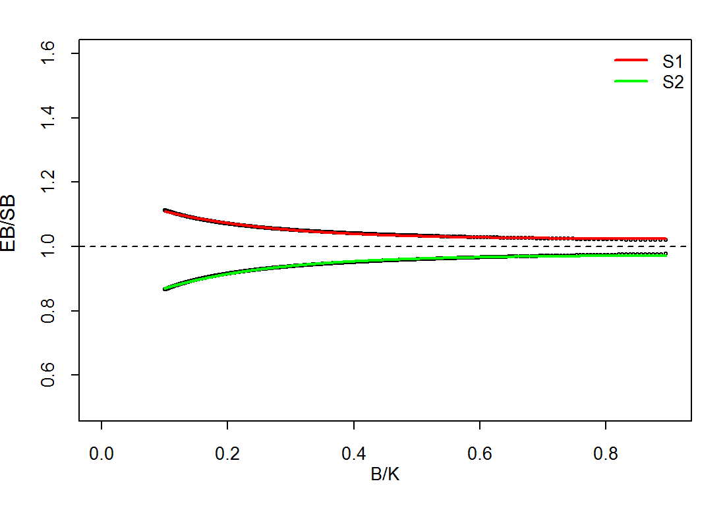
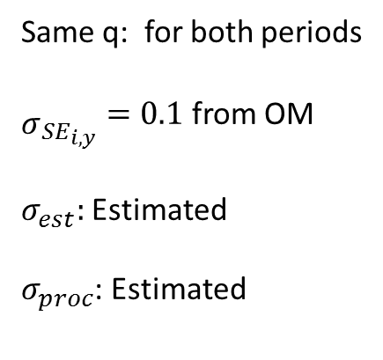
2. EM: JABBA-Select
Same q: for both periods
${\begin{aligned} \\ σ\end{aligned}}_{{SE}_{i,y}}=0.1$ from OM
$σ_{est}:$ Estimated
$σ_{proc}$: Estimated
Selectivity fixed to ‘true’ value of selectivity curve

Slide 10
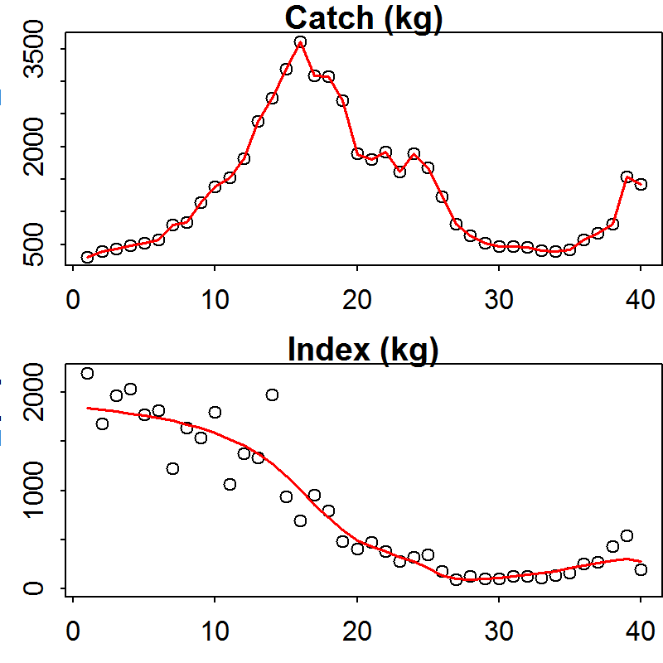
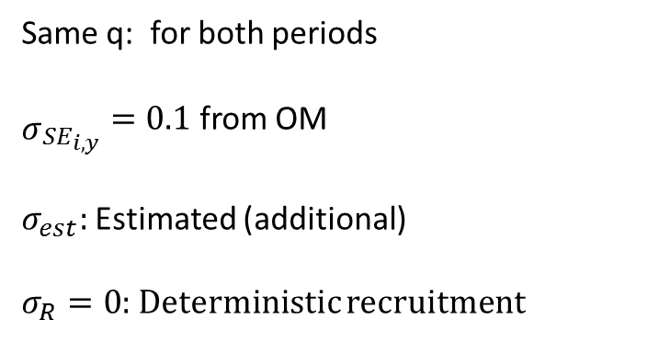
3. EM: Deterministic ASPM (TMB)
Same q: for both periods
${\begin{aligned} \\ σ\end{aligned}}_{{SE}_{i,y}}=0.1$ from OM
$σ_{est}:$ Estimated (additional)
$σ_{R}=0$: Deterministic recruitment
Common priors to JABBA-Select
M: Estimable (Prior as JABBA-Select)
Growth, Maturity, Selectivity and steepness h
Fixed to ‘true’ values

Slide 11
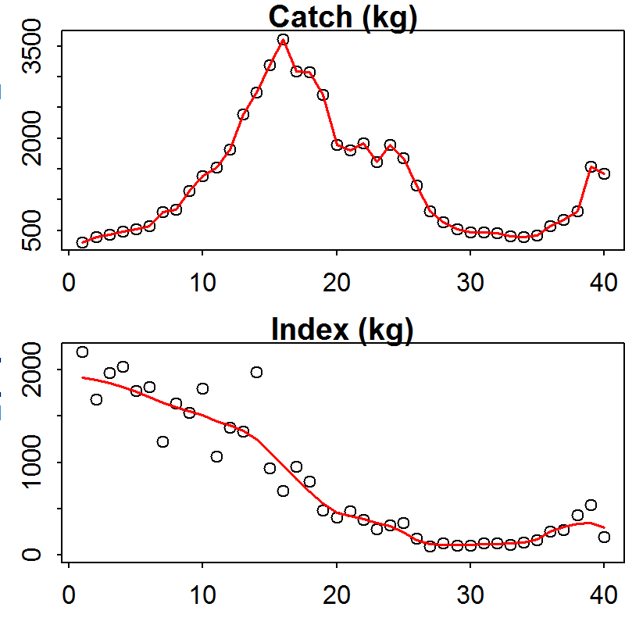
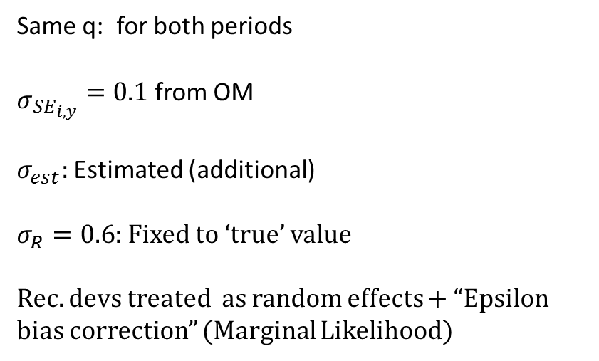
4. EM: Stochastic ASPM (TMB)
Same q: for both periods
${\begin{aligned} \\ σ\end{aligned}}_{{SE}_{i,y}}=0.1$ from OM
$σ_{est}:$ Estimated (additional)
$σ_{R}=0.6$: Fixed to ‘true’ value
Rec. devs treated as random effects + “Epsilon bias correction” (Marginal Likelihood)
Common priors to JABBA-Select
M: Estimable (Prior as JABBA-Select)
Growth, Maturity, Selectivity and steepness h
Fixed to ‘true’ values

Slide 12

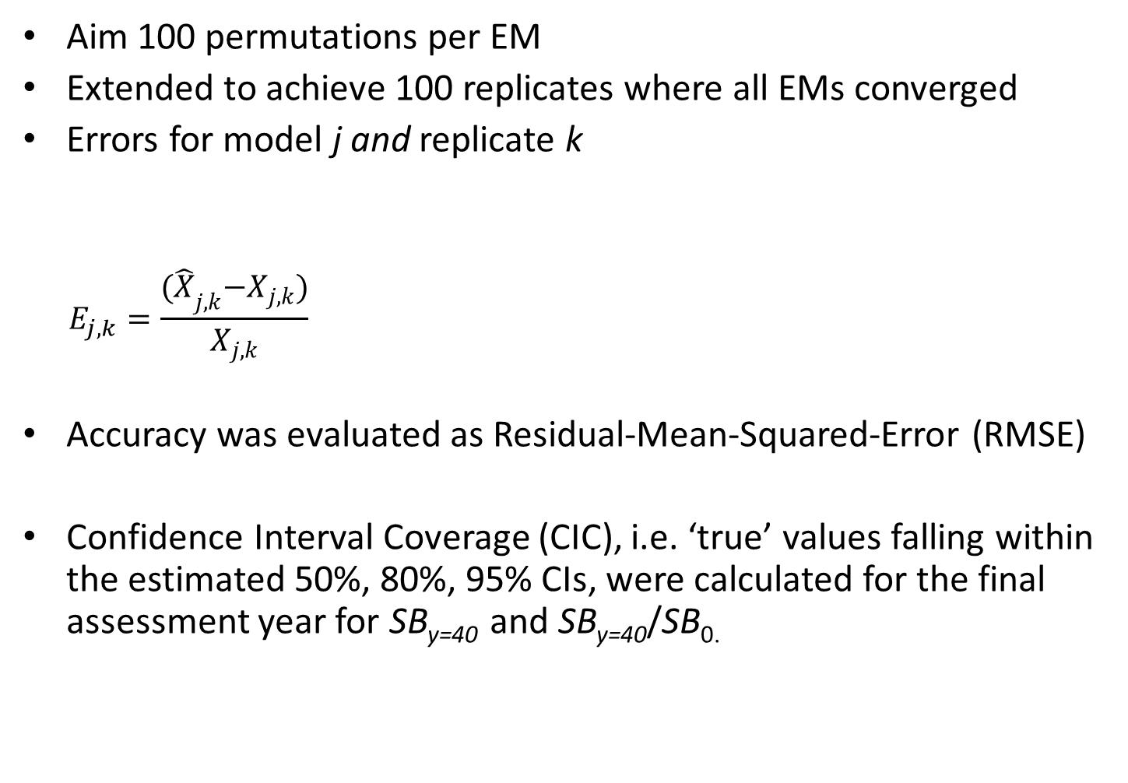

Performance Metrics
Aim 100 permutations per EM
Extended to achieve 100 replicates where all EMs converged
Errors for model j and replicate k
$$E_{j,k}=\frac{{(\hat{X}}_{j,k}−X_{j,k})}{X_{j,k}}$$
Accuracy was evaluated as Residual-Mean-Squared-Error (RMSE)
Confidence Interval Coverage (CIC), i.e. ‘true’ values falling within the estimated 50%, 80%, 95% CIs, were calculated for the final assessment year for SB_{y=40} and SB_{y=40}/SB_{0.}
$$E_{j,y,k}=\log\left({\hat{SB}}_{j,y,k}\right)−log ({SB}_{j,y,k})$$
for SB_{y}/SB₀, ${MSY}_{s}$ and $H_{{MSY}_{s} }$

Slide 13
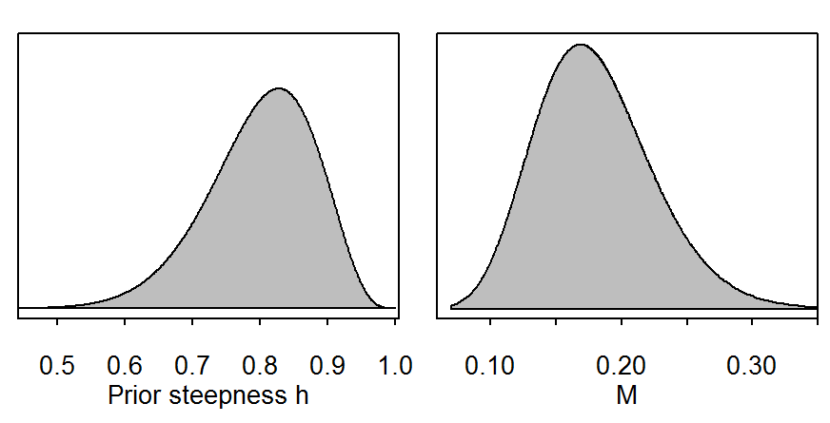
Sensitivity I: OM mis-specifications
Combination: Low h and high M
h = 0.8
M = 0.18
h = 0.65
M = 0.23

Slide 14
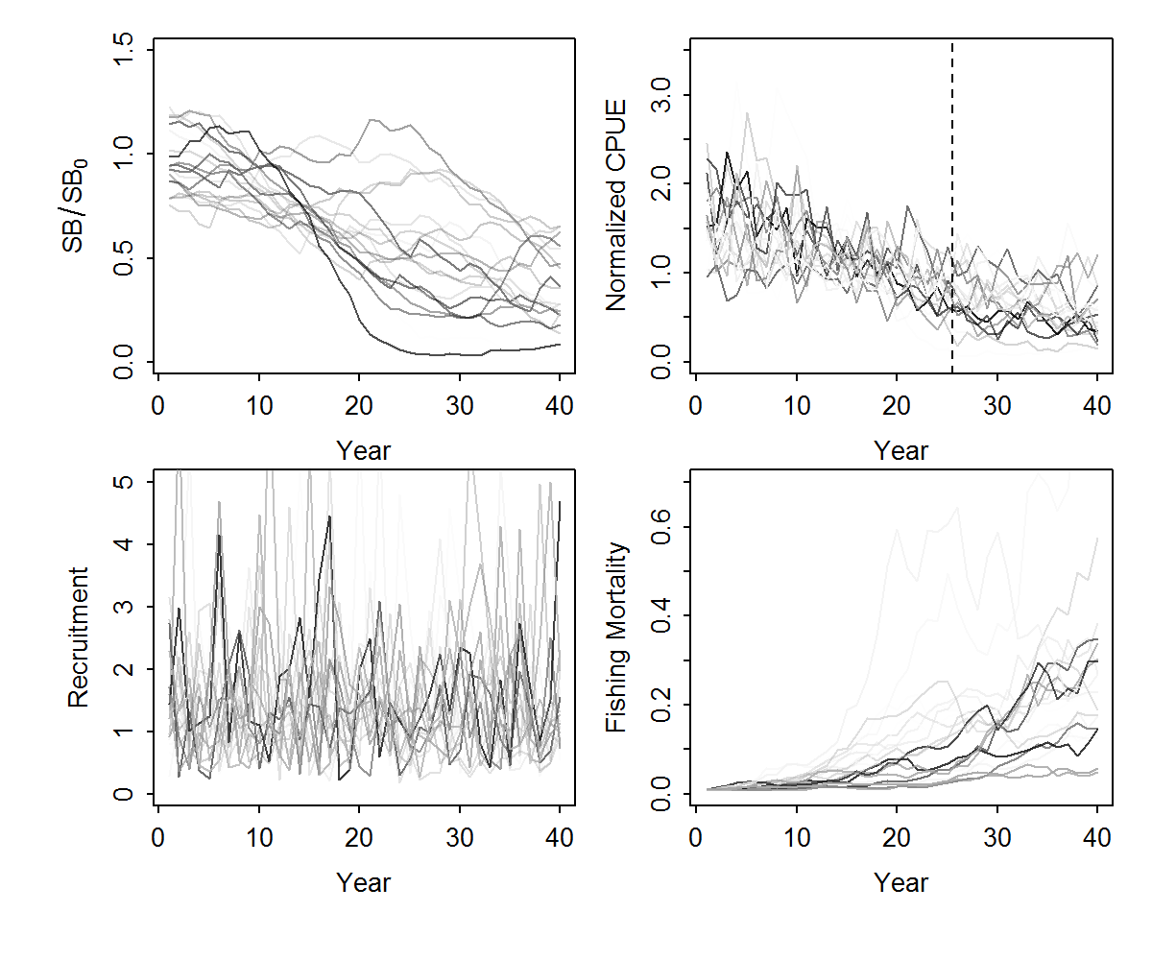
Sensitivity II: One-Way

Slide 15
Examples spawning biomass trajectories

Slide 16
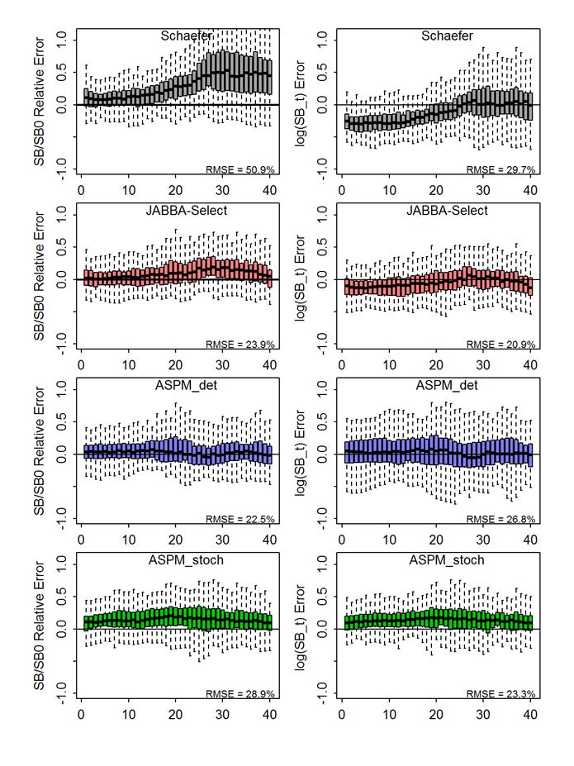
Performance Evaluation (correctly specified)

Slide 17
Sensitivity I (low h & high M): Performance Evaluation

Slide 18
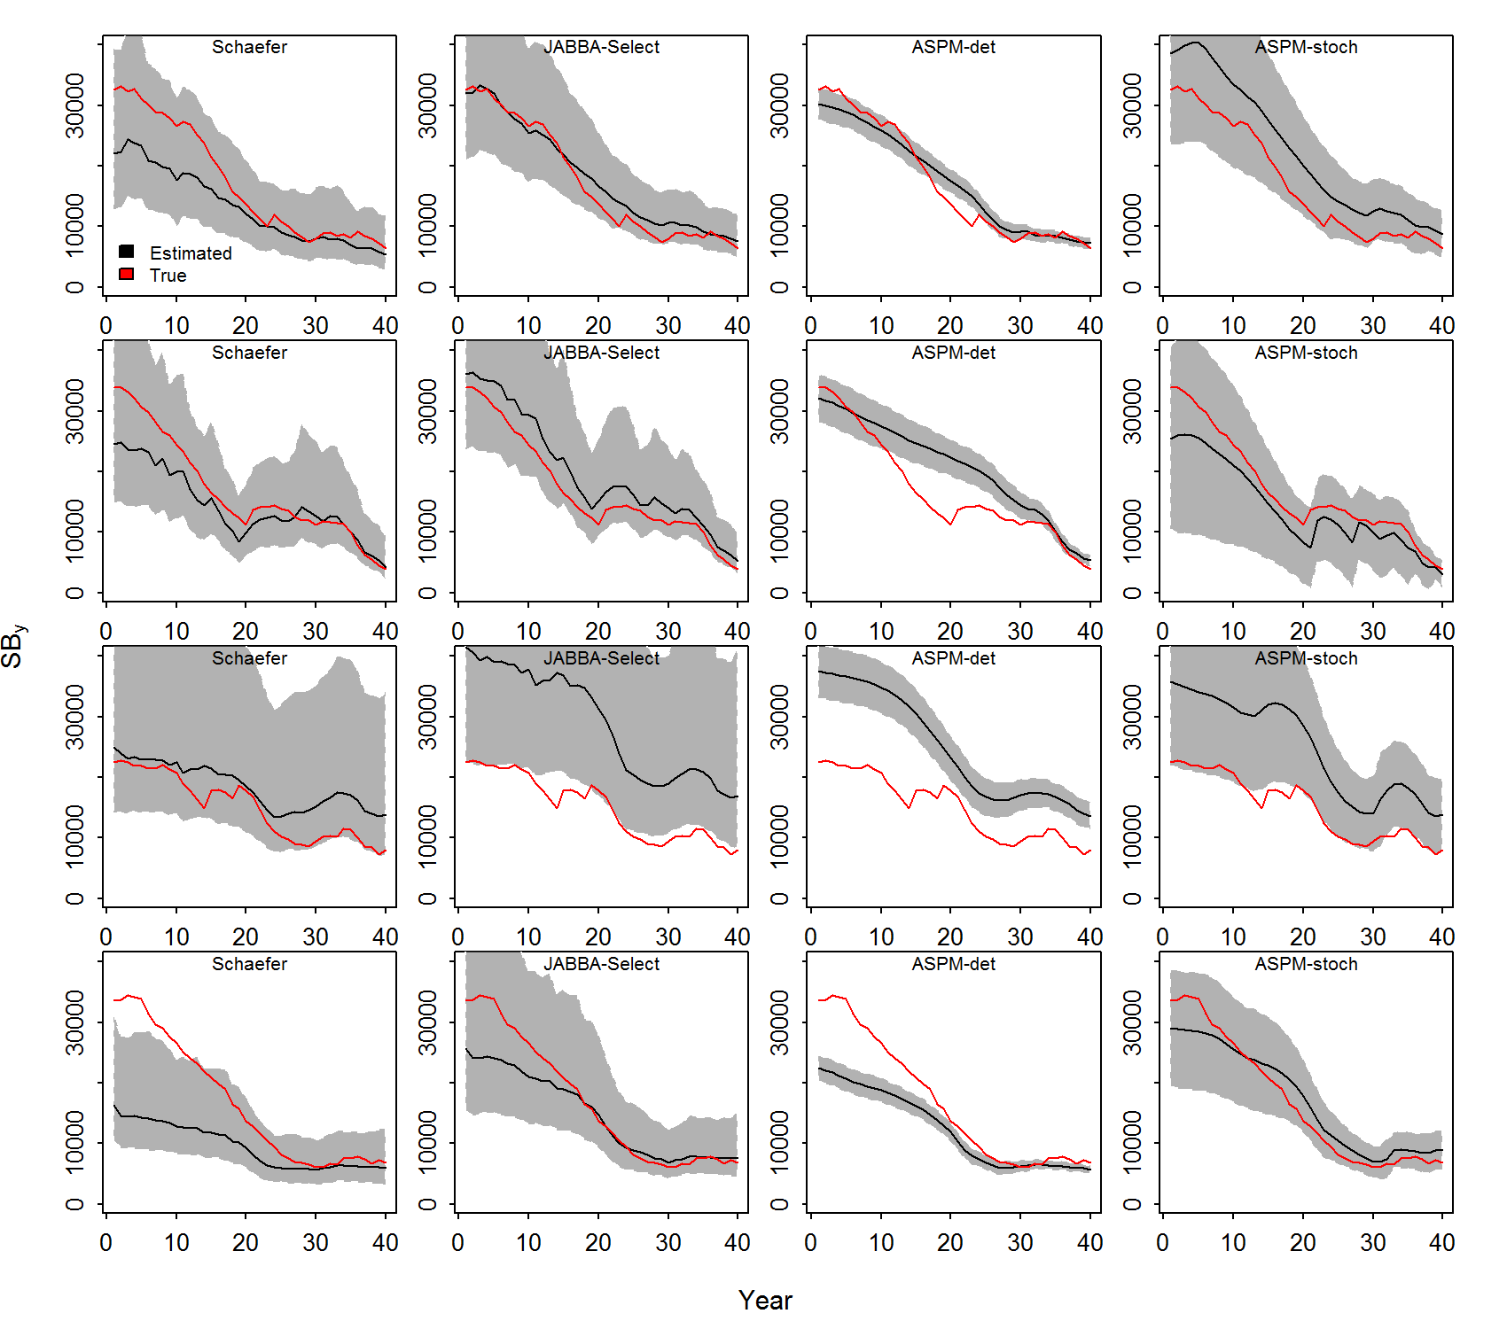
Example runs One-Way

Slide 19
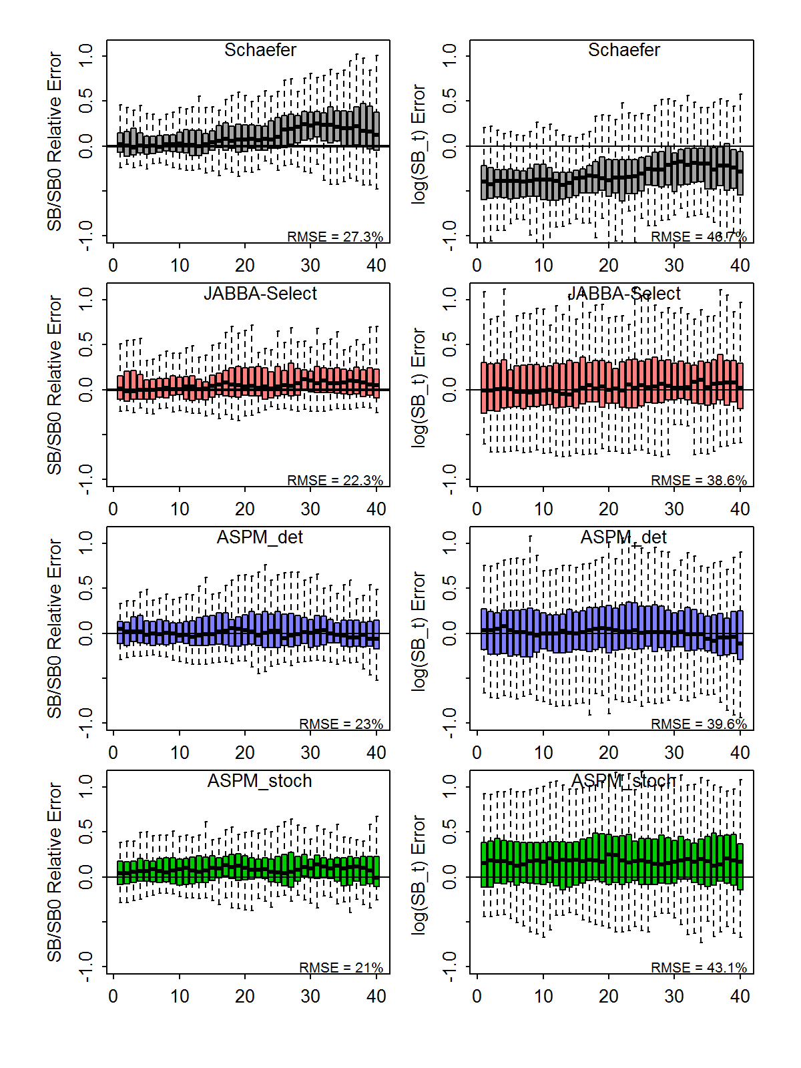
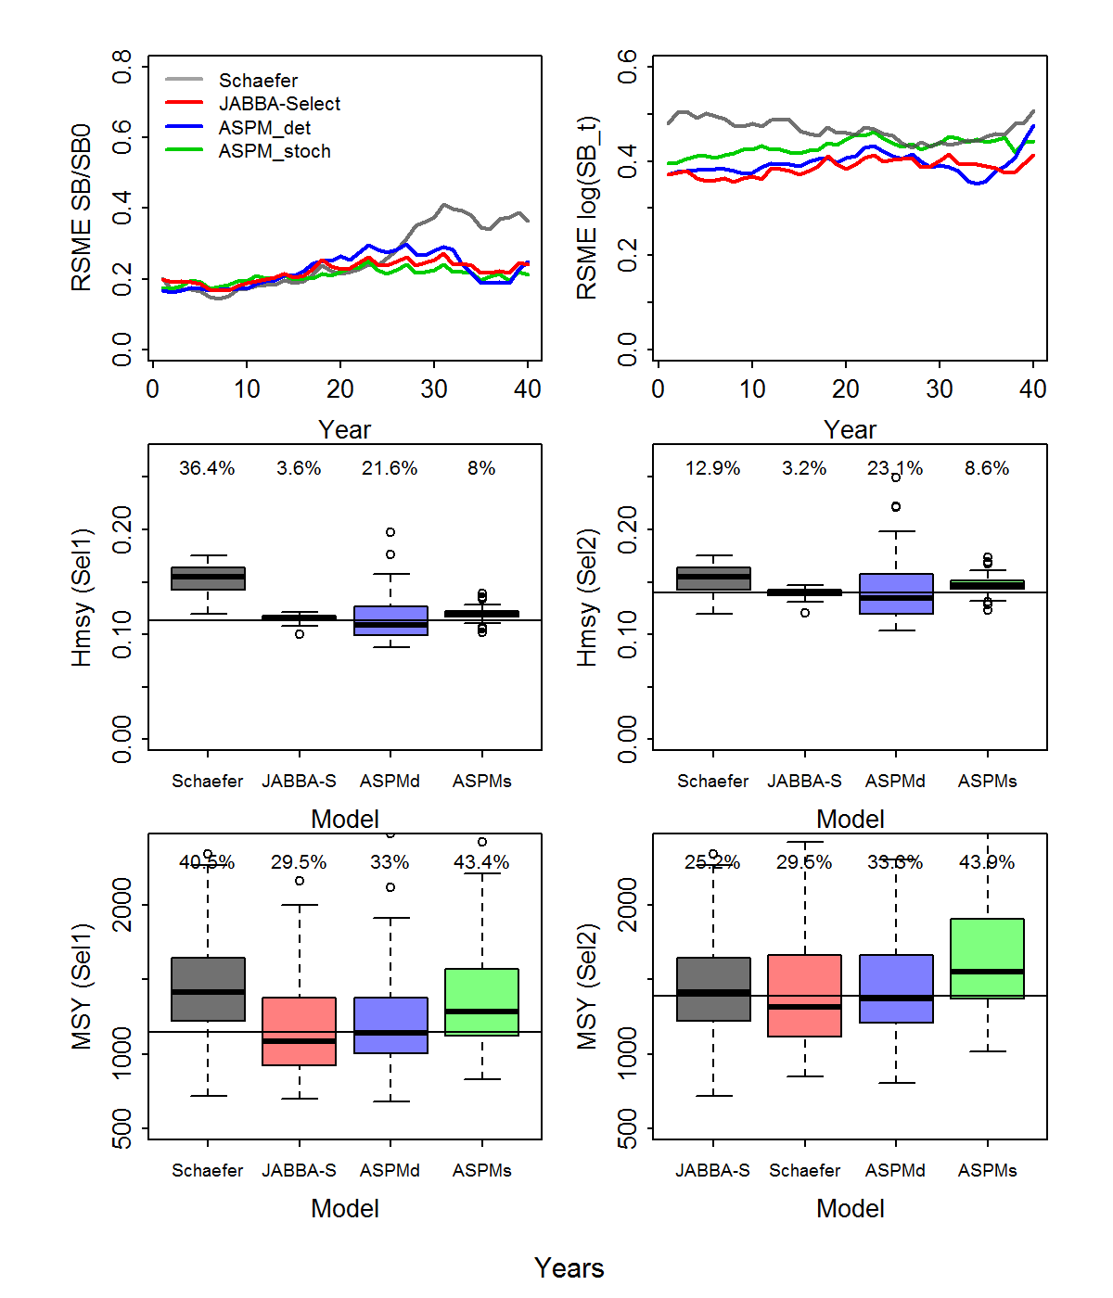
Sensitivity II: One-Way

Slide 20
Confidence Interval Coverage of ‘true’ values
Table 5. Confidence interval coverage (CIC) denoting the proportion of iterations where the ‘true’ values SB_{y=40} and SB_{y=40}/SB₀ for the final assessment year (y = 40) fell within the predicted 50%, 80% and 95% confidence interval (CI) showing the results from a Schaefer model, JABBA-Select, a deterministic age-structured surplus production model (ASPM-det) and stochastic age-structured model (ASPM-stoch)

Slide 21
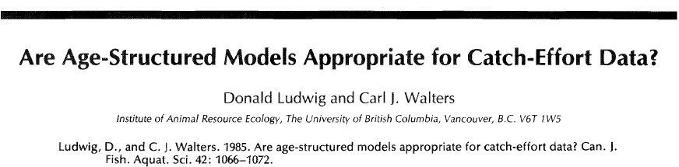
“Even when the data are generated using Deriso's [age-structured] model, the simpler production model generally gives as good or better estimates for the optimal effort.[..]The phenomenon described above is not really surprising. It illustrates the general principle that the complexity of models and of decision procedures should be compatible with the amount of information available. “

Slide 22
Panel Question 2
2. Simulation-Estimation Study (IWS/2018/Linefish_P2):
Evaluate the suitability of the revised simulation framework in terms of comparability between modelling frameworks and performance metrics, addressing IWS 2017 (E.2).
D. S. Butterworth:
There is a close (though not exact) correspondence between the key parameters of surplus production and age-structured production models.
[…] there are cases where JABBA[-Select] has been applied to “one way trips” – abundance indices showing only downward trends, which leave estimates of the r [H_{MSY} and m] and K [SB0] parameters confounded. […] so it becomes more important to review the reliability of the procedures used to convert the age-structured production models priors to surplus production model priors.
The question hence arises, for those one-way-trip circumstances, whether there is a case for simulation studies to compare the performance of working directly with an age-structured production model and its priors, with converting those priors into surplus production model priors and assessing with a surplus production model.

Slide 23

Thank You

