Slide 1






JABBA-Select: Model Documentation
Henning Winker*, Felipe Carvalho, James Thorson, Denham Parker, Sven Kerwath, Tony Booth, Laurie Kell
MARAM International Stock Assessment Workshop 2018
*Henning.winker@gmail.com

Slide 2
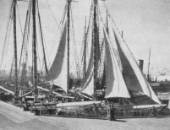
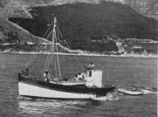

Linefishery application
Mid-1800‘s: Establishment of a thriving linefishery sector in the cape region
1986 – 1906: First records landings of catch and CPUE
1926 – 1931: Second set of catch records
1985: National Marine Linefish System (NMLS)
& first management regulations (e.g. gag- and size limits)
1990s: Once-off per-recruit assessments
1999: Linefish management protocol (LMP)
  - Biological reference points incl. SB/R & Decline in CPUE
2000: Declaration of the state of emergency in the linefishery
2003: Drastic effort cut (~ 70%) and several new size and bag limits
2010 Shore-based observer programme for size data ceased
2011-13: Standardization of linefish CPUE by accouning for targeting
2012-13: First round of age-structured assessments for 4 species
      Fitted to CPUE + size comps (1987-2010)
2014-16: Difficulties to update age-structured assessments
2017 Preliminary follow-up stock assessments using JABBA-Selectict for now 8 species (Snoek, Yellowtail, Santer, Red Roman, Silver kob, Carpenter, Slinger, Hottentot)
2018 Completion of full JABBA-Select documentation?

Slide 3
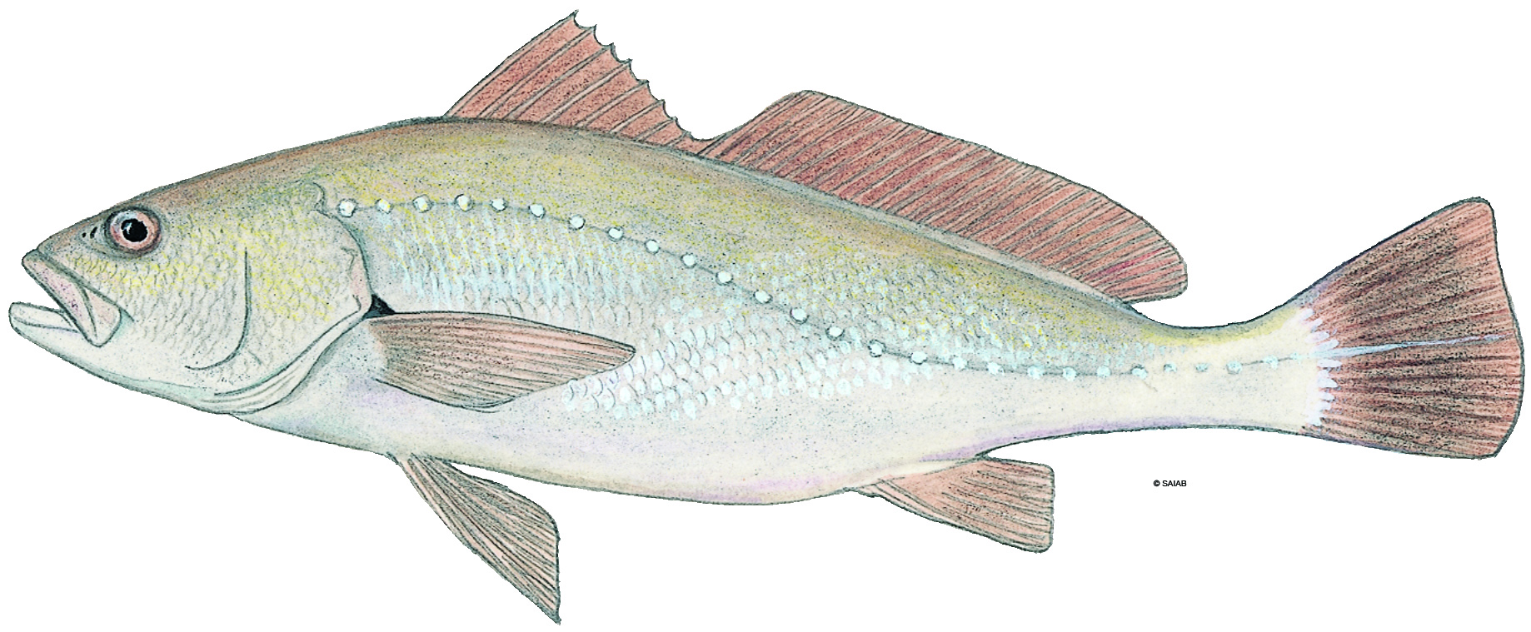
Case study example:
Silver kob (Argyrosomus inodorus)
Commercial ‘linefish’ (hand-line) species of the South African linefishey
Notable quantities caught by the inshore trawl
Increase in size limits for handline caught fish from 400 to 500 mm in 2003
No size limit for the inshore trawl fishery SL50 ~ 330 mm
Catch time series starts (only) in 1987
Coherent evidence that the stock was severely depleted by 1987 (~10% pristine)
In addition: recent experimental resurveys of historical trawl survey strata that had in the 1900s produced 56.6 (26% to total abundances), mostly large kob, per standardized drag, but none in any of the three surveyed strata in 2016 (Curry 2017, PhD Thesis).
Two standardized linefish abundance indices available (South, South-East)
Trawl survey indices are problematic because of mostly zero encounters in recent years

Slide 4
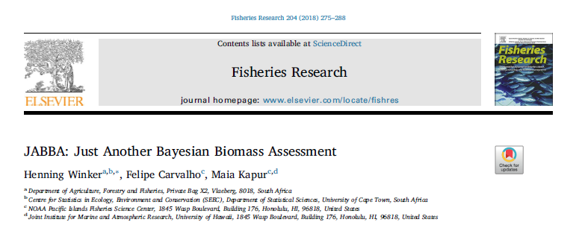


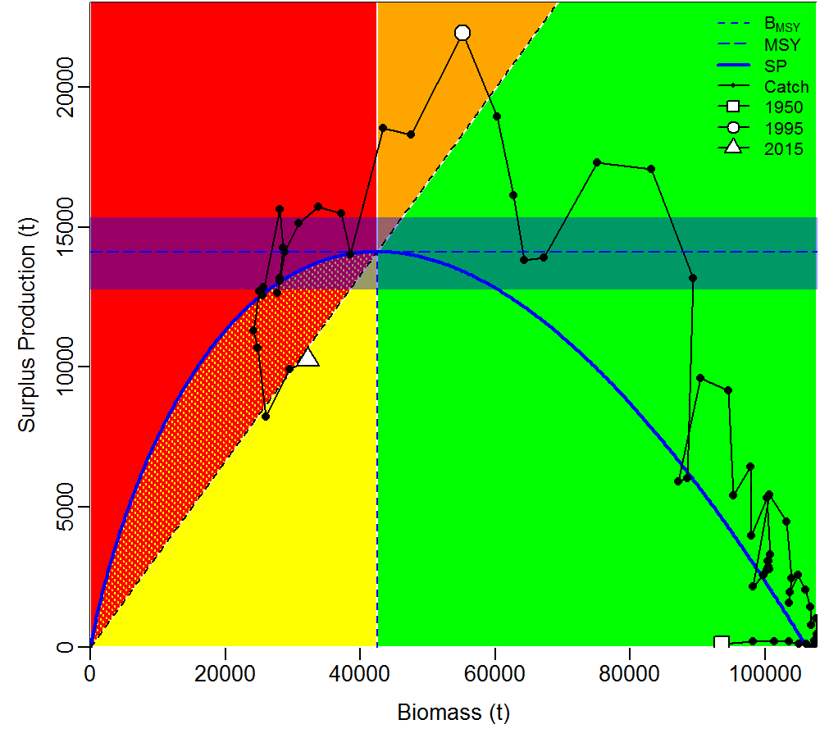
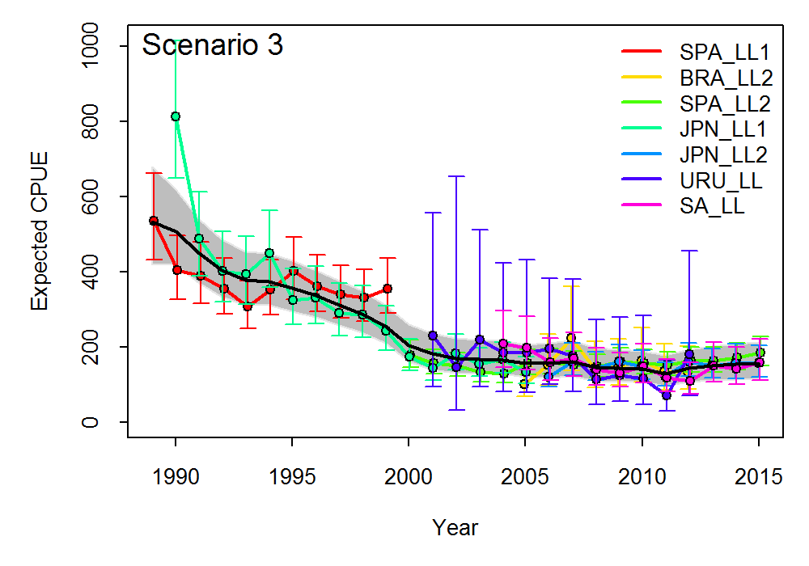
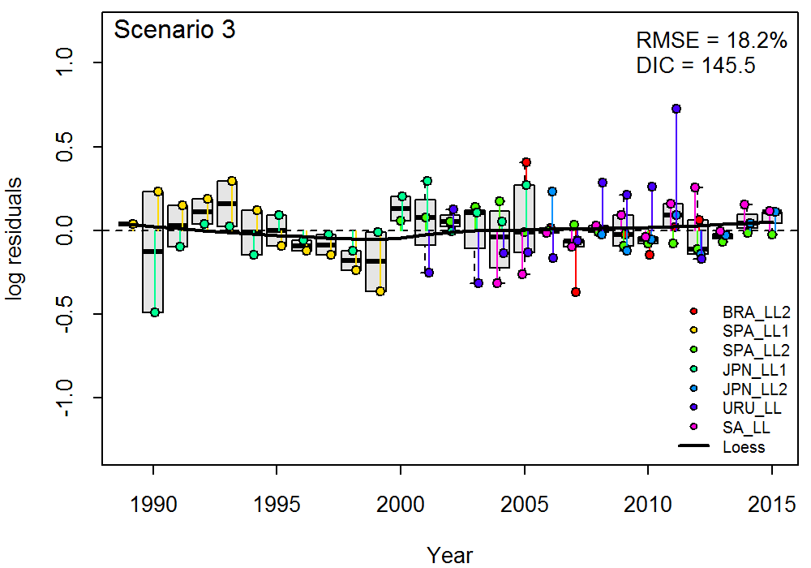
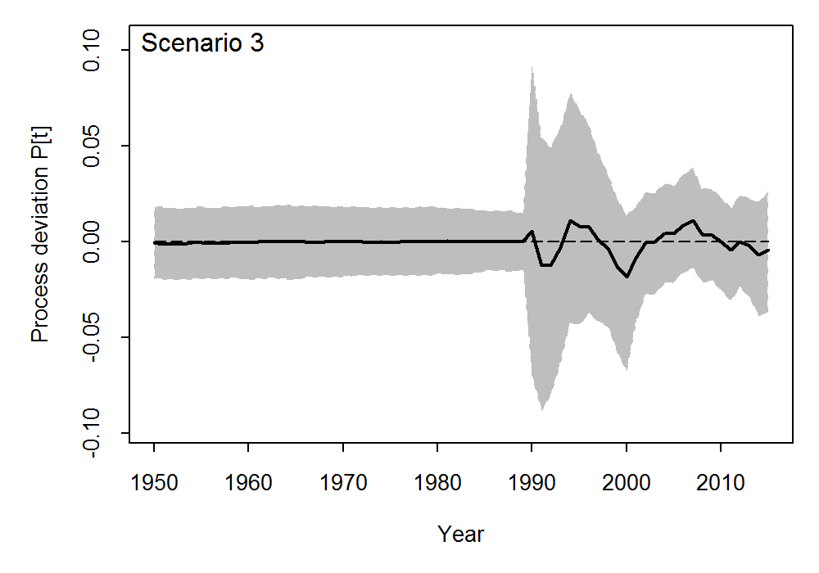
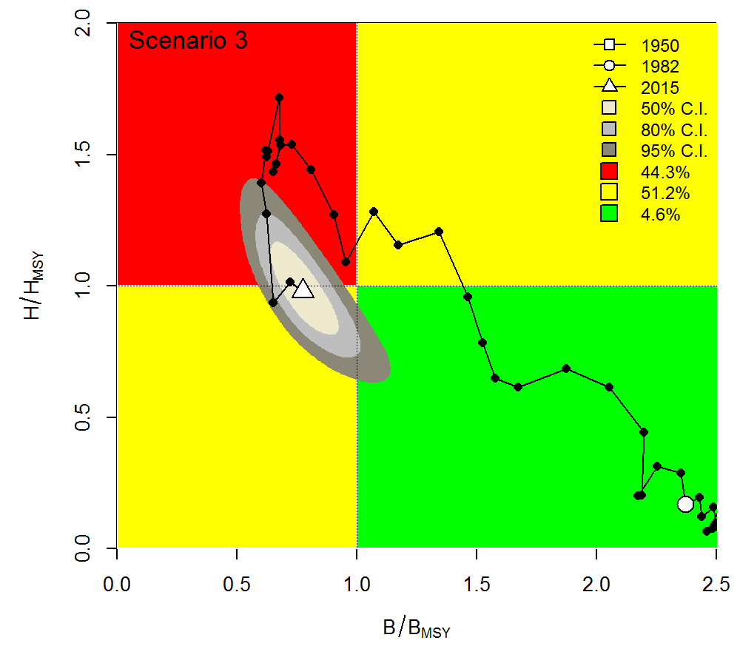
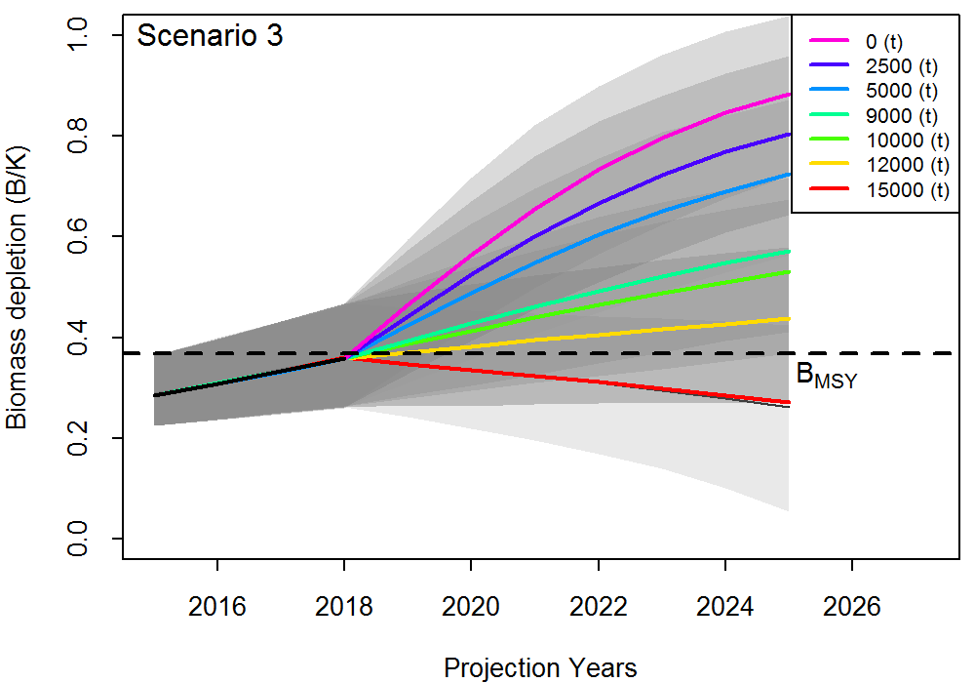
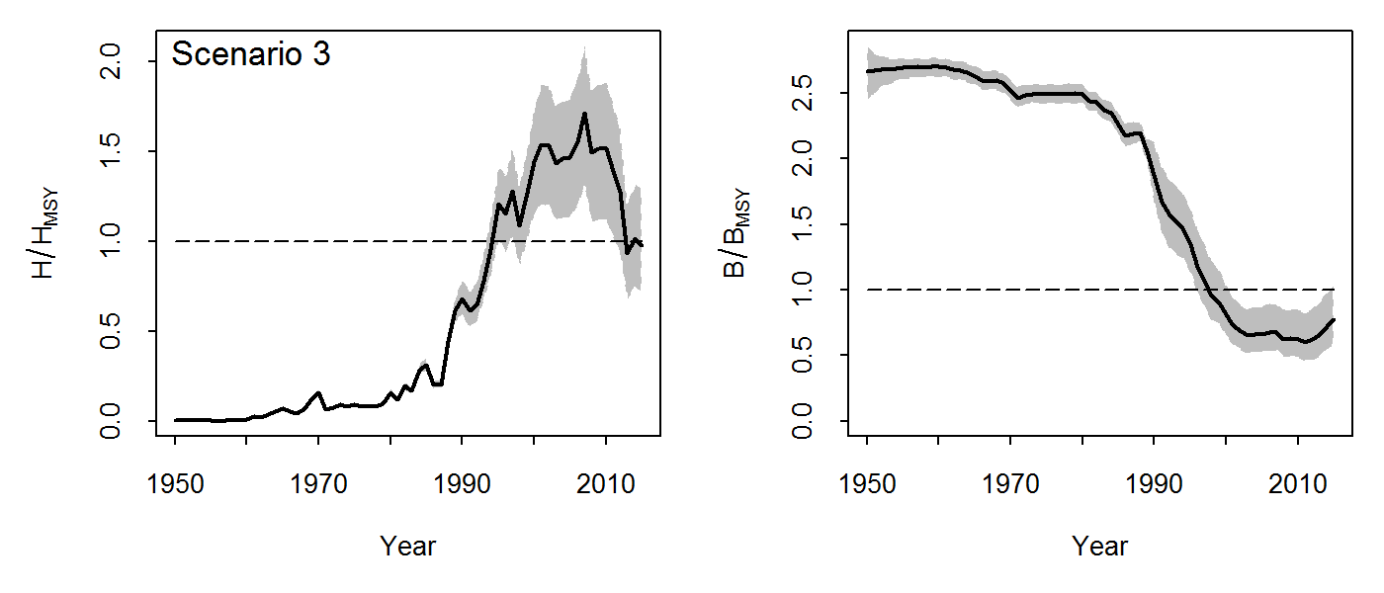
JABBA-Select builds on
JABBA Just Another Biomass Bayesian Assessment
R/JAGS interface hosted on GitHub

Slide 5
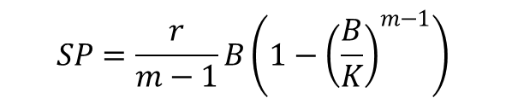
JABBA formulation:
Pella-Tomlison Surplus Production Model
Surplus production function of the generalized three parameter SPM by Pella and Tomlinson (1969)
$$SP=\frac{r}{m−1}B\left(1−{\left(\frac{B}{K}\right)}^{m−1}\right)$$
where r is the intrinsic rate of population increase at time t, K is the unfished biomass and m is a shape parameter that determines at which B/K ratio maximum surplus production is attained.
If m = 2, the model reduces to a Schaefer form, with the surplus production SP attaining MSY at exactly K/2
If 0 < m < 2, SP attains MSY at depletion levels smaller than K/2 and vice versa
The Pella-Tomlinson model reduces to a Fox model if m approaches one (m=1) resulting in maximum surplus production at ~ 0.37K

Slide 6
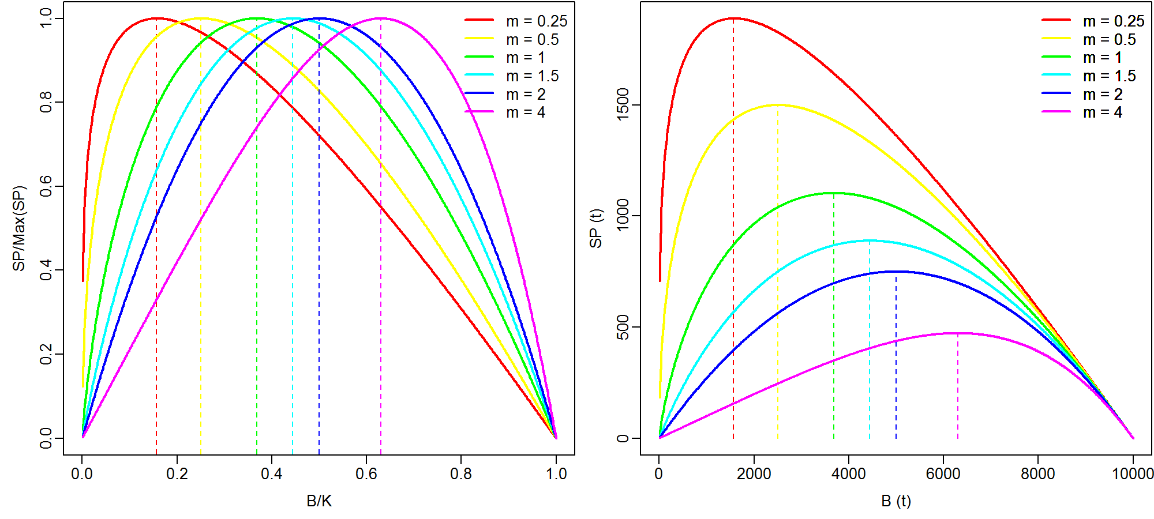
Shape parameter defines B_{MSY}/K
K = 1000 t, r = 0.3

Slide 7
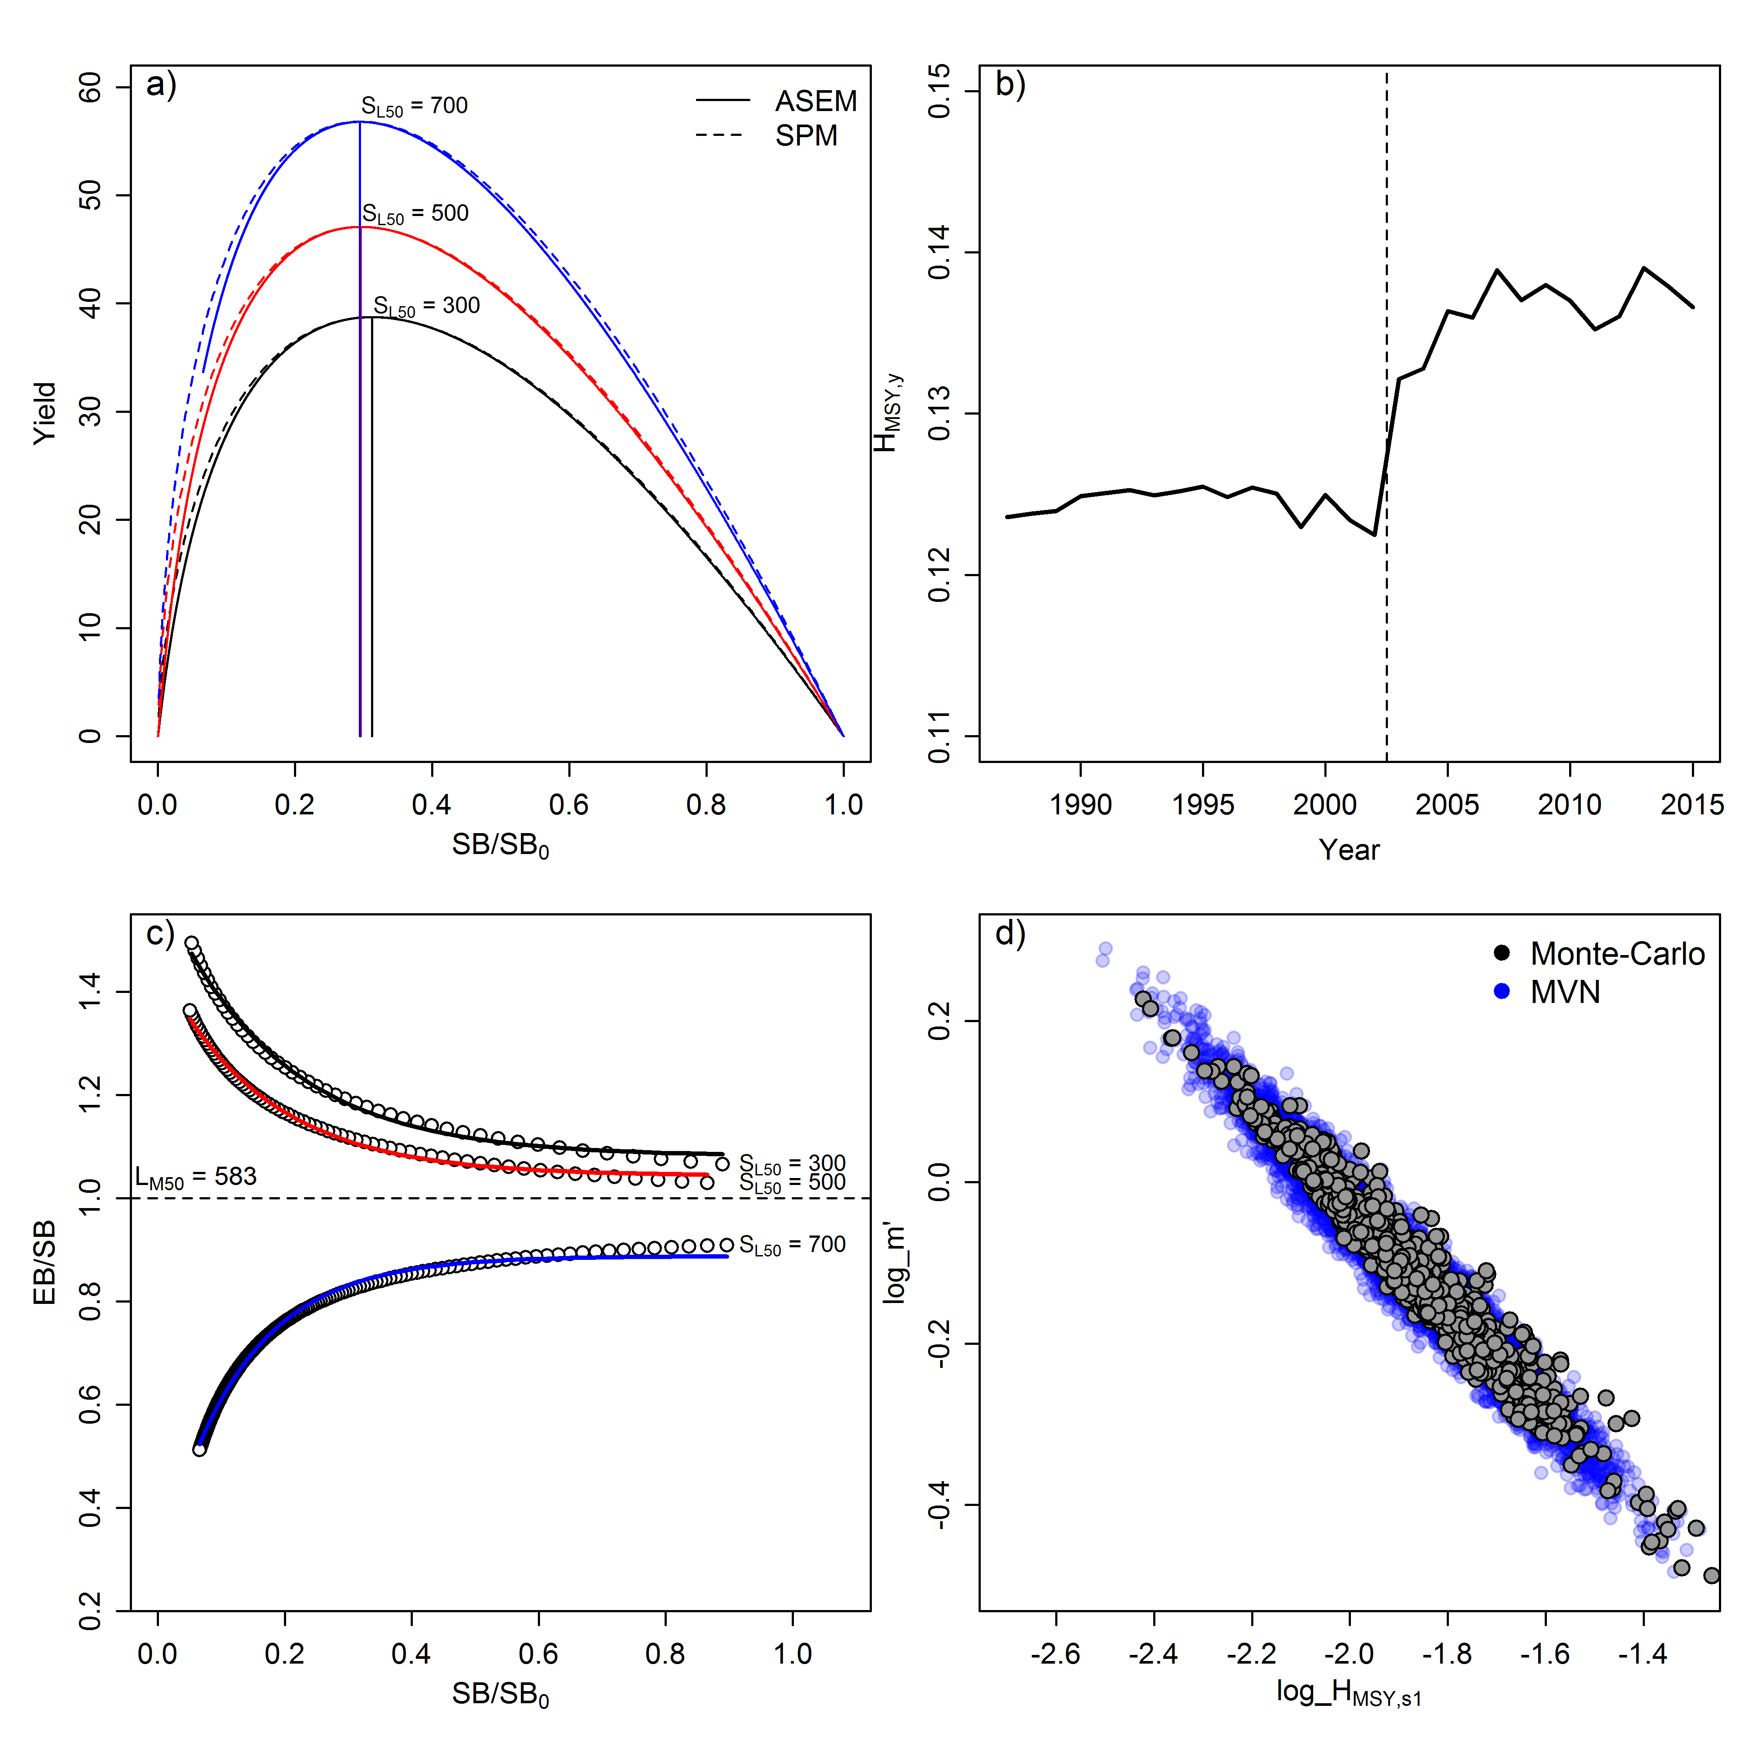
The four new elements of JABBA-Select

Slide 8
The four new elements of JABBA-Select

Slide 9
1. Link to Age-Structured Equilibrium Model (ASEM)
or
This allows re-formulating the production function of the Pella-Tomlinson equation as a function of H_{MSY}, such that:
(JABBA-Select Eq.1)

Slide 10
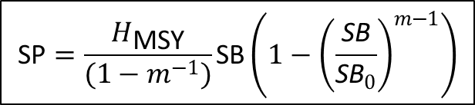
Linking age-structure and surplus production models:
JABBA-Select
$$\text{SP}=\frac{H_{\text{MSY}}}{(1−m^{−1})}\text{SB}\left(1−{\left(\frac{\text{S}\text{B}}{{\text{S}\text{B}}_{0}}\right)}^{m−1}\right)$$
Fig. 1. Schematic of functional relationships between the productivity parameter r and the shape parameter of the surplus production function and the Age-Structured Equilibrium Model (ASEM; i.e. yield- and spawning biomass-per-recruit models with integrated spawner recruitment relationship). Numbers in boxes denote the sequence of deriving deviates of r and m from life history and selectivity parameter inputs into the ASEM.

Slide 11
South African line fish examples
Parameter | Silver kob | Carpenter |  | Sources
L∞ | 1372 | 619 | mm | Griffiths (1997); Brouwer & Griffiths (2005)
κ | 0.115 | 0.06 | year⁻¹ | Griffiths (1997); Brouwer & Griffiths (2005)
t₀ | -0.815 | -4.5 | years | Griffiths (1997); Brouwer & Griffiths (2005)
a | 0.000006 | 0.00004 | g | Griffiths (1997); Brouwer & Griffiths (2005)
b | 3.07 | 2.855 | g mm⁻¹ | Griffiths (1997); Brouwer & Griffiths (2005)
A_{mat} | 3 | 4 | years | Griffiths (1997); Brouwer & Griffiths (2005)
d_{t} | 0.1 | 0.01 | year⁻¹ | assumed ~ knife-edge
t_{max} | 25 | 30 | years | Griffiths (1997); Brouwer & Griffiths (2005)
M | 0.18 | 0.1 | year⁻¹ | Winker et al. (2014b)
h (Steepness) | 0.8 | 0.6 |  | Winker et al. (2014b)
a_{min} | 1 | 1 | years | minimum assessment age
a_{max} | 20 | 30 | years | assumed plus group
S_{L,S1} | 400 | 270 | mm | Winker et al. (2014b)
d_{S1} | 5 | 12 | mm⁻¹ | Winker et al. (2014b)
S_{L,S2} | 500 | 330 | mm | Winker et al. (2014b)
d_{S2} | 5 | 10 | mm⁻¹ | Winker et al. (2014b)
S_{L,S3} | 334 | 280 | mm | Winker et al. (2014b)
d_{S3} | 11 | 22 | mm⁻¹ | Winker et al. (2014b)

Slide 12
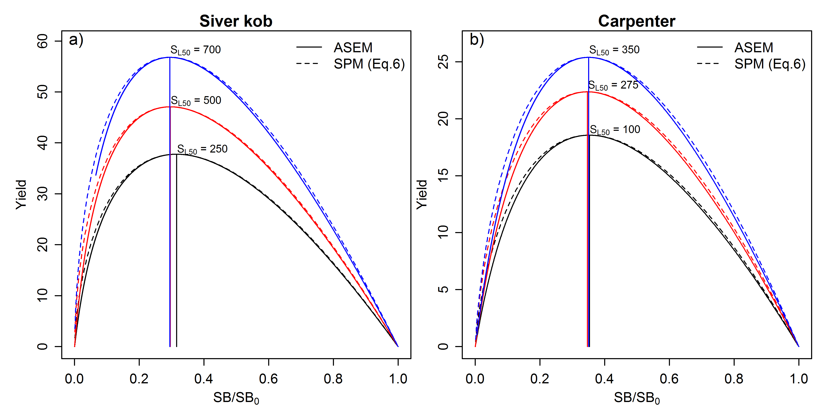
Production functions: ASEM vs SPM
SPM: Surplus production model
ASEM: Age-structured equilibrium model (i.e. per-recruit with B&H SSR)
SL50 = Length-at-50-selectivity
Note that because SB_{MSY} / SB₀ and MSY/SB_{MSY} are relative, and absolute estimates and therefore fitting a model not required!!! A simple Age-structured equilibrium model for determination Fisheries Reference Points (FRPs) would do ☺

Slide 13
The four new elements of JABBA-Select

Slide 14
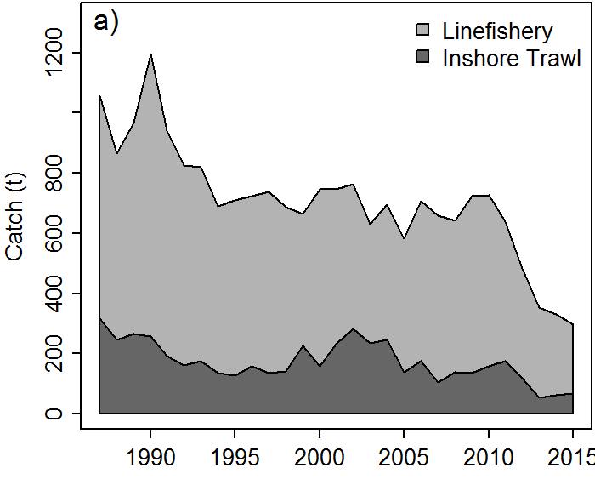
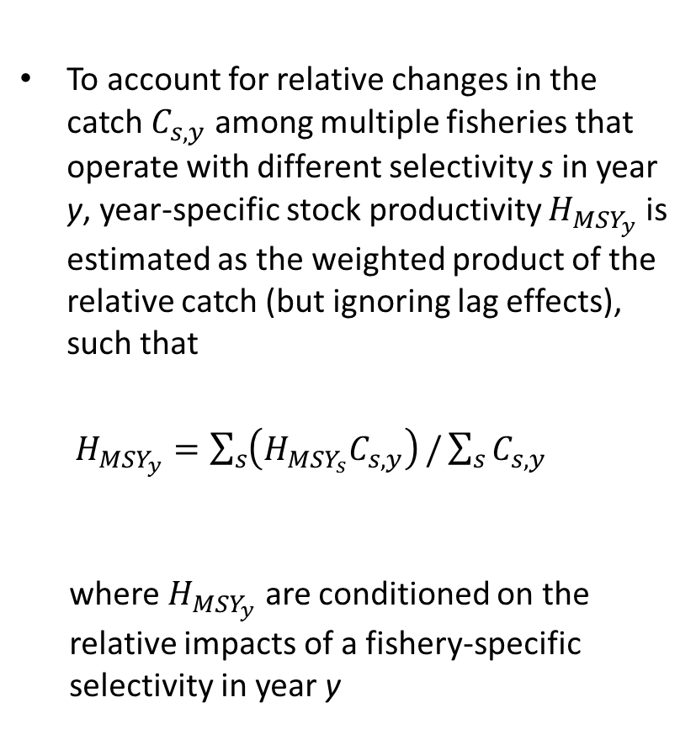

Selectivity-specific production parameter $H_{{MSY}_{s} }$
To account for relative changes in the catch $C_{s,y}$ among multiple fisheries that operate with different selectivity s in year y, year-specific stock productivity $H_{{MSY}_{y}}$ is estimated as the weighted product of the relative catch (but ignoring lag effects), such that
$H_{{MSY}_{y}}=\sum_{s}{\left(H_{{MSY}_{s}}C_{s,y}\right)}/\sum_{s}{C_{s,y}}$
where $H_{{MSY}_{y}}$ are conditioned on the relative impacts of a fishery-specific selectivity in year y
Increase in
size limits
Variations in ratio trawl to hand-line offtake

Slide 15
The four new elements of JABBA-Select

Slide 16
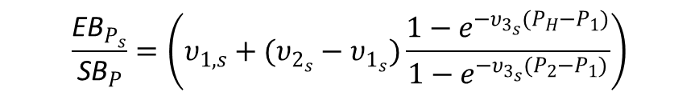
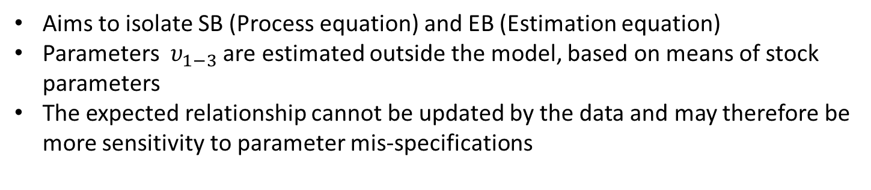
3. Approximating SB/EB via ASEM to relax SPM assumption SB = EB
$$\frac{{\text{EB}}_{P_{s}}}{{\text{S}\text{B}}_{P}}=\left(υ_{1,s}+(υ_{2_{s}}−υ_{1_{s}})\frac{1−e^{−υ_{3_{s}}(P_{H}−P_{1})}}{1−e^{−υ_{3_{s}}(P_{2}−P_{1})}}\right)$$
EB: Exploitable biomass as function of selectivity
SB: Spawning biomass as function of maturation
P_{H} : SB/SB0 as function of harvest rate
H: Harvest rate, here H = C/SB
S_{L50}: Length-at- 50%-selectivity
L_{M50}: Length-at- 50%-maturity
Aims to isolate SB (Process equation) and EB (Estimation equation)
Parameters $υ_{1−3}$ are estimated outside the model, based on means of stock parameters
The expected relationship cannot be updated by the data and may therefore be more sensitivity to parameter mis-specifications

Slide 17
The four new elements of JABBA-Select

Slide 18
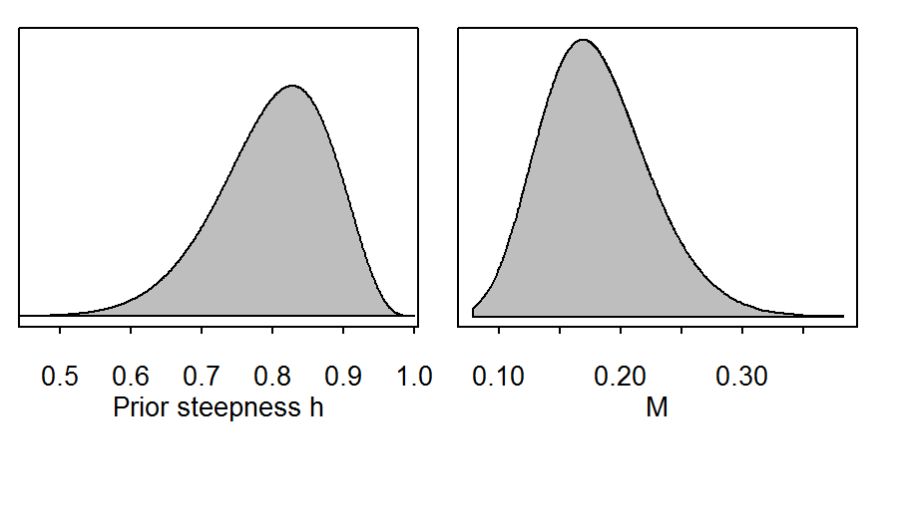
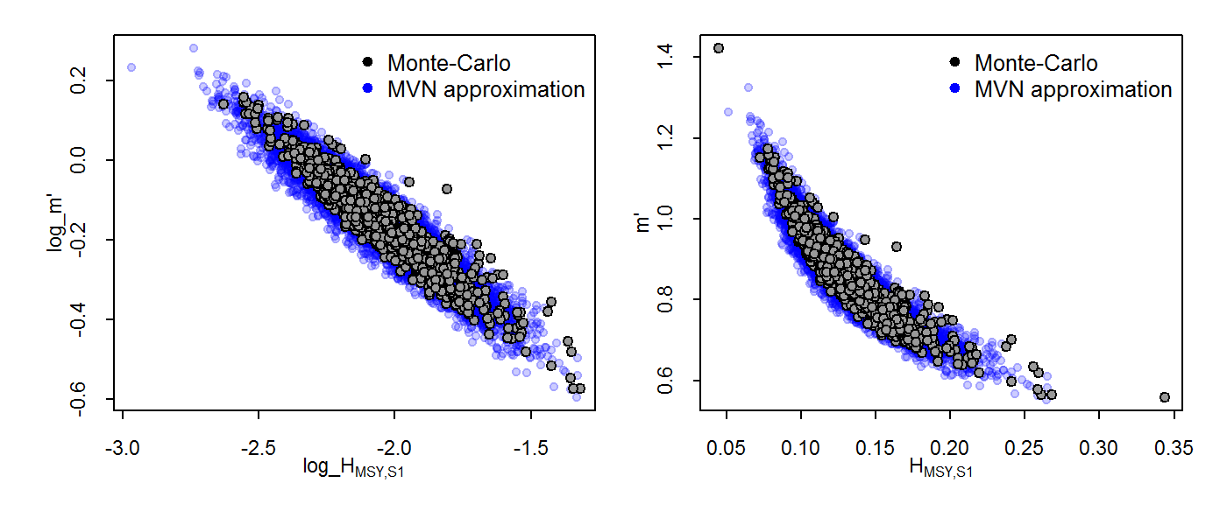
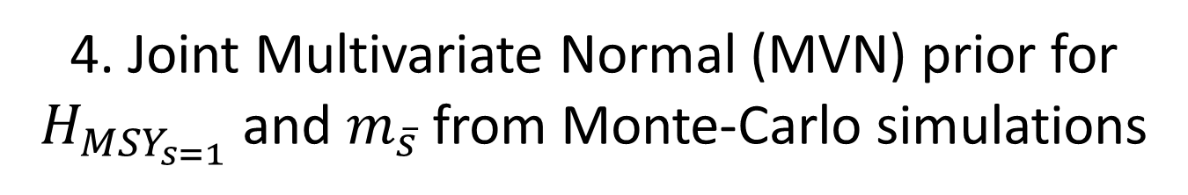
4. Joint Multivariate Normal (MVN) prior for $H_{{MSY}_{s=1}}$ and $m_{\overline{s}}$ from Monte-Carlo simulations
ASEM

Slide 19

Ratios for$H_{{MSY}_{s>1}}/H_{{MSY}_{s=1}}$

Slide 20
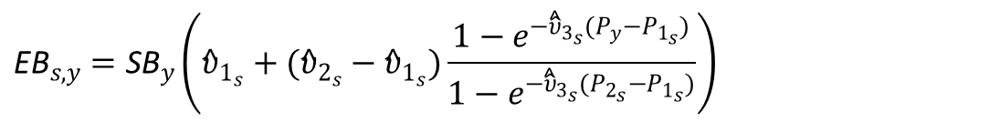
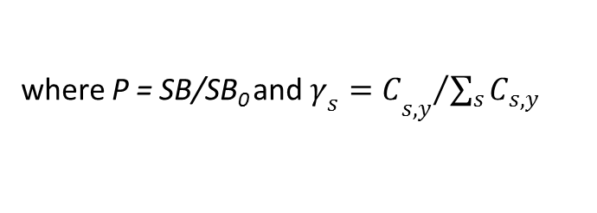

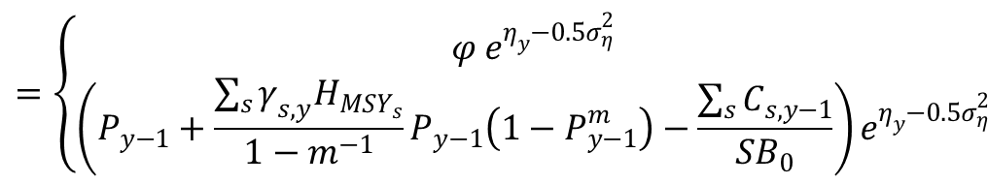


JABBA-Select Formulation
Process equation
$$=\left\{\begin{aligned}φ e^{η_{y}−{0.5σ}_{η}^{2}} \\ \left(P_{y−1}+\frac{\sum_{s}{γ_{s,y}H_{{MSY}_{s}}}}{1−m^{−1}}P_{y−1}\left(1−P_{y−1}^{m}\right)−\frac{\sum_{s}{C_{s,y−1}}}{{SB}_{0}}\right)e^{η_{y}−{0.5σ}_{η}^{2}}\end{aligned}\right.$$
$$P_{y}$$
where P = SB/SB₀ and ${{γ_{s}=C}_{s,y}}/{\sum_{s}{C_{s,y}}}$
Process error
Separating SB and EB
Weighting factor for $H_{{MSY}_{s}}$
$${\text{EB}}_{s,y}={\text{SB}}_{y}\left({\hat{υ}}_{1_{s}}+({\hat{υ}}_{2_{s}}−{\hat{υ}}_{1_{s}})\frac{1−e^{−{\hat{\hat{υ}}}_{3_{s}}(P_{y}−P_{1_{s}})}}{1−e^{−{\hat{\hat{υ}}}_{3_{s}}(P_{2_{s}}−P_{1_{s}})}}\right)$$
Observation Equation
$${ln(I}_{f,s,y})\sim Normal\left({ln(q}_{i}{\text{EB}}_{s,y}\right),σ_{ε_{iy}}^{2})$$
Subscript corrected

Slide 21
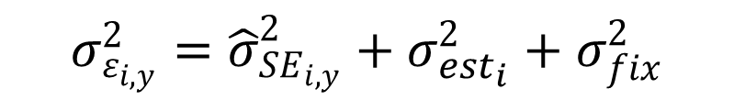
Observation Variance
$$σ_{ε_{i,y}}^{2}={\hat{σ}}_{{SE}_{i,y}}^{2}+σ_{{est}_{i}}^{2}+σ_{fix}^{2}$$
Total observation variance
Fixed (additional )
observation variance
Square standard errors of the year effect (Standardization model)
Estimable (additional )
observation variance
All variance components can be switched on/off in any combination
Provides additional option data weighting options (see Francis 2011)

Slide 22
Summary of Results:
Silver kob (Argyrosomus inodorus)

Slide 23
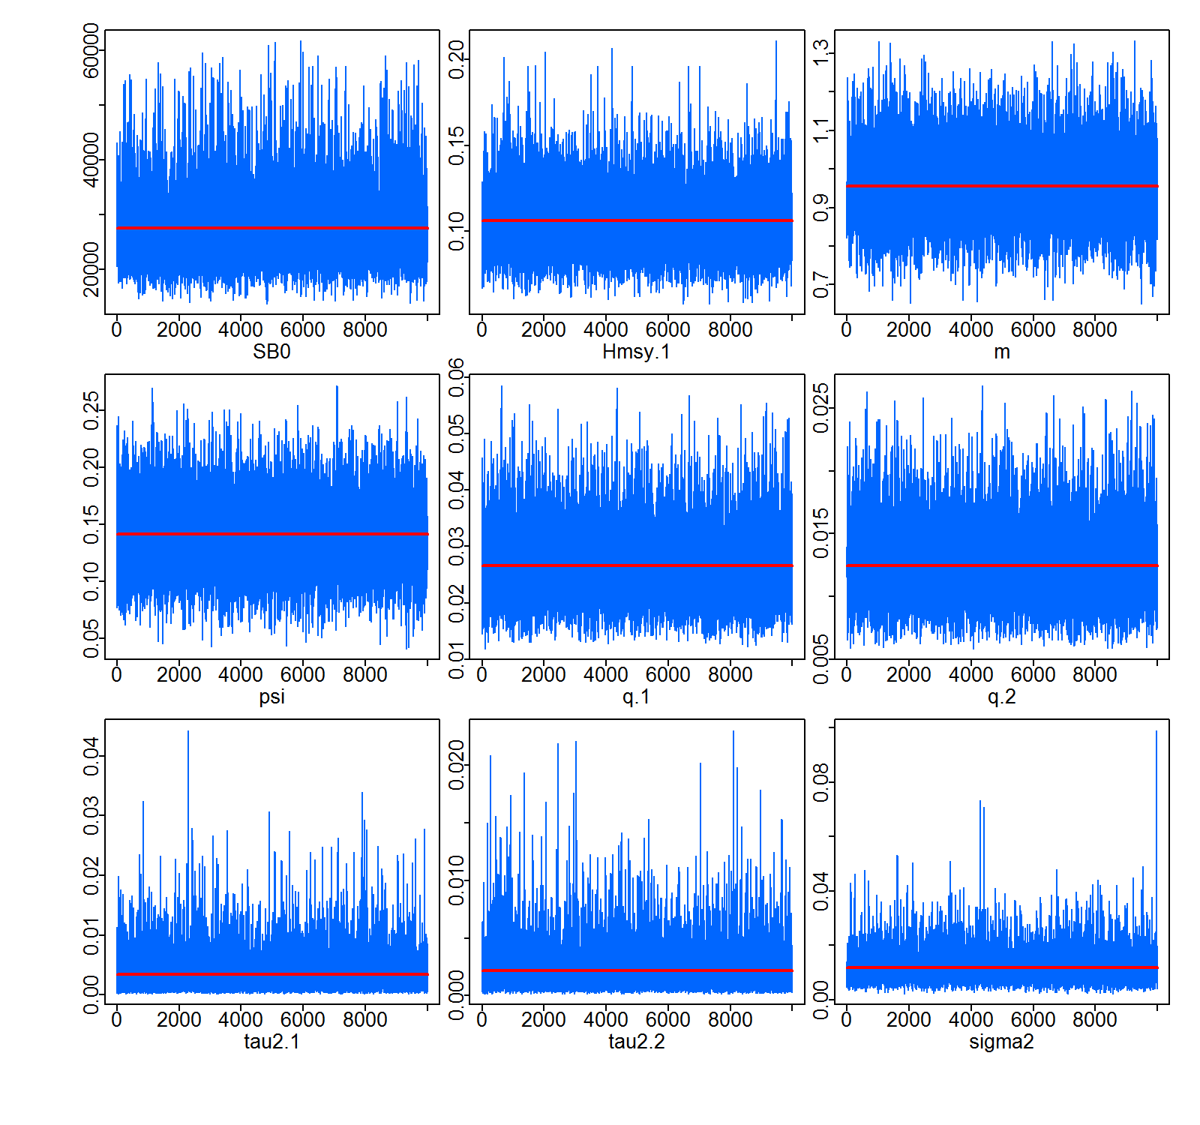
MCMC Diagnostics
Iterations: 55000, Burn-in: 5000, Thinning: every 5th, Chains: 1, Saved: 1
Run time: 1 min 41 sec
Parameter estimates + Converge Stats
 | Median | LCI | UCI | Geweke.p | Heidelberger.p
SB0 | 26909.68 | 16874.32 | 60888.45 | 0.064 | 0.326
Hmsy.1 | 0.105 | 0.072 | 0.153 | 0.11 | 0.145
Hmsy.2 | 0.116 | 0.079 | 0.169 | 0.113 | 0.144
Hmsy.3 | 0.093 | 0.064 | 0.137 | 0.107 | 0.125
q.1 | 0.026 | 0.015 | 0.044 | 0.099 | 0.102
q.2 | 0.012 | 0.007 | 0.021 | 0.061 | 0.053
psi | 0.137 | 0.061 | 0.216 | 0.523 | 0.228
sigma2 | 0.011 | 0.004 | 0.028 | 0.438 | 0.532
tau2.1 | 0.002 | 0 | 0.013 | 0.924 | 0.613
tau2.2 | 0.002 | 0 | 0.008 | 0.925 | 0.811
m | 0.951 | 0.764 | 1.18 | 0.111 | 0.226

Slide 24
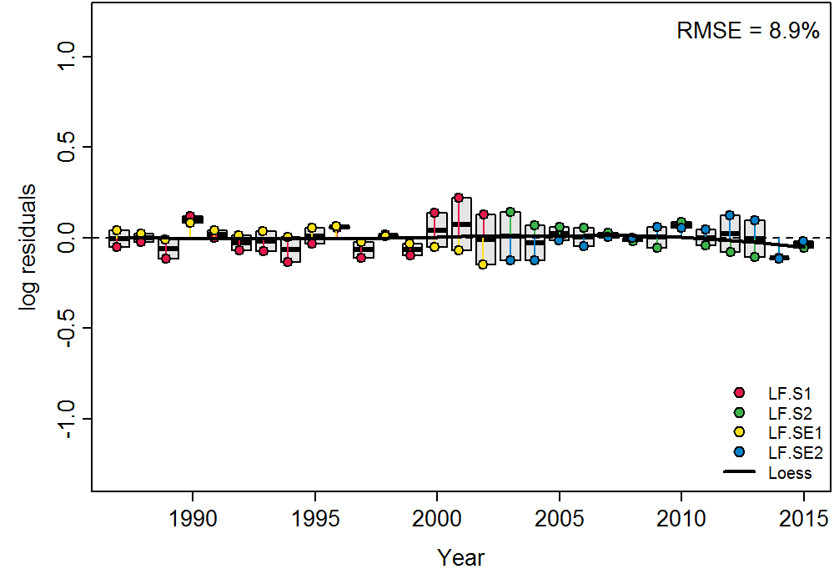
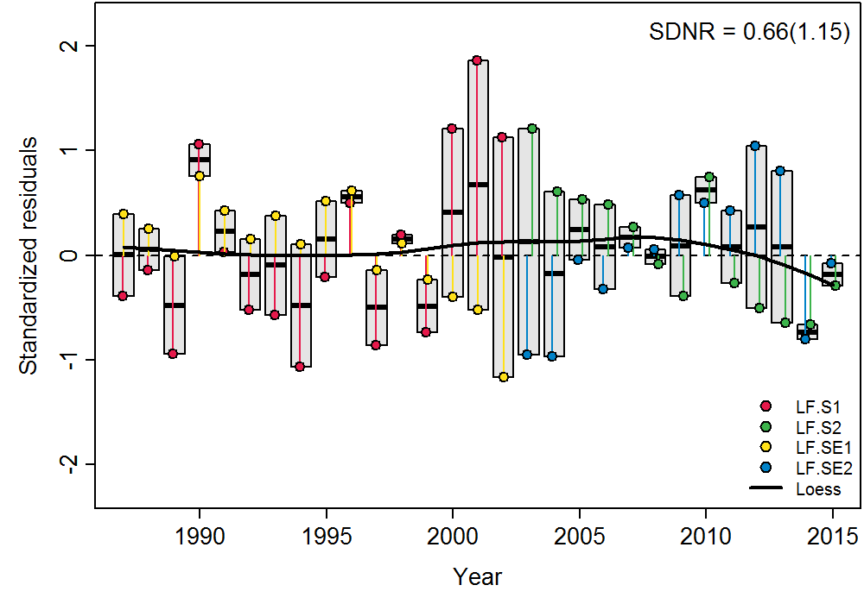
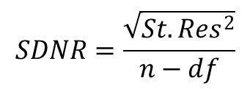
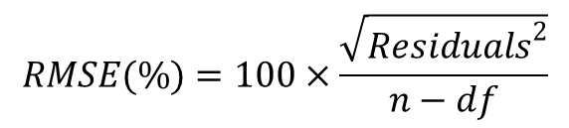

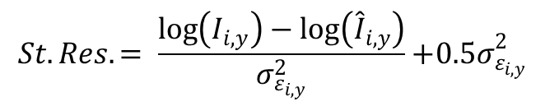
Goodness of Fit
Statistic | Value
N | 58
p | 11
DF | 47
SDNR | 0.66
RMSE | 8.9
DIC | 247.2
$$Residuals=\log\left(I_{i,y}\right)−\log\left({\hat{I}}_{i,y}\right)$$
$$RMSE(\%)=100×\frac{\sqrt{{Residuals}^{2}}}{n−df}$$
?
Francis (2011) Table B1: T2.4A
$$St. Res.= \frac{\log\left(I_{i,y}\right)−\log\left({\hat{I}}_{i,y}\right)}{σ_{ε_{i,y}}^{2}}{+0.5σ}_{ε_{i,y}}^{2}$$
Total or Residuals?
$$SDNR=\frac{\sqrt{{St.Res}^{2}}}{n−df}$$

Slide 25
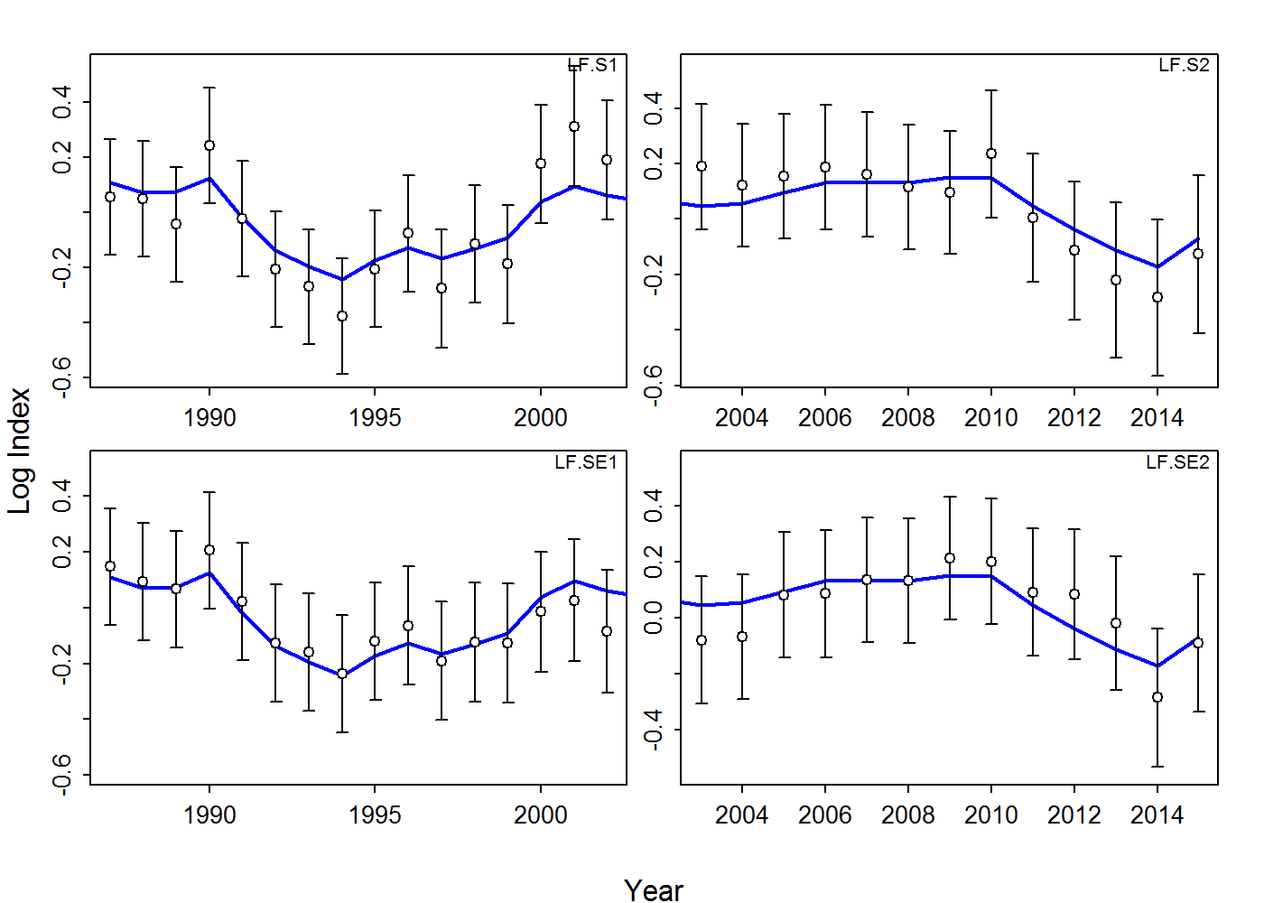
Log-Fits

Slide 26
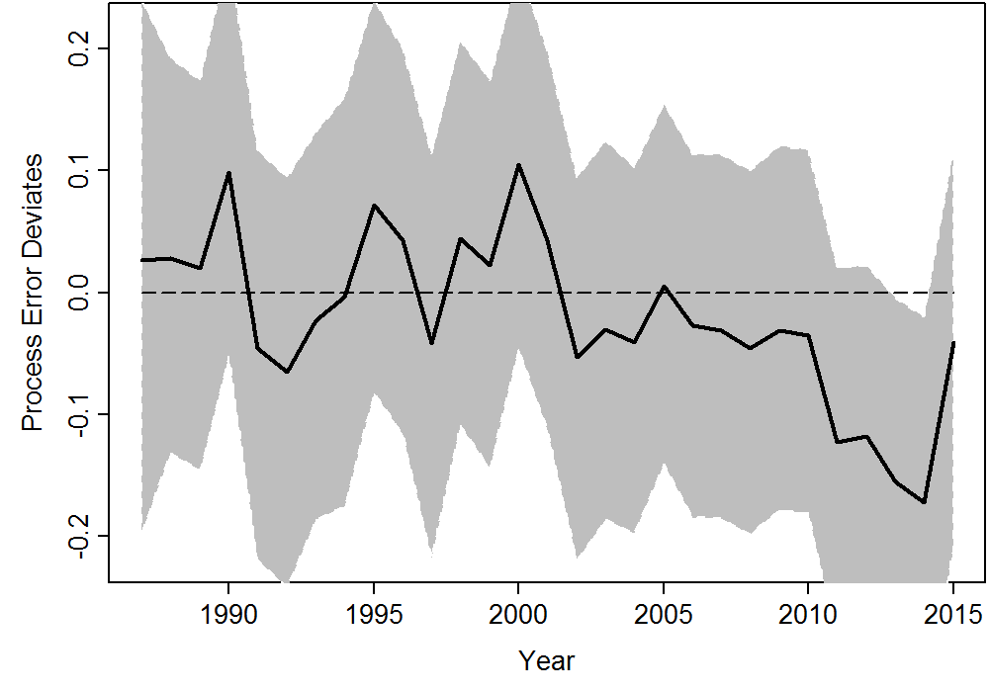
Process Error
Calculated as the difference between the deterministic expectation and the stochastic realization of log(SB_{y})

Slide 27
Posterior vs Prior Distributions
PPMR: Posterior to
Prior Means Ratio
PPVR: Posterior to
Prior Variance (CV²)
Ratio

Slide 28
JABBA-Select: Reference Points Output
Ref: User-defined
B_{MSY} target (e.g. 40% SB₀)
 | Median | LCI | UCI
SB0 | 26909.68 | 16874.316 | 60888.452
m | 0.951 | 0.764 | 1.18
Hmsy.1 | 0.105 | 0.072 | 0.153
Hmsy.2 | 0.116 | 0.079 | 0.169
Hmsy.3 | 0.093 | 0.064 | 0.137
SBmsy | 9699.005 | 5560.443 | 22996.856
MSY.1 | 1009.765 | 745.771 | 1936.211
MSY.2 | 1116.295 | 824.114 | 2140.589
MSY.3 | 901.328 | 665.077 | 1722.221
Href.1 | 0.093 | 0.071 | 0.121
Href.2 | 0.103 | 0.078 | 0.134
Href.3 | 0.083 | 0.063 | 0.108
SBref | 10763.87 | 6749.727 | 24355.381
Yref.1 | 1003.664 | 739.515 | 1933.759
Yref.2 | 1109.148 | 817.148 | 2137.252
Yref.3 | 895.148 | 657.019 | 1718.241
P1987 | 0.141 | 0.059 | 0.225
P2015 | 0.119 | 0.052 | 0.187
B_Bmsy.cur | 0.298 | 0.131 | 0.467
H_Hmsy.cur | 0.942 | 0.638 | 1.361

Slide 29
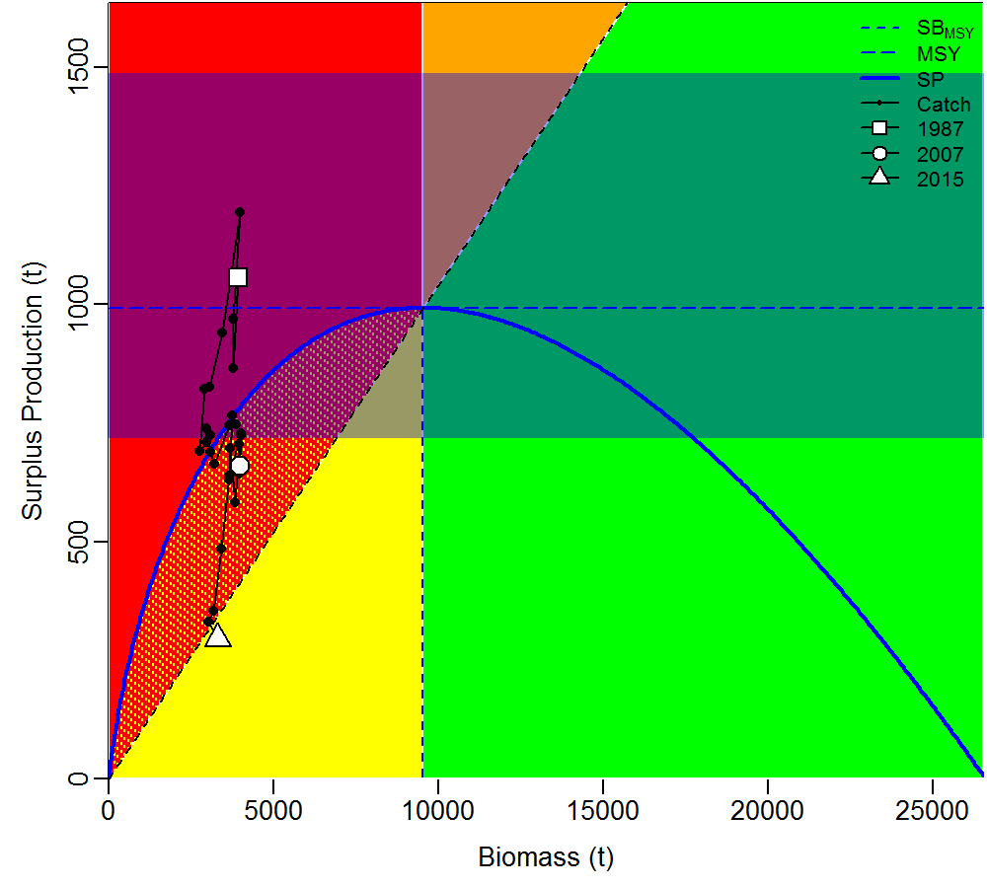
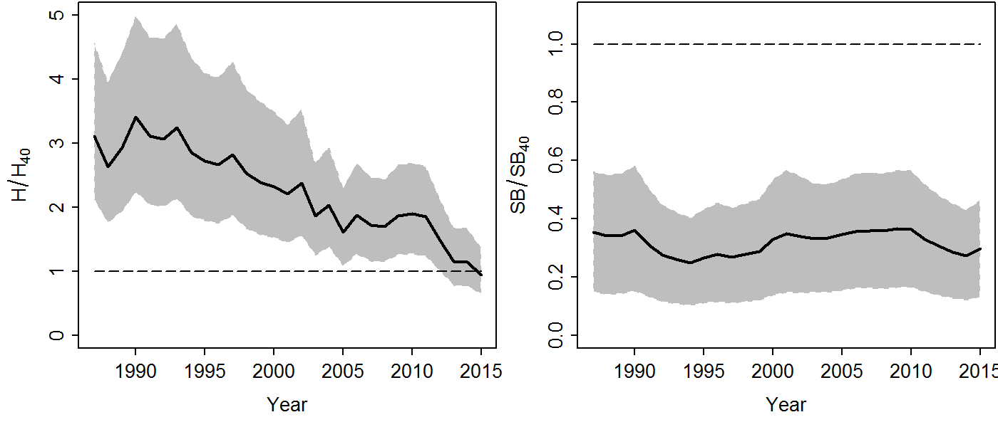
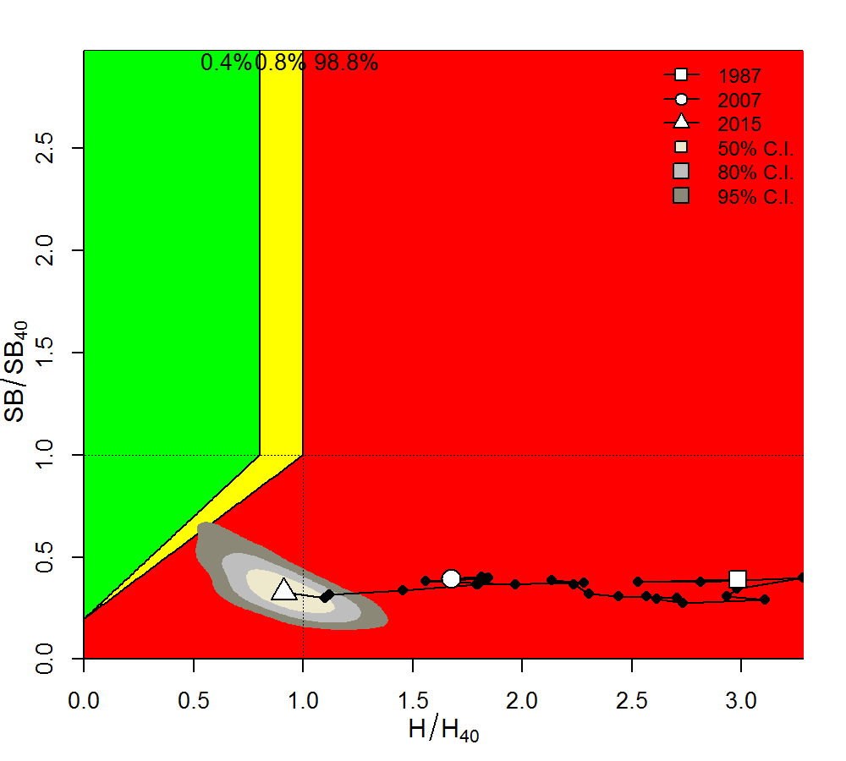
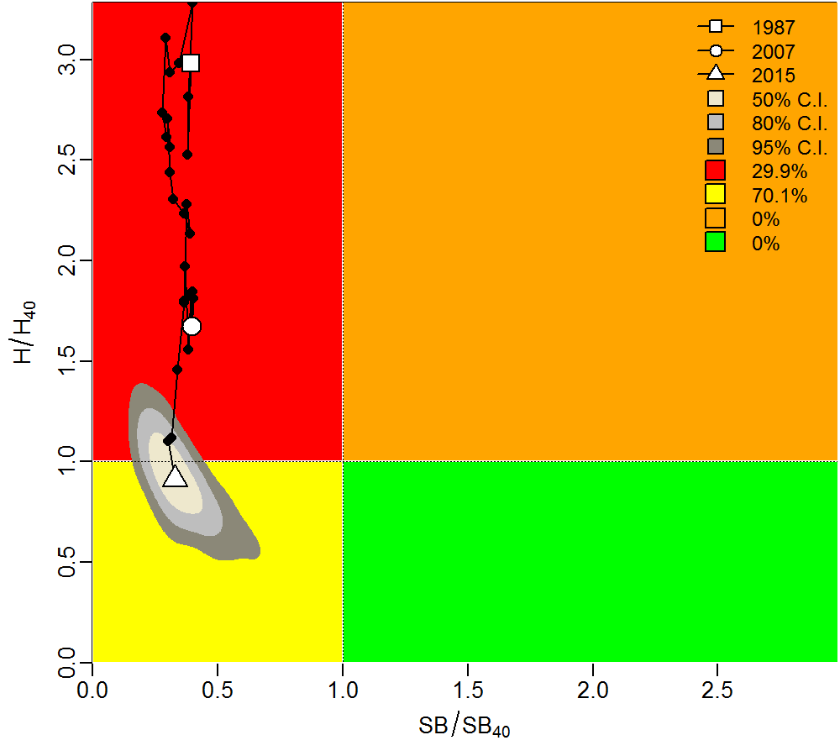
Stock Status Plots

Slide 30
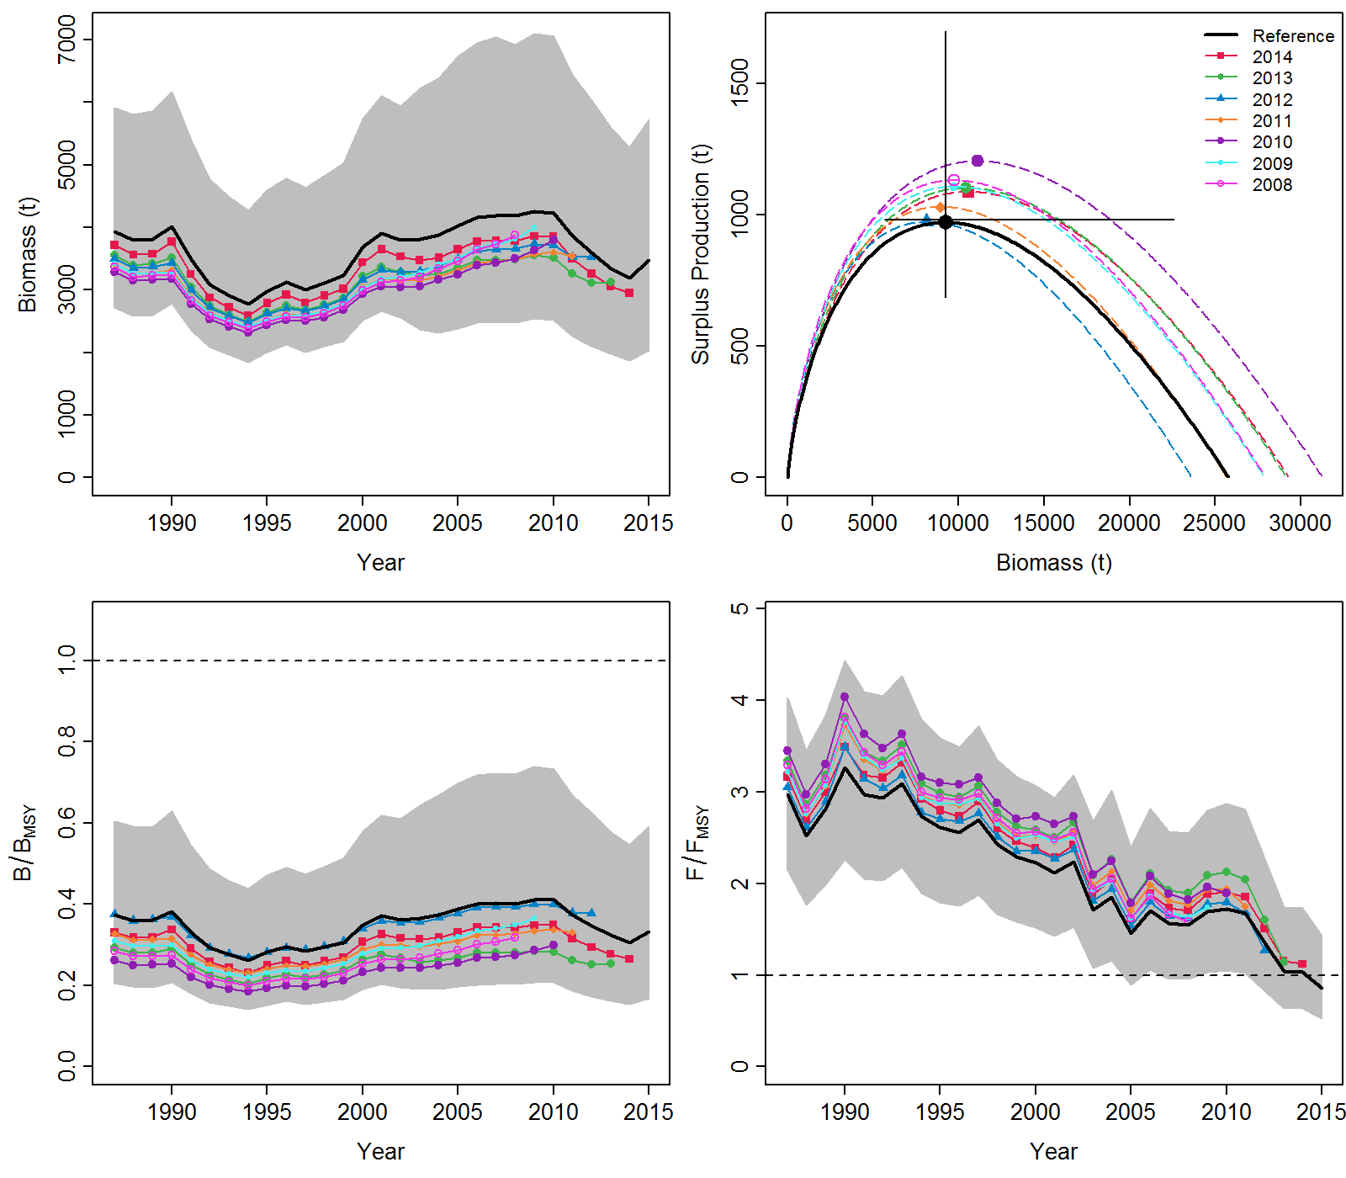
Easy to implement Extensions: Retrospective Analysis

Slide 31
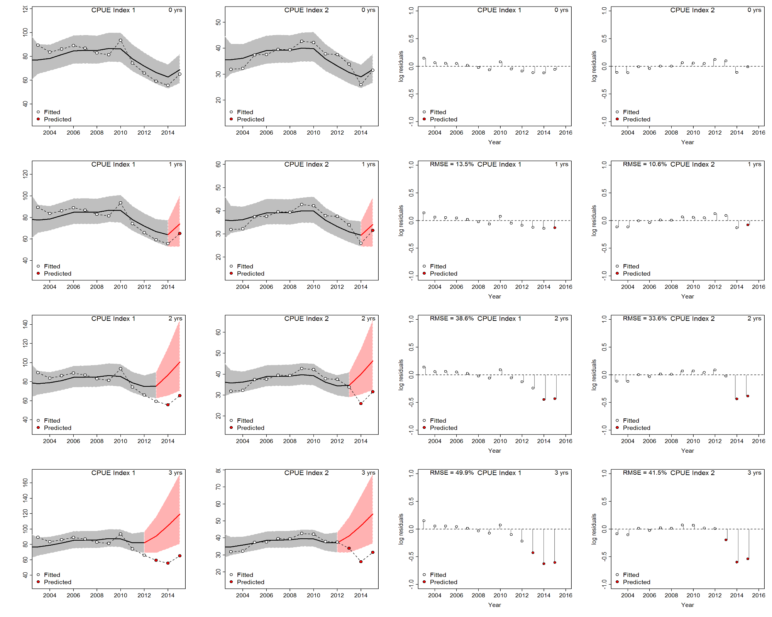
Or… Hindcasting + Cross-Validation of Prediction Residuals (Kell et al. 2016)

Slide 32
Thank You

