Slide 1
An overview of the SA hake fishery
M.D. Durholtz

Slide 2
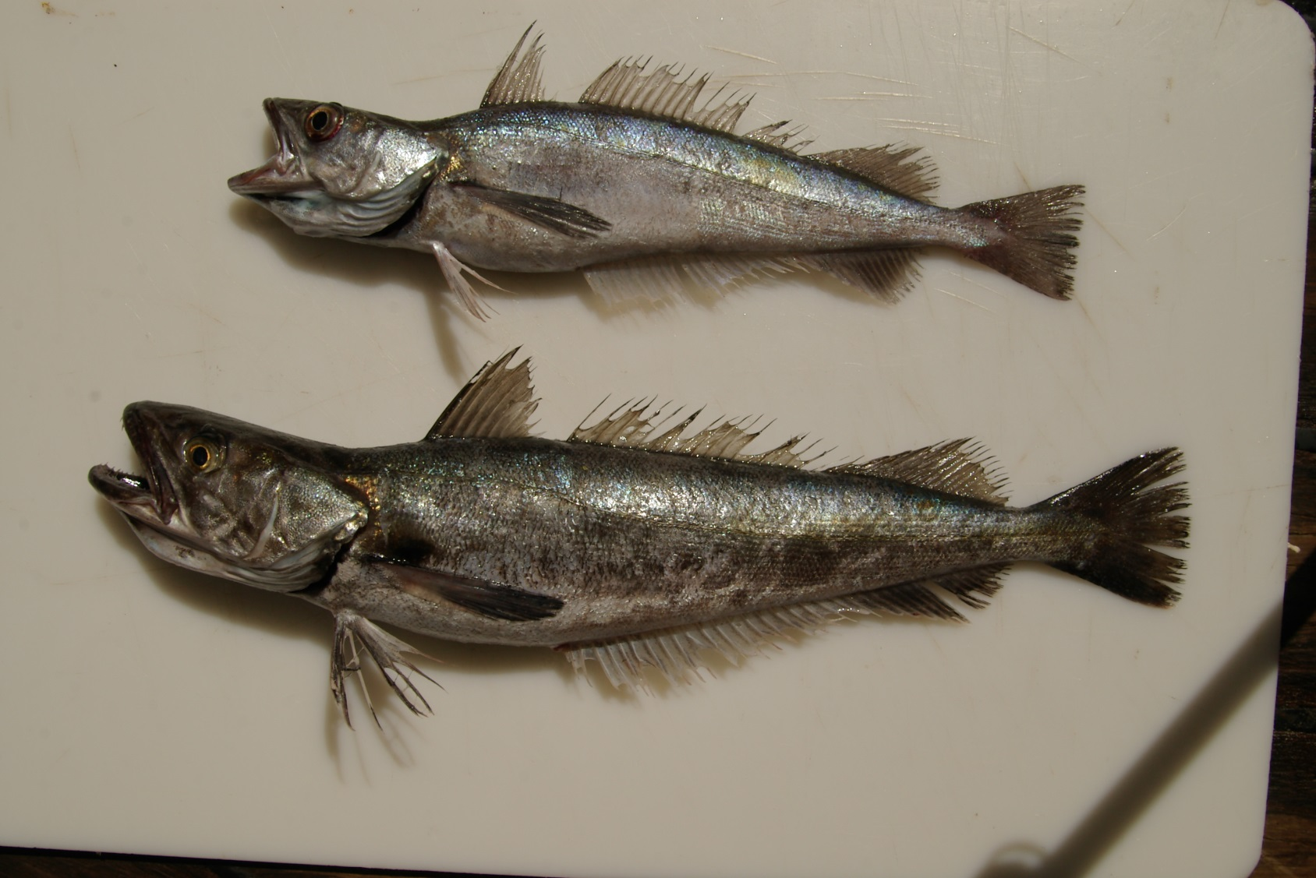
Species
2 species, morphologically very similar:
Deep-water Cape hake Merluccius paradoxus
Shallow-water Cape hake Merluccius capensis

Slide 3
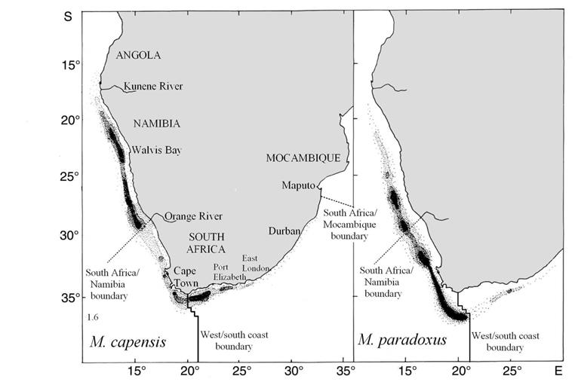
Distribution
(Adapted from Payne 1989)
Notes:
M. capensis: S. Angola to N KZN, 30 – 500 m but most of population 100 -300 m
M. paradoxus: N Namibia to Southern Moçambique, 110 – 1 000m + but most of population 200 – 800 m

Slide 4
Fishery
Targeted by 4 fishing sectors:
Deep-sea trawl: Operates around the entire SA coast in waters deeper than 110 m. Currently restricted to the “trawl footprint”. 83.93% of the TAC.
Inshore trawl: Restricted to the SA South Coast east of the 20°E line of longitude. Currently restricted to the “trawl footprint”. 6.18% of the TAC.
Hake longline: Operates around the entire SA coast. 6.55% of the TAC.
Hake handline: Restricted to the SA South Coast east of the 20°E line of longitude. 3.34% of the TAC.
Also caught as incidental by-catch in the traditional linefish and horse mackerel-directed midwater trawl fisheries.
Notes:
Midwater by-catch reserve (= 2% of midwater horse mackerel TAC = about 600 t) first deducted before hake sector allocations are made

Slide 5
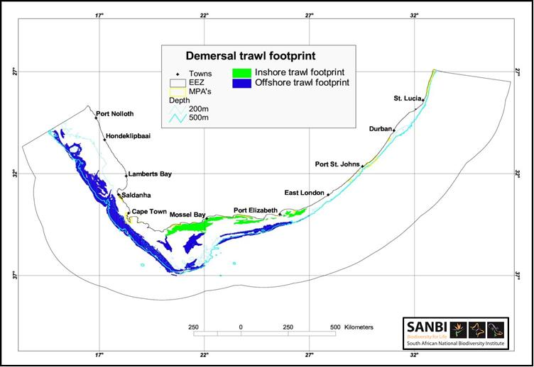
Fishery

Slide 6
Catches
Notes:
(a) Pre-1978: Species-split uses an algorithm that assumes 1958 is central year of switch between relative exploitation of the two species

Slide 7
Abundance indices – deepsea trawl CPUE

Slide 8
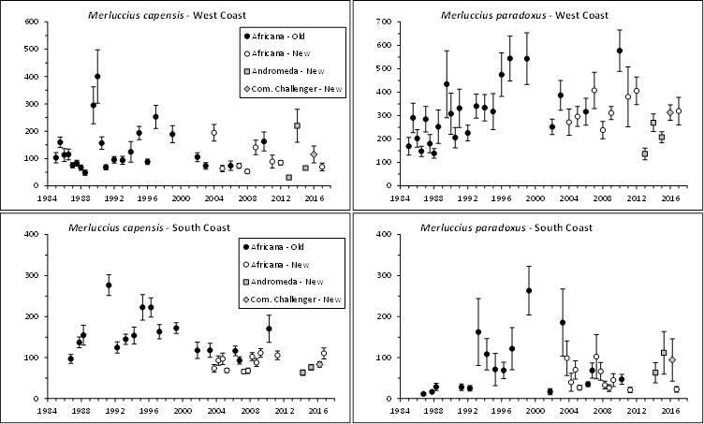
Abundance indices – fishery-independent demersal surveys

Slide 9
Other data
In principle by:
Coast - always
Species – survey only
Gender – partial, and only recently
Commercial proportions at length (NB: NOT species disaggregated)
Survey proportions at length
Age at length
Female maturity at length ogive
Weight at length

Slide 10
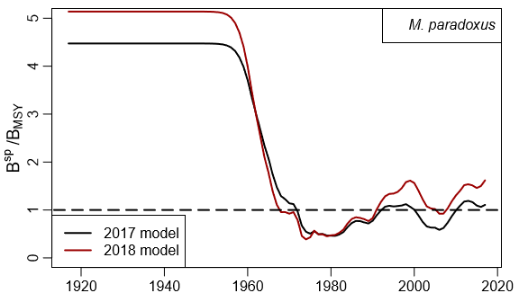
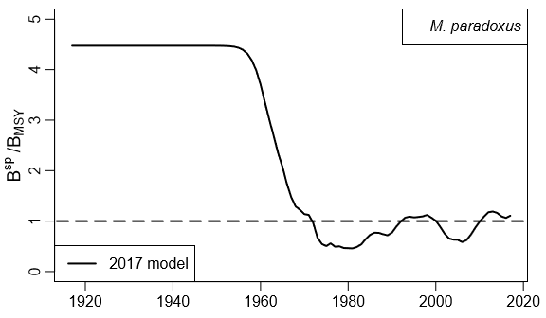
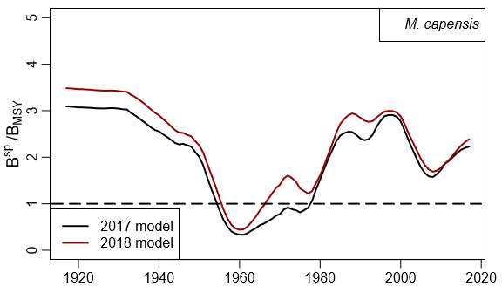
Hake 2018 Reference Case
Perception of resource status: 2017 vs 2018
What has changed:
Revised method for incorporating catch-at-length data
Use of mortality-at-age vectors from hake inter-species predation/cannibalism model
Updated species splitting algorithm and updated CPUE and catch data
MARAM/IWS/2018/Hake/P2

Slide 11
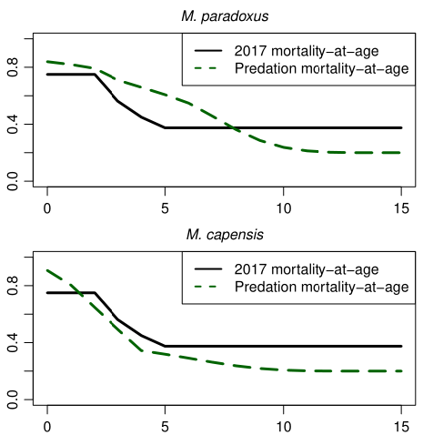
MARAM/IWS/2018/Hake/BG7

Slide 12
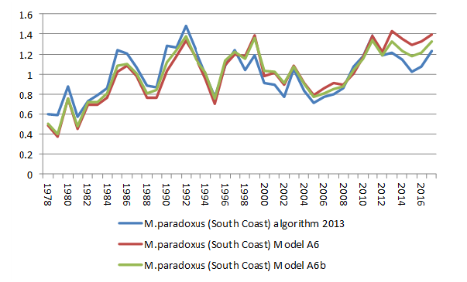
M. paradoxus South Coast CPUE
Hake/P8 and Hake/BG6

Slide 13
Reference Case assessment results
Reference Case (RC):
OM RS02
Modified Ricker stock recruitment relationship
Central year of shift in catch from primarily M. capensis to primarily M. paradoxus is 1958
Hake/P1

Slide 14
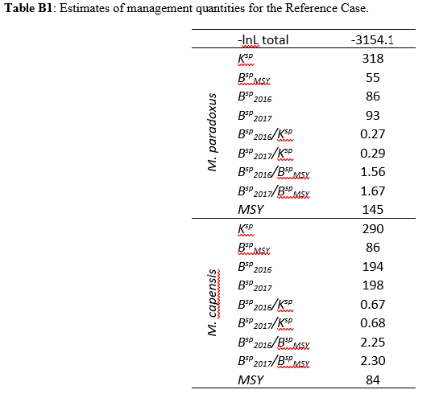
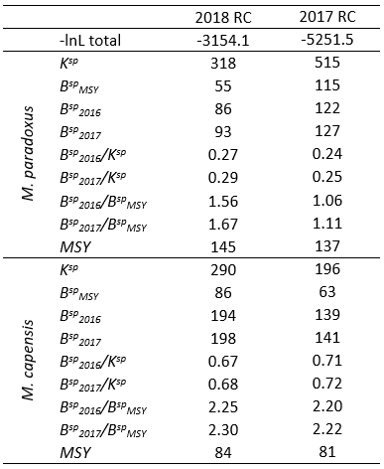
Hake/P1

Slide 15
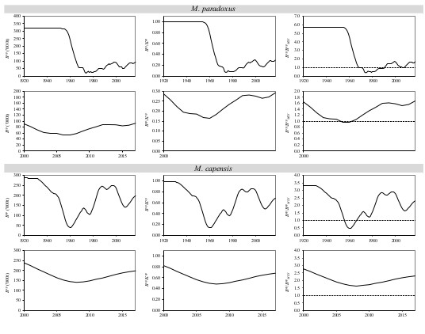
Figure B1: Spawning biomass trajectories (in absolute terms, and relative to pre-exploitation level and B_{MSY}) for the RC. The second and last rows repeat the first and third rows but with a different year range.
Hake/P1

Slide 16
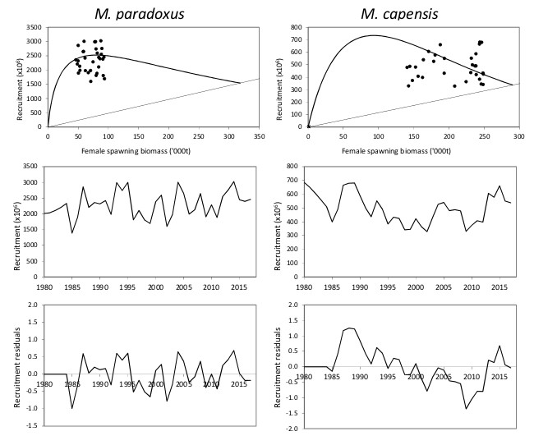
Figure B2: Stock-recruitment curves and recruitment trajectories for the RC.
Hake/P1

Slide 17
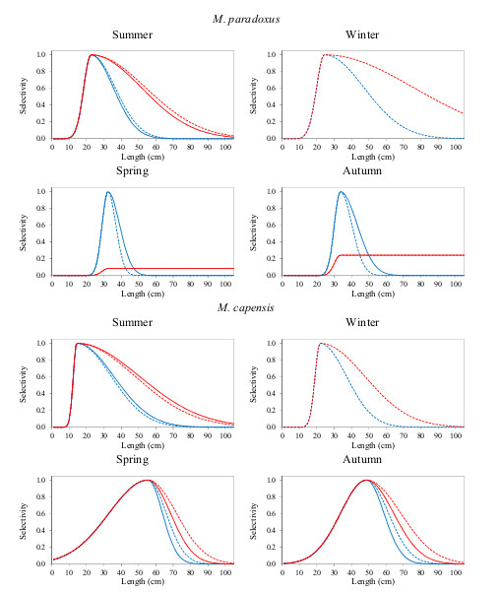
Figure B3: Survey selectivities-at-length for the Reference Case (blue curves for males, red curves for females, dashed curves for old gear and full curves for new gear).
Hake/P1

Slide 18
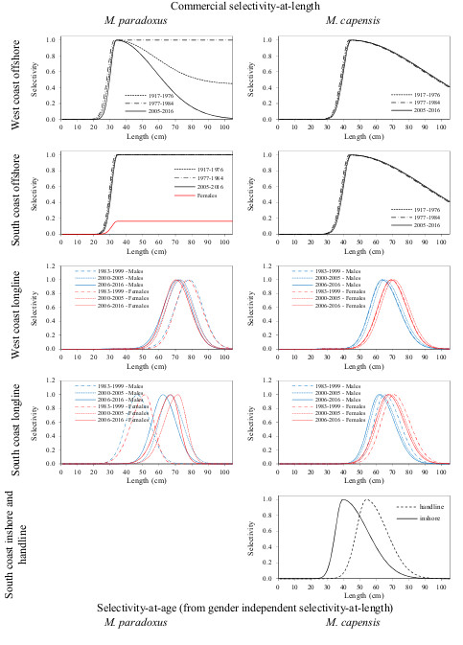
Hake/P1
Figure B4: Commercial selectivities-at-length for the Reference Case (black curves for sex-aggregated, blue curves for males and red lines for females).

Slide 19
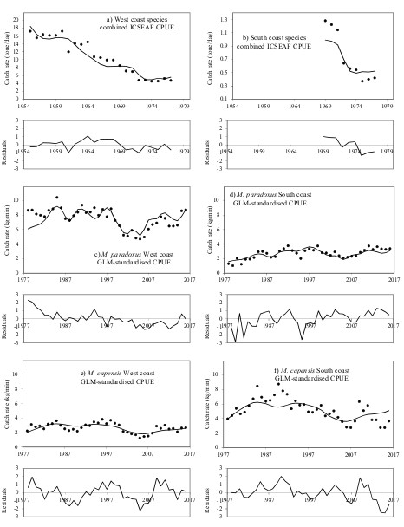
Figure B5: Fits to the CPUE series, with standardized residuals, for the Reference Case.
Hake/P1

Slide 20
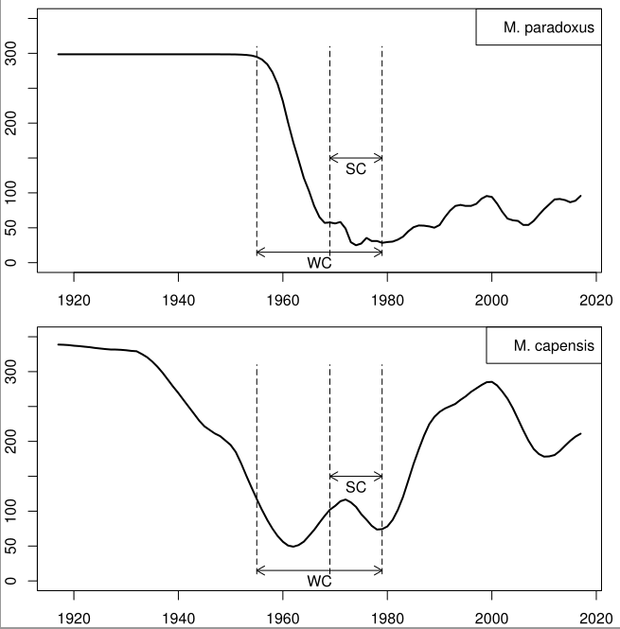

Slide 21
Reference Set for OMP2018
Nine Operating Models for two axes of uncertainty:
Three choices for central year of shift
1952, 1958, 1963
Three choices for stock-recruitment
Modified Ricker,
Beverton-Holt with h=0.90
Beverton-Holt with h=0.70
No model starting in 1978
No alternatives for mortality-at-age
Hake/P3

Slide 22
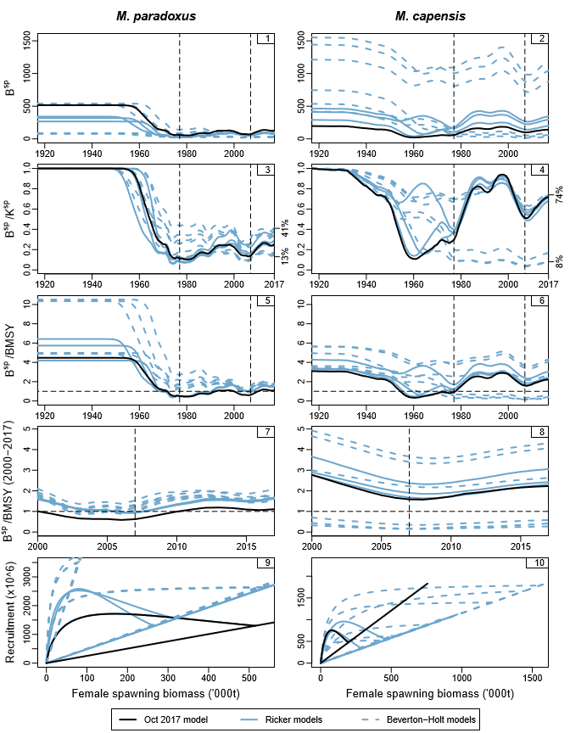
Hake/P3

Slide 23
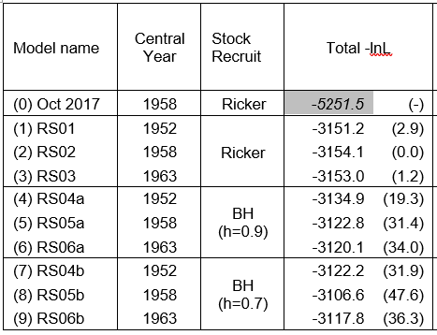
Table 2: Negative log-likelihood components are shown for the RS models.
Hake/P3

Slide 24
Candidates for OMP2018
Three options for TAC cap
150 000t (same as OMP2014)
160 000t
No cap
Three options for OMP tuning parameter b
same as OMP2014
increased by 5%
increased by 10%
2019 and 2020 TACs
No constraints
2019 TAC cannot be less than 2018 TAC
2019 and 2020 TACs fixed at 2018 value plus 10%
Hake/P4

Slide 25
OMP2018
The TAC cap has been increased to 160 000t
The OMP tuning parameter b has been increased by 5% from the 2014 values
The 2019 and 2020 TACs are fixed at the 2018 value plus 10%
A few other differences of a more technical nature as described in Hake/P4
A more “aggressive” OMP
Hake/P4

Slide 26
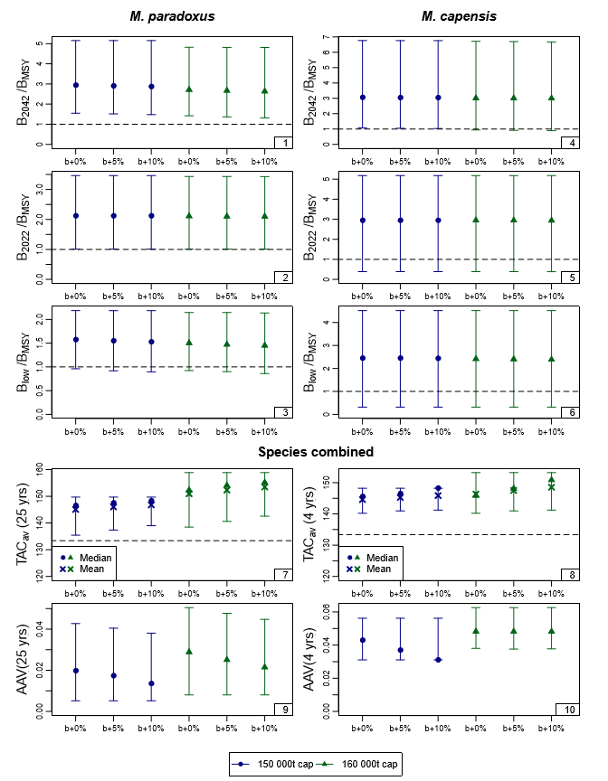
Performance statistics
Hake/P4
Notes:
B^{sp}/B_{MSY} for 2042 and 2022 (i.e. at the planned end of OMP2018 application),
B^{sp}(low)/B_{MSY} (the lowest value of this statistic in the projection period to 2042)

Slide 27
Hake/P4
Notes:
TAC_{av} (the average catch over the projection period (25 years) and over the next four years)
AAV (the average inter-annual proportional change in catch over the projection period (25 years) and over the next four years)

Slide 28
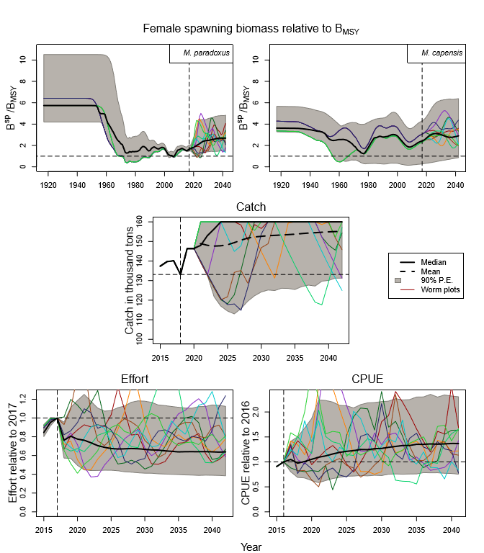
OMP2018 projections
Hake/P4

Slide 29
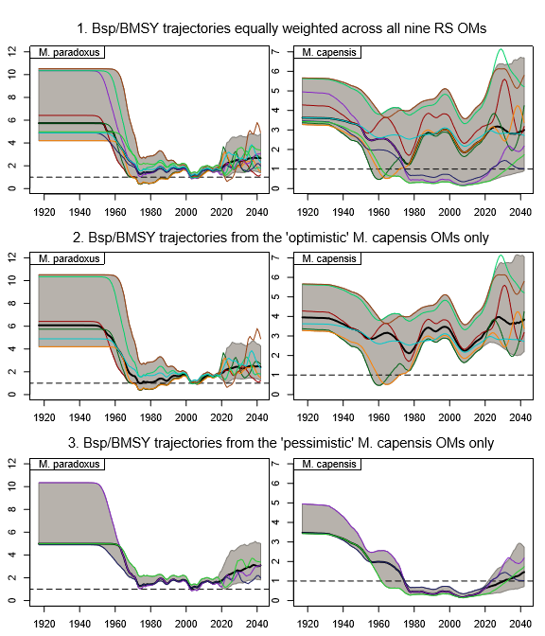
Six “optimistic” and three “pessimistic” OMs
Hake/P4

Slide 30
Robustness tests
Hake/P6a
RT1-RT5: Future surveys
RT6: Mortality-at-age
RT7-RT8: Species splitting algorithms
RT9-RT10: Recruitment failure
Hake/P6b
RT11-RT26: Variety of tests

Slide 31
Hake/P6a & b

Slide 32
Questions to the panel
There have been a number of modifications to the basic assessment over the last 18 months, which have resulted in an appreciably better estimate of status relative to B_{MSY} for the M. paradoxus resource (whose status previously – fluctuation to below B_{MSY} - had been a matter of debate and concern) – are these modifications together with their consequent changes in results justified? (MARAM/IWS/2018/Hake/P2)

Slide 33
What has changed:
Revised method for incorporating catch-at-length data
Use of mortality-at-age vectors from hake inter-species predation/cannibalism model
Updated species splitting algorithm and updated CPUE and catch data

Slide 34
Questions to the panel
The revised OMP proposed (OMP-2018) is more “aggressive” than its predecessor OMP-2014 in giving higher TACs for the same abundance (increasing the b control parameters in the HCR by 5%, and increasing the cap on the TAC from 150 000 to 160 000 MT. Do the results from the updated Operating Models and simulation tests justify a revision in this direction?

Slide 36
Questions to the panel
A particular concern arising for the revised OMP-2018 development has been the possibility of needing in the future to substitute an industry vessel for the standard research vessel (which is now old and experiencing many maintenance problems) to carry out hake abundance estimation surveys, and furthermore the possibility that funding limitations may impact the (regular) continuation of these surveys. A number of robustness tests have been conducted to evaluate the consequences, and the proposed revised OMP-2018 has been considered to have shown adequately robust performance for these. Especially in circumstances where a more “aggressive” OMP has been proposed, which will yield greater TACs than the previous OMP-2014, have the tests conducted been sufficient, and if not what further tests are suggested?

Slide 37
RT1 – RT5
RT1: No future surveys
RT2: All future surveys with industry vessels
RT3: Surveys every second year
RT4: RC with undetected increase in commercial catchability
RT5: No future surveys with an undetected increase in commercial catcahability

Slide 39
Questions to the panel
A new metarule has been proposed for OMP-2018 which involves the specification of a threshold to indicate when extra measures may be necessary to deal with especially low M. capensis abundance. Are this rule and the basis used to develop an initial value for this threshold appropriate?

Slide 40
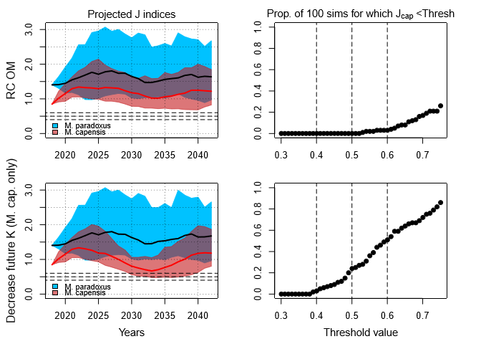
Hake/P7

Slide 41
Questions to the panel
What are priority needs (if any) for further robustness tests of OMP-2018? In particular, has adequate attention been paid to the possibilities of recruitment failure (currently surrogated by a decrease in K for both species in the future)?

Slide 42
Questions to the panel
The assessments generally estimate fairly low values of B_{MSY}/K. These might be argued as leading to acceptance of recovery targets that are too low. Do these “low” values constitute a concern, or a need for alternative higher “targets”?

Slide 43
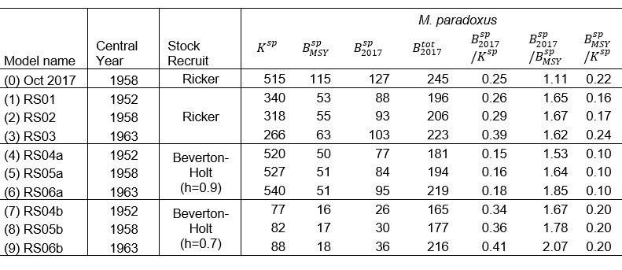
Hake/P3

Slide 44
Questions to the panel
Is there a need for a trawl-ID covariate in the GLMM analysis underlying the hake catch species-splitting model used? (MARAM/IWS/2018/Hake/P8)

Slide 45
Thank you for your attention

