Slide 1
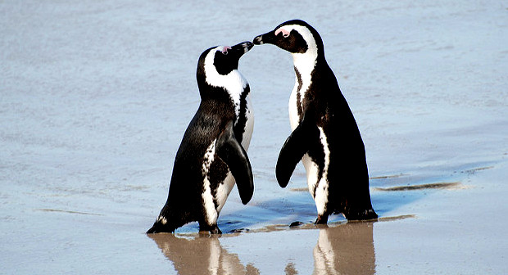
Penguins
International Stock Assessment Workshop
Cape Town
2 December 2019

Slide 2
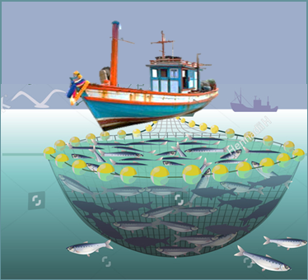
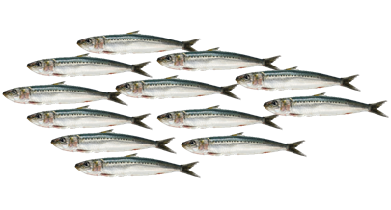
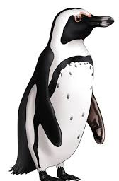
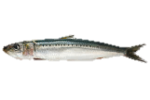
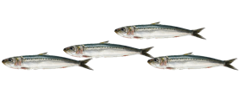
Island Closure Experiment

Slide 3
Endangered
African Penguins
African Penguin numbers off South Africa have declined by ~70% since 1989.
Sherley RB et al. in prep

Slide 4
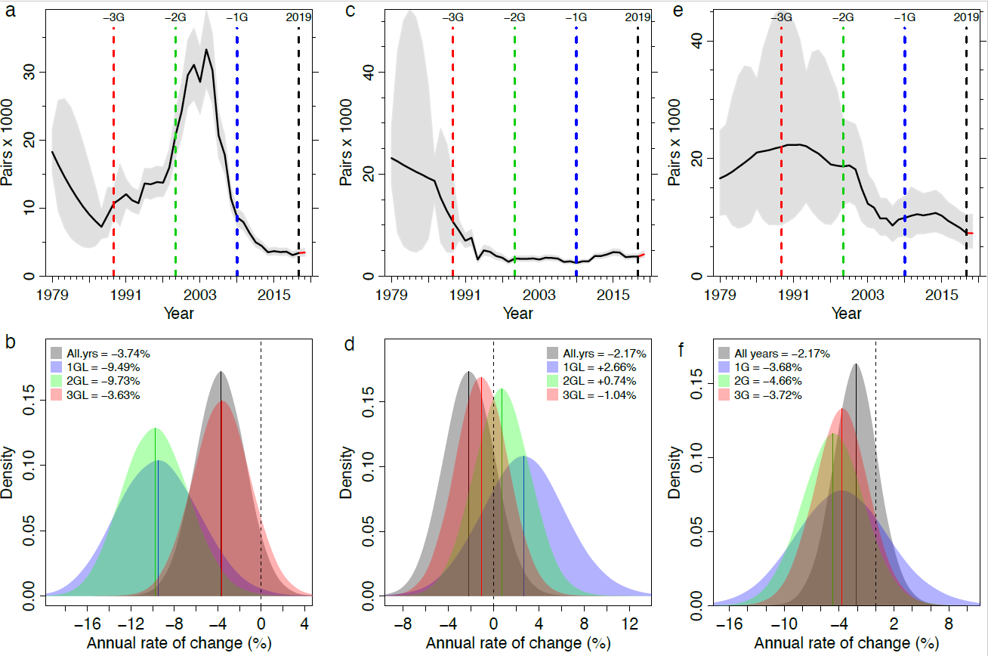
Regional declines
West Coast
South West Coast
South Coast
West Coast
South West Coast
South Coast
Sherley RB et al. in prep

Slide 5
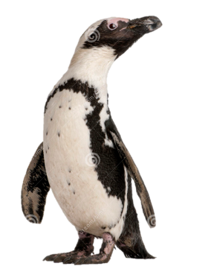
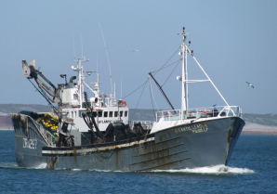
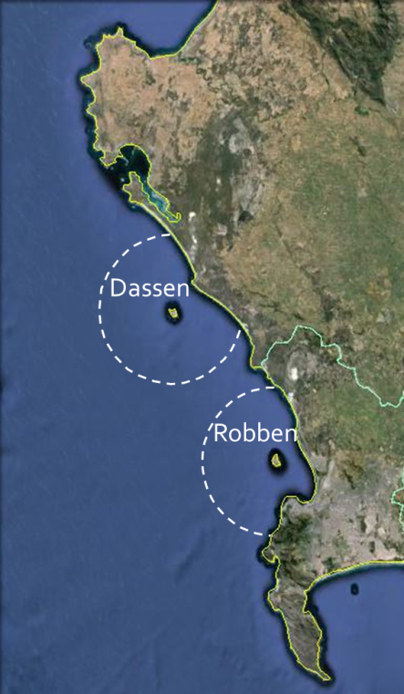
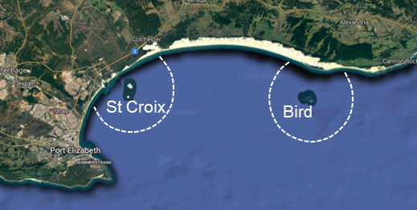
Island Closure experiment
To what extent will suspension of pelagic fishing in the neighbourhood of breeding colonies of African penguins impact penguin dynamics?
Penguins may be especially sensitive to changes in pelagic fish abundance and distribution as a consequence of their land-based breeding sites and limited foraging range (<20 km) during breeding.
South Africa’s small pelagic purse-seine fishery targets mainly sardine and anchovy, which are also the main prey species for penguins
West Coast
South Coast
Dassen and Robben Island
Bird and St Croix Island

Slide 6
Progress
Island | 2008 | 2009 | 2010 | 2011 | 2012 | 2013 | 2014 | 2015 | 2016 | 2017 | 2018 | 2019
Dassen Island | X | X |  |  |  |  | X | X | X
Robben Island |  |  |  | X | X | X |  |  |  | X | X | X
St Croix Island |  | X | X | X |  |  |  | X | X | X
Bird Island |  |  |  |  | X | X | X |  |  |  | X | X
Monitoring intensified
Acoustic biomass surveys
Economic cost to fishery
Parameters monitored include number of breeding pairs, number of moulters, adult survival, breeding success, chick condition, foraging effort of adults and diets of adults feeding chicks.
Provide a direct estimate of the biomass of small pelagic fish available to penguins around some of the islands were initiated in 2009
To determine the loss of economic value experienced by the South African pelagic fishery as a result of the closure around four penguin breeding islands, with forecasts of the economic impact of future closures.

Slide 7
African Penguin Biodiversity Management Plan
Disease
Predation
Chick rescue and rearing
Habitats and artificial nests
.
Oiling
Establishment of new colonies
.

Slide 8
This meeting is only about 4 things!!
Focussed discussion!
The Panel

