Slide 1
Non-stationarity issues in assessment and management
Some dos and don’ts
Ana Parma
CONICET, Argentina
International Stock Assessment Review Workshop
University of Cape Town, November 2022
MARAM/IWS/2022/RefPnts/Pres3

Slide 2

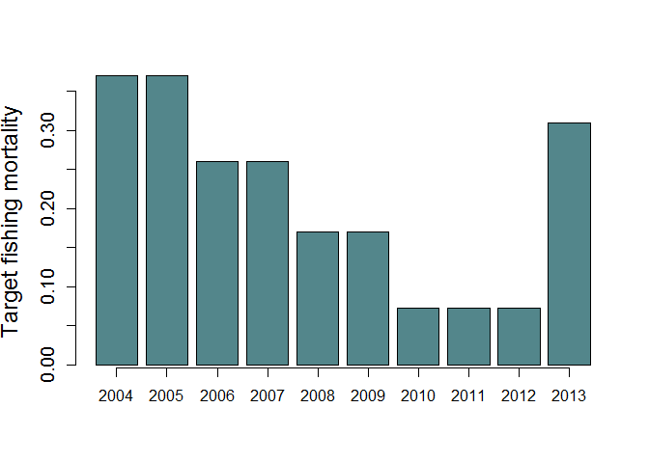
A motivating example: Yellowtail flounder- Southern New England
Original plan
rebuild by 2014
try to meet rebuilding target
Declared overfished
In 2003
2012 assessment
Two scenarios considered:
Mature biomass (mt)
1- Low recruitments due to small spawning stock size
B_{MSY} = 22,615 mt
2- Productivity reduced after 1990
B_{MSY}= 2,995 mt
threshold
Stock re-classified as rebuilt
Notes:
The Stock Assessment Review Committee concluded that the evidence was 60:40 in favor of (2) and the stock was reclassified as rebuilt

Slide 3
Many of the don’ts in combination!
Likely nonstationatity in the SRR that was initially ignored
“Best assessment” paradigm
Widely divergent management actions triggered by a very uncertain determination
overfished → rebuild in 10 years
not overfished → apply normal HCR

Slide 4
What could be done differently?
Likely nonstationatity in the SRR → Admit alternative hypotheses consistent with data
“Best assessment” paradigm → consider these hypotheses in MSE
Widely divergent management actions … → avoid discontinuities in HCR
Growing evidence that trends in productivity (in addition to distributional shifts) are pervasive

Slide 5
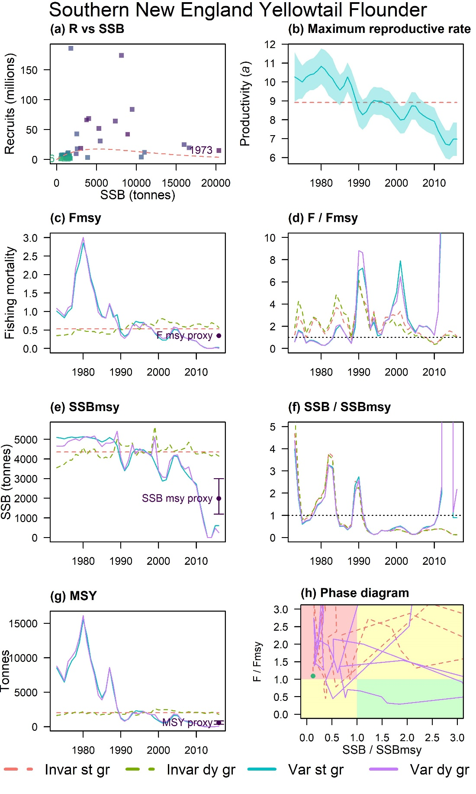
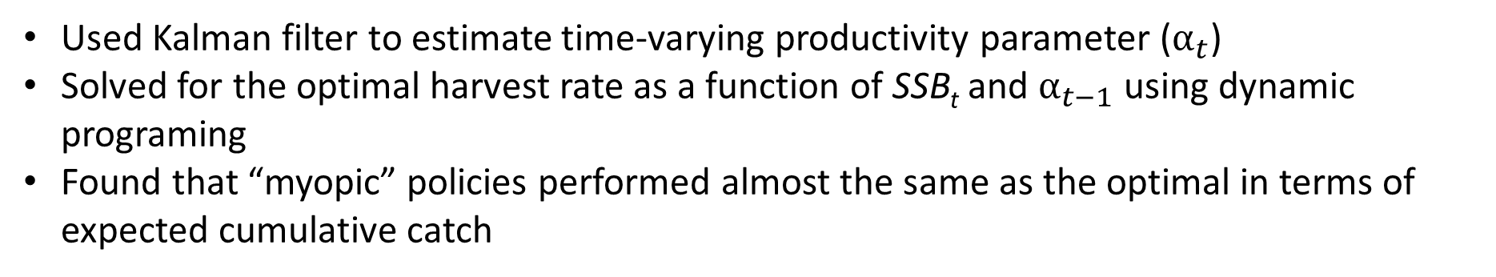
Some relevant results from optimization analyses
Collie, Bell, Collie & Minto. 2021. Harvest strategies for climate-resilient fisheries. ICES JMS
Used Kalman filter to estimate time-varying productivity parameter ($α_{t}$)
Solved for the optimal harvest rate as a function of SSB_{t} and $α_{t−1}$ using dynamic programing
Found that “myopic” policies performed almost the same as the optimal in terms of expected cumulative catch

Slide 6
Management and research implications
Are these results robust to assumptions about the SSR and whether productivity or carrying capacity or both are changing?
If management can be based on most current productivity/regime, then greater priority should be placed on timely detection and response to changes in productivity than on prediction
How estimable are these trends using state-space models? [there are some simulation-estimation results but more needed]

