Slide 1
Probability and Reference Points in Practice: aspirations, uses, abuses, and general confusion
MARAM/IWS/2022/RefPnts/Pres2
$$\int{\text{L}\text{(}\text{θ}\text{, }\text{δ}\text{(}\text{x}\text{))}\text{π}\text{(}\text{θ}\text{|}\text{x}\text{) }\text{d}\text{θ}}$$
Nathan Taylor
Notes:
Bayes action δ∗(x)
Loss function L(θ, δ(x)) is a function of unknown parameter θ ∈ Θ.

Slide 2
Why the issue of reference points and probability matters?
For me, discussions began about if the presentation of probability (such as we can determine this) to decision makers was useful for decision making
My contribution to this discussion was the hake slide that was circulated among the meeting documents. I´ll discuss this situation of an example of how confusion can be introduced into the system within the Best Assessment paradigm
The discussion branched from the question of the use of probability in fisheries to reference points and climate change so I added another quick case study about Pacific herring
I´ll be quick but could give a talk on each bullet point that follows.
Notes:
Bayes action δ∗(x)
Loss function L(θ, δ(x)) is a function of unknown parameter θ ∈ Θ.

Slide 4
The hake story
Pacific hake is large fishery extending from California to Alaska managed by a bilateral treaty (2003/2006) between Canada and the US; the treaty defines a default 40:10 harvest control rule with a fixed proportion of the total TAC shared between the two counties.
In 2011, there was a massive stock assessment estimation error so that when the harvest control rule was applied it predicted the highest quota ever of about 650,000 tons. Luckily only about 250,000 tons of this quota was taken (for a variety of reasons) because in 2011, the survey measured the lowest coastwide biomass ever recorded.
The situation in 2011 (plus the coincident desire for MSC certification) led to a set of MSE simulations that illustrated how a few different MPs (for example catch caps plus the existing 40:10 rule) would perform (higher catch, lower AAV, and higher conservation performance). But to my knowledge no MP has been adopted for this fishery. The default process is the best assessment paradigm, with an annual haggle over the quota.
What´s the problem with decisions based on probability in this fishery? Consider the preceeding figure: the shaded interval represents the 95% credibility interval as sampled from the marginal posterior density of the derived parameters in the 2021 assessment. But as can be plainly seen, the probability interval does not even capture the range of median historical biomass trajectories (the other lines)

Slide 5
Lessons learned from the hake story
$$\int{\text{L}\text{(}\text{θ}\text{, }\text{δ}\text{(}\text{x}\text{))}\text{π}\text{(}\text{θ}\text{|}\text{x}\text{) }\text{d}\text{θ}}$$
What we/I sort of thought we were doing
1. We don´t have this (the loss function)
2. Despite the kilojoules used running computers, we don´t represent this in a credible way plus by the time it ends up in decision tables, decision makers have seen 10 different versions of it
3. Decision makers in hake don´t decide this way. Stakeholders were not inspired to great levels of confidence having lived the consequence of the preceding figure
4. If you fix the data and the harvest control rule, then assessment model choice becomes your harvest control rule

Slide 6
Pacific Herring: similar crisis + non-stationarity and other difficulties = much more vitriol
5 major coastwide stocks (2 minor)
Harvest control rule established in 1985 coastwide (if B_t+1>0.25B0 then Ct+1=20%Bt, else Ct=0).
Close-loop simulation in 1988 for SOG*
HCR “applied” annually but a tradition of assessment model tweaking until 2011 (assuming q=1)
By 2012, 3/5 major areas closed to fishing
To be consistent with “precautionary policy” in 2011, there were major assessment models changes: estimated q with prior, and time-varying B₀ and Bayesian posterior predictions, With declines in body size at age, and apparent increases in natural mortality, B0 went down in some areas by 25%.
When the latter was done, 0.25B*0< 0.25B0 so fisheries that had been closed (i.e. below the 0.25B0 “cutoff” were opened)
Some happy, some sued
Notes:
* The simulation testing (Hall et al. 1988), suggested that there should be a less than 95% of fisheries dropping below 20%B0

Slide 7
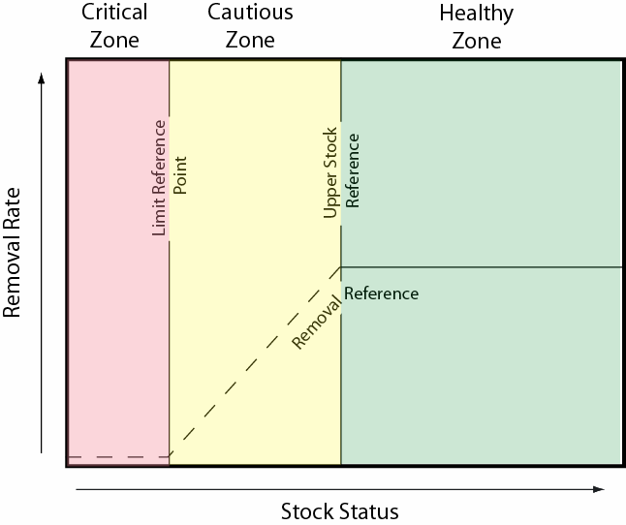
Trying to make things better
Notes:
The reason for the new assessment model is that they were trying to apply a “new” canadian policy. This meant changing what had been an MSE approach to a best assessment paradigm.

Slide 8
Herring lessons*
Pacific herring was a crisis made of many elements
Failure to test the 1988 Hall et al. 1988 MP across all stock areas
Failure to understand MPs is (data+assessment model+ HCR)
Failure to modify MPs well after (20 years!) the predictions made in the 1988 close-loop simulation were observed to be invalid
Failure to modify the MPs after the stationary assumptions baked into the analysis were observed to have been violated
Failure to separate ”Operational Control Points” sensu Cox et al. 201x from objectives (reference points kind of) in the Canadian “policy”
Allocation fight
Failure to understand reference points (how can B0 be time varying?)
The management problem is potentially more complex than implicit climate change effects on growth and survival: explicitly herring are eaten by at least 2 Species at Risk including: Humpback whales, Chinook salmon (a prey item for a 3rd Species at Risk)
With the accumulation of common practice, the failures had become institutionalized so that the inertia was/is very deep and poured in concrete; in spite of the aspirational statements made in Canadian policy documents addressing climate change at the time there was no culture of addressing them, nor a forum to discuss how species interactions should be managed
Notes:
In the narrative I have given, it might seem like it should have been completely obvious that bad things would happen in this fishery but initially at least, it wasn´t

Slide 9
Nothing is new under the sun
Decision making processes in fisheries are not a solitary decision maker integrating across a set of states of nature to select decision rules than minimize their posterior risk.
Often negotiations where parties anchor (sensu Kahneman) on a stock assessment output (mean biomass at time t, predicted biomass at time t, etc.) over which to negoatiate
Stock assessment’s characterization of the posterior risk is poor (this is hardly a new conclusion Ludwig and Walters 1985, Magnusson et al. 200x?, NRC 1998, 30 years of practical failures)
Even if 2 were not true, it´s not clear how well the uncertainty helps (as represented in the hake example), especially in the tails of the distribution;
probility is not well understood,
conditional probability even less so
if you accept point 1 it isn´t really used anyway
Biomass reference point are not understood by decision makers: this is much worse with non-stationarity i.e. climate change both observed or predicted.
Have we lost the plot? Models were supposed to be to help decision makers understand the possible consequences of their decisions i.e. useful (in my training anyway); they were never supposed to provide some credible inference about the true state of nature that would form the basis for negotiations about the TAC.

Slide 10
What could help?
If not MSE, an MSE mindset: it might not be practical to do MSE for every situation but understanding the basic tenants help (e.g. choosing and assessment model is tantamount to making policy decision)
MP=data+hcr+(optional assessment model)
Hake and herring got into trouble with assessment models in part because their control rules and their data inputs were fixed so that assessment model changes big or small were readily converted into policy changes
Some long-term synoptic review of if management system is working (and a forensic review when it isn´t) is needed for many fish stocks. Most assessment reviews are desparate affairs where this doesn´t happen. Review panels are dominated by the latter. Need more of the former.
Operating models with climate change are still a challenge: you could drive herring OMs with output from Ecosystem models (be they MICE models or something more complicated) but those models have to be build within the existing community to attain some credibility
In some situations I think it´s possible to treat some non-stationarity within a single species MSE context – but defensible hypothesis for OMs needed
In others, like small pelagics, that are the food for multiple other target species managed by different authorities, then a single-species approach (especially the management side) becomes less defensible and there needs to be a forum for decision making on these species that is distinct from others.

