Slide 1
Have fishery scientists and managers gotten too far out over their skis? By Michael Sissenwine, Woods Hole Oceanographic Institution
MARAM/IWS/2022/RefPnts/Pres1
Virtual Presentation at
ANNUAL INTERNATIONAL STOCK ASSESSMENT REVIEW WORKSHOP, UNIVERSITY OF CAPE TOWN, MONDAY 28 NOVEMBER TO FRIDAY 2 DECEMBER 2022

Slide 2
Getting too far out over our skis--
Origin- When a skier leans too far forward over their skis, they end up with their faced planted in the snow.
According to a Google Search- “Thinking or acting impetuously or preemptively, before the reality or truth of something is revealed.”
Is today’s stock assessment and fishery management framework too far out over its skis?

Slide 3
How did we get too far over our skis?
Stock assessment and fishery management approaches evolved during the 2nd half of the 20th century.
Science pushed management, leading institutionalizing scientific concepts:
MSY, Biological reference points, Kobe Plot
Minimum stock size thresholds and rebuilding stocks
Evolution has turned into inertia:
There’s no time to thinking about a better way
Concepts and practices institutionalized in policies and law are hard to change
Science push has been replaced by managers pull
Scientists struggle to fulfill expectations of managers (which scientists created!)
There have been many fishery management successes (stocks have improved), BUT
There are also many failures:
The problem of managers abusing scientific advice continues in some places,
The problem of managers following scientific advice that is wrong or changes much more rapidly that stocks change is also prevalent.
So called “state of the art” stock assessments are frequently rejected and replaced by ad hoc advice (e.g., trend based, more or less the basis of advice 50 years ago!).

Slide 4
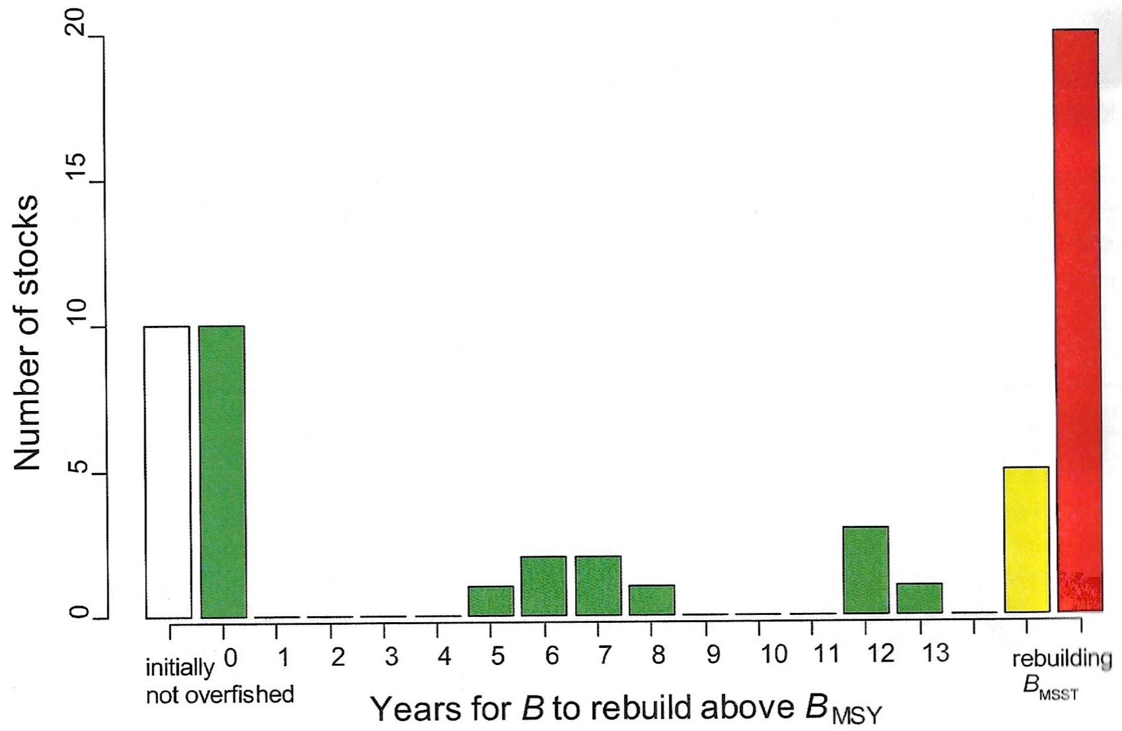
Evidence of the problem—It isn’t breaking news, but largely ignored!
Findings for 55 rebuilding plans based on analytical assessment:
More than one third of stocks reported as rebuilt were not overfished!
Of the two thirds that were overfished, most have not rebuilt
Notes:
Almost 10 years ago, the National Academy of Sciences Research Council reviewed the performance of traditional single species management in terms of rebuilding plans. I was a member of the committee, and I think we were all surprised by the results. Of 55 rebuilding plans we reviewed in detail. There were all of the stock that had so called analytical assessment or the most complicated type of assessment models. These were some of the most important fisheries in the country. The conclusion was that most of the stock that were reported as having been rebuilt, were not overfished when it was decided that rebuilding plans were needed. Of the remaining stocks that probably were overfished, 2/3rds had not rebuilt. This problem almost certainly persists.

Slide 5
Common Element Underlying the Problems
Dependence on assumption of stationarity of time series.
Production functions--- non-stationarity problem:
Changes in demographics, but these can be observed in near real time and taken into account.
Changes in S-R functions (i.e., regime shifts)- only detectable with long time series.
Relative abundance indices---non-stationarity problem:
Changes in timing of migrations relative to survey timing.
Changes in survey technology with imperfect calibration.
Changes in fishing practices (affecting CPUE indices).
Changes in the area accessible to surveys and fishing

Slide 6
Common Element Underlying the Problems
In theory, non-stationarity is a problem for biomass and F reference points, but as a practical matter, Biomass reference points are dependent on stationarity of time series. Widely use F proxies are not.
Null hypothesis of stationarity is difficult to reject with noisy data (i.e., statistical hypothesis testing), but common sense says it is often (maybe usually) invalid.
Non-stationarity is not a new problem, but climate change highlights it, and may provide the impetus to address it.

Slide 7
Overcoming inertia—addressing non-stationarity
New survey designs and technologies to account for factors that that cause non-stationarity.
Inclusion of environmental co-varables in CPUE indices.
MSE that uses dynamic reference points applicable to a plausible range of changes in production functions. Will the uncertainty be so large that results aren’t useful?
Back to the future- Iterative approaches that move stocks in “right direction.”
F-based proxies to replace biomass reference points:
Revisit the the SEFSC’s transitional SPR approach of the 1990s.
Measure performance of rebuilding plans in terms of age structure/composition.
Use generic MSE to test approaches.

Slide 8
Overcoming inertia—addressing non-stationarity
My ideas about to address non-stationarity may be wrong, and other people have ideas that may be better. What’s important now is:
To acknowledge the problem,
To begin or expand the conversation to address it,
To commit resources (including the time of some of the “best and brights”),
For scientists to lead since scientists promoted the concepts and approaches underlying today’s stationary time series dependent practices.
The law isn’t the problem:
Goals of sustainability, high yield, rebuilding, precaution in the face of uncertainty are fine
The solution is harmonizing scientific and management practices with scientific capabilities and limitations and realities of nature.

Slide 9
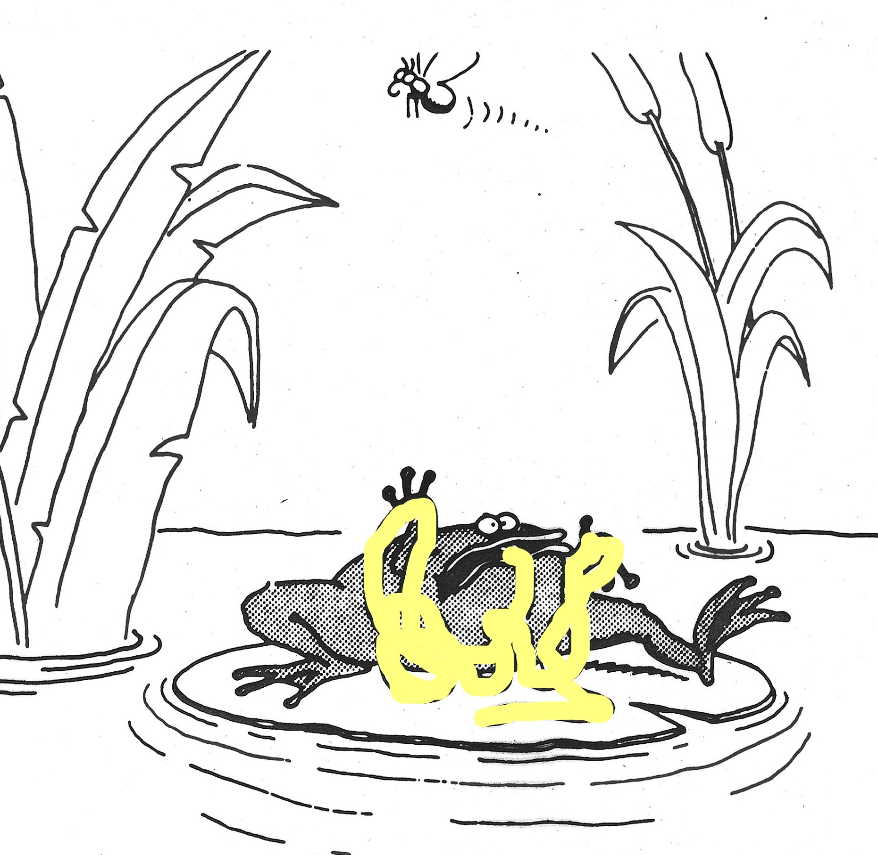
Maybe simpler is better?
Blasted Recoil Device!!!

