Slide 1
An overview of the SA hake fishery
D. Durholtz

Slide 2
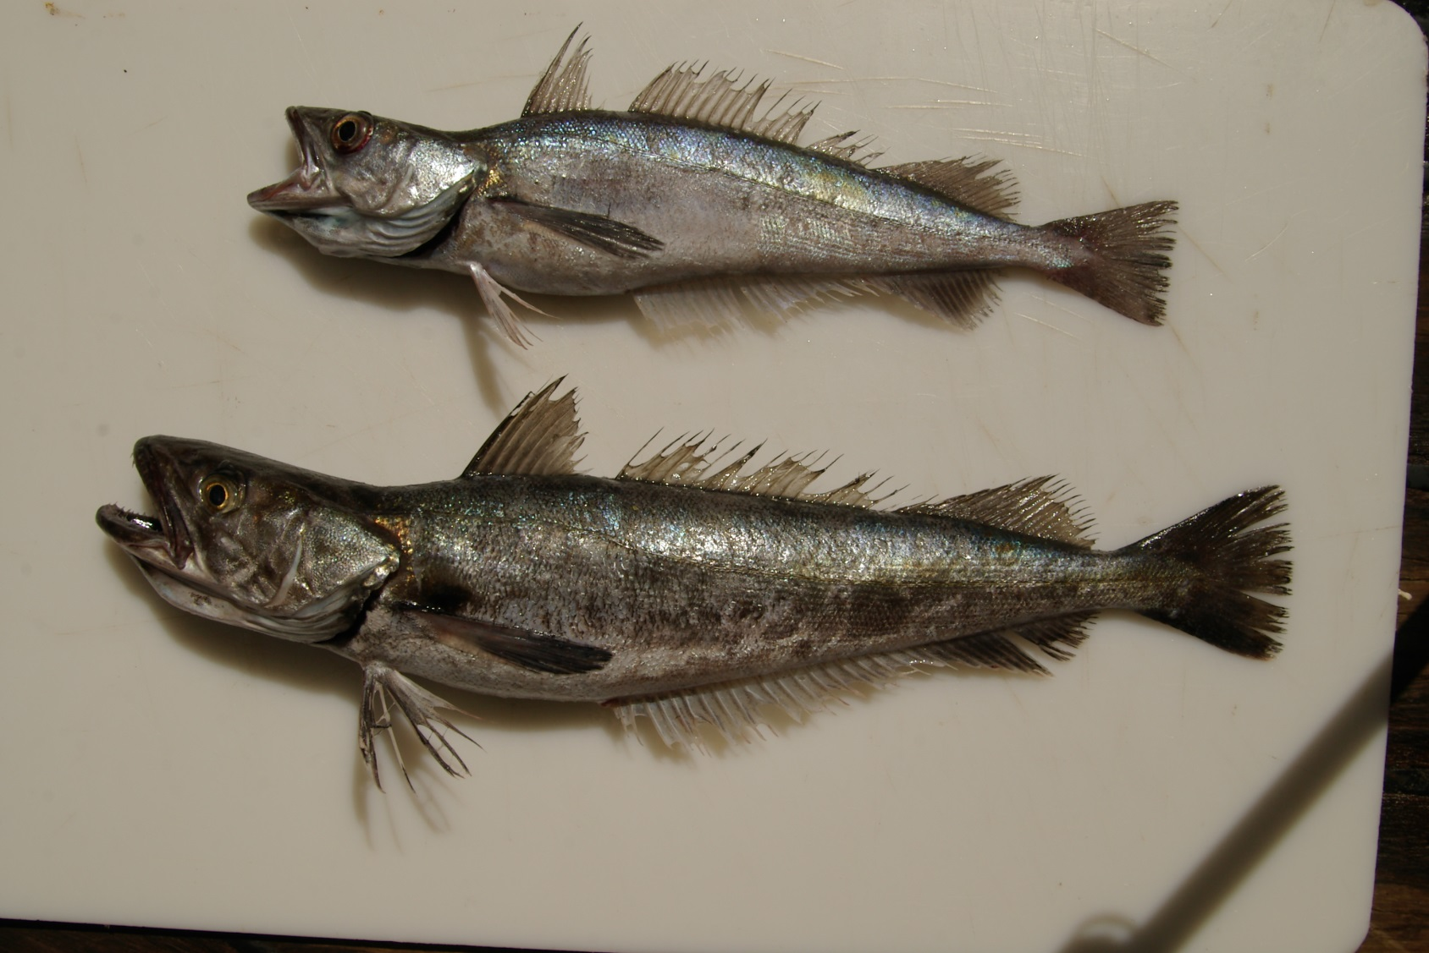
Species
2 species, morphologically very similar:
Deep-water Cape hake Merluccius paradoxus
Shallow-water Cape hake Merluccius capensis

Slide 3
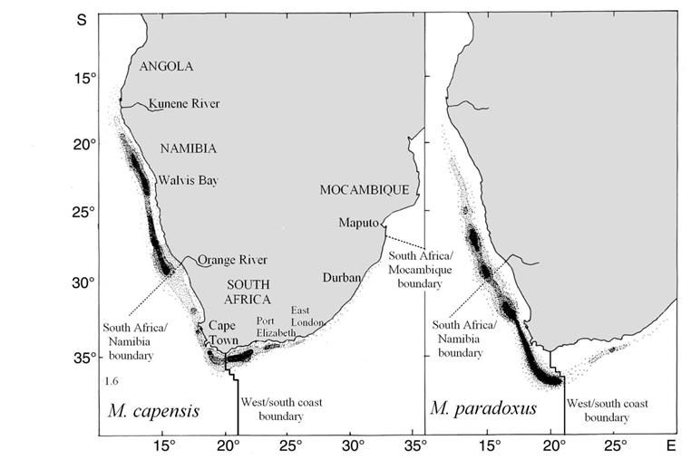
Distribution
(Adapted from Payne 1989)
Notes:
M. capensis: S. Angola to N KZN, 30 – 500 m but most of population 100 -300 m
M. paradoxus: N Namibia to Southern Moçambique, 110 – 1 000m + but most of population 200 – 800 m

Slide 4
Fishery
Targeted by 4 fishing sectors:
Deep-sea trawl: Operates around the entire SA coast in waters deeper than 110 m. Currently restricted to the “trawl footprint”. 83.93% of the TAC.
Inshore trawl: Restricted to the SA South Coast east of the 20°E line of longitude. Currently restricted to the “trawl footprint”. 6.18% of the TAC.
Hake longline: Operates around the entire SA coast. 6.55% of the TAC.
Hake handline: Restricted to the SA South Coast east of the 20°E line of longitude. 3.34% of the TAC.
Also caught as incidental by-catch in the traditional linefish and horse mackerel-directed midwater trawl fisheries.
Notes:
Midwater by-catch reserve (= 2% of midwater horse mackerel TAC = about 600 t) first deducted before hake sector allocations are made

Slide 5
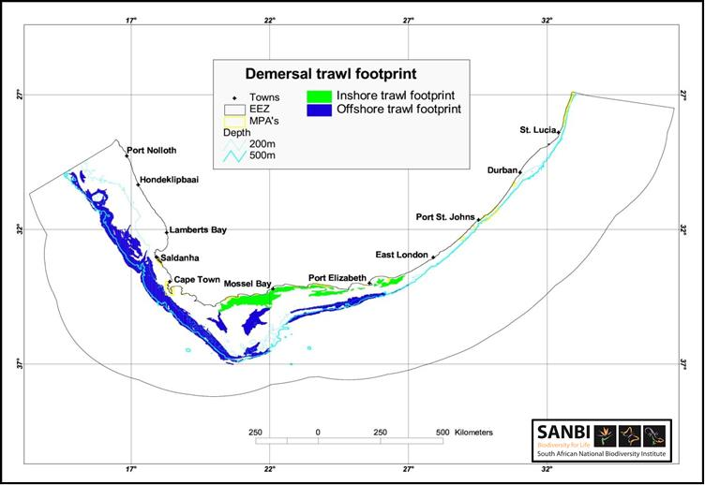
Fishery

Slide 6
Catches
Notes:
(a) Pre-1978: Species-split uses an algorithm that assumes 1958 is central year of switch between relative exploitation of the two species

Slide 7
Abundance indices – deepsea trawl CPUE

Slide 8
Abundance indices – fishery-independent demersal surveys

Slide 9
Other data
In principle by:
Coast - always
Species – survey only
Gender – partial, and only recently
Commercial proportions at length (NB: NOT species disaggregated)
Survey proportions at length
Age at length
Female maturity at length ogive
Weight at length

