Slide 1
Introduction to hake trawl vs longlining issue and documents.
28 NOVEMBER 2022

Slide 2
Documents Tabled at IWS 2022, as available on MARAM website
P1: Bergh, M. (OLSPS Marine). Summary of the spatial competition issue for trawling vs longlining and questions for the IWS panel. MARAM/IWS/2022/Hake/P1. 2pp. (uploaded 18/11/2022)
P2: Bergh, M. (OLSPS Marine). Evidence of spatial competition between hake deep-sea trawls and longline sets, an overview. MARAM/IWS/2022/Hake/P2. 8pp. (uploaded 18/11/2022)
P3: Bergh, M. (OLSPS Marine). Trends in the spatial distribution of hake long line fishing effort. MARAM/IWS/2022/Hake/P3. (DFFE Fisheries document: FISHERIES/2022/AUG/SWG-DEM/10REV). 19pp. (uploaded 18/11/2022)
P4: Bergh, M. (OLSPS Marine). The relationship between the number of trawls and long line sets at different spatio-temporal resolutions. MARAM/IWS/2022/Hake/P4. (DFFE Fisheries document: FISHERIES/2022/OCT/SWG-DEM/42). 16pp. (uploaded 18/11/2022).
BG1: Bergh, M. (OLSPS Marine). Economic and other impacts of proposed changes to hake sectoral allocations. MARAM/IWS/2022/Hake/BG1. (DFFE Fisheries document: FISHERIES/2022/APR/SWG-DEM/07). 64pp. (uploaded 18/11/2022)

Slide 3
P1: 1 Page Summary document, Key Questions for the Panel
P1: Bergh, M. (OLSPS Marine). Summary of the spatial competition issue for trawling vs longlining and questions for the IWS panel. MARAM/IWS/2022/Hake/P1. 2pp. (uploaded 18/11/2022)
Does the work in HAKE/P3 and P4 adequately demonstrate that there is spatial competition between the longline and the hake trawl fisheries? If not what further work is required?
What methods should be applied to estimate the extent to which the CPUE in the trawl fishery is reduced because of the presence of the longline fishery?

Slide 4
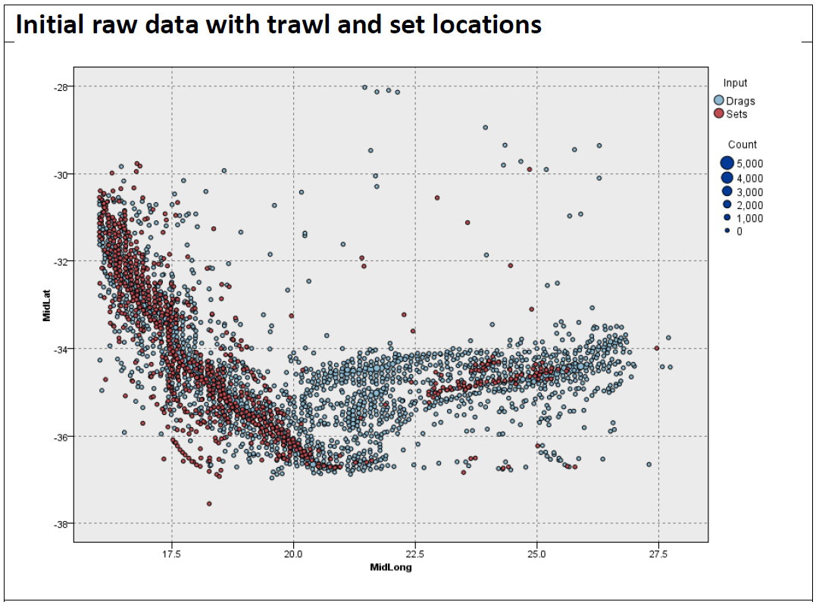
P2 – Overview Document – Summary of P3 and P4, with some reference to BG1
P2: Bergh, M. (OLSPS Marine). Evidence of spatial competition between hake deep-sea trawls and longline sets, an overview. MARAM/IWS/2022/Hake/P2. 8pp. (uploaded 18/11/2022)
The hake deep sea trawl and longline fisheries overlap spatially, with intensification since about 2014. Key figure is:

Slide 5
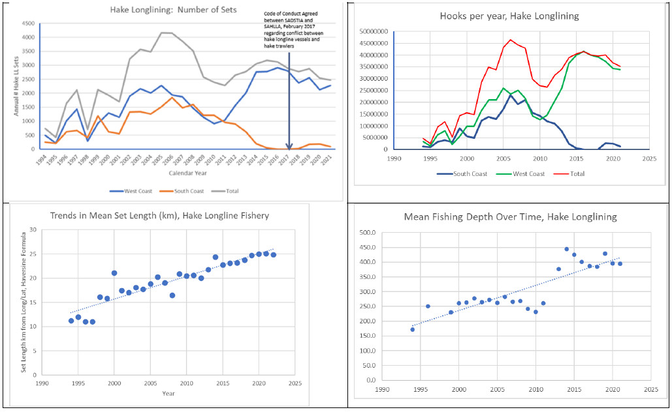
P2 – Overview Document – Summary of P3 and P4, with some reference to BG1
Hake longline fishing impact on the West Coast in deep water has intensified over the last 10 years

Slide 6
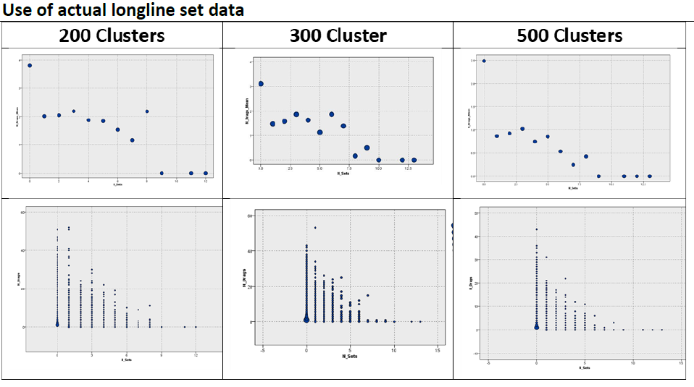
P2 – Overview Document – Summary of P3 and P4, with some reference to BG1
At operationally meaningful spatial and time scales there is a negative relationship between the number of trawls and the number of longline sets, for the period 2015 to 2020

Slide 7
P3: General trends in hake longlining effort over time and space
P3: Bergh, M. (OLSPS Marine). Trends in the spatial distribution of hake long line fishing effort. MARAM/IWS/2022/Hake/P3. (DFFE Fisheries document: FISHERIES/2022/AUG/SWG-DEM/10REV). 19pp. (uploaded 18/11/2022)
More detail than is contained in P2 re trends in the hake longlining fishing effort. Does not deal with deep-sea trawl fishery catch or effort data.
Shows trends in longline CPUE.

Slide 8
P4: Shows that there is a negative relationship between the #trawls and #longline sets
P4: Bergh, M. (OLSPS Marine). The relationship between the number of trawls and long line sets at different spatio-temporal resolutions. MARAM/IWS/2022/Hake/P4. (DFFE Fisheries document: FISHERIES/2022/OCT/SWG-DEM/42). 16pp. (uploaded 18/11/2022).
More detail than is contained in P2. E.g. (i) results of GLM analyses (ii) a check as to whether the negative relationship identified could be an artefact.

Slide 9
BG1: This document locates the spatial competition issue presented to the IWS panel within a broader debate about the sectoral allocation issue
BG1: Bergh, M. (OLSPS Marine). Economic and other impacts of proposed changes to hake sectoral allocations. MARAM/IWS/2022/Hake/BG1. (DFFE Fisheries document: FISHERIES/2022/APR/SWG-DEM/07). 64pp. (uploaded 18/11/2022)

Slide 10


